Slide 1
Governance Audit Emerging Themes
October 2024

Slide 2
Overview
15 Audits Submitted (~12%) – Survey: https://www.surveymonkey.com/r/QLR3ZQP
The audit has a new, revised streamlined format where we give examples of what sort of things we’re looking for to aid completion and support the development of a governance action plan
Personalised feedback was provided to all schools who submitted by end of Summer Term 2024.
Key themes..

Slide 3
Succession Planning
Chair Succession Planning remains a key concern.. This continues to be a national issue across the UK, as confirmed by the NGA and joint working parties I attend with my counterparts. Suggestions:
Delegation: The main concern is usually capacity. This can be alleviated through effective delegation.
Governor Training: a highly trained board is one from which future leaders can easily emerge.
Chair-Specific Training: should be undertaken by Chairs/Vice Chairs/Aspiring Chairs (eg: ‘New and Aspiring Chairs’ on 18th Nov).
Vice-Chair’s Role: elect a Vice Chair that is able to step-up when required. Delegate leadership tasks to the Vice Chair.

Slide 4
Succession Planning
Co-Chairing: Share the leadership burden, especially where two governors have the collective skills but not enough time.
Chair Mentoring: Thanks to some of our more experienced Chairs who have volunteered, new chairs can access mentoring for added support.
External Recruitment: Sign up to DfE funded agencies like Governors for Schools to help widen the search.
Commissioning a Chair Recruitment Service: Governors for Schools offers a dedicated Chairs recruitment service. The price is £500/700+Vat (for school budgets under/over £2.5m). 6 months guarantee!
Succession Plan: Agree a Succession Plan which encompasses all the above.

Slide 5
Understanding the Wider Education Landscape
LA Director's Briefing, Reports and Termly Newsletter
DfE; NGA; GovernorHub and other paid subscriptions
Social media groups
Neil Marlow will do piece on this at the Spring Directors Briefing

Slide 6
Governor Training
Attendance Dip
  High satisfaction rates vs Reduced Budgets
  New registration portal
Training as high priority for your Board
  Strong boards are made up of well-trained governors. Appoint a designated governor for training.
  The DfE lists the lack of training as grounds for suspension.
Value for Money
  - Additional joint-courses and discounts on bolt-ons (eg: Governor Hub)
  - You spoke, we listened:
    Complaints handling drop-in sessions now termly
    Director’s presentation on the wider landscape and future options
    Performance Data Monitoring to Evaluate impact Curriculum
  - Discounts on bolt-ons like Modern Governor and Governor Hub.

Slide 7
Interpreting School Data
Annual presentation on attainment data to GB
Ofsted ISDR
New course: Autumn 2025 "Evaluating the Quality of Education: Understanding school data and the impact of the school curriculum".

Slide 8
Governor Training Programme – Autumn 24
Introduction to Finance – Part 1 - Mon 14 Oct, 18:30-19:30 (joint session)
Governors' Responsibilities for Online Safety and DfE Standards for Cyber Security – Tue 15 Oct
The Ofsted Framework - Mon 21 Oct, 18:00-19:30
Discussion Forum for Chairs and Vice Chairs - Wed 6 Nov, 18:00, The Bohemia Pub, N12 9QH
Ofsted Ready: Interview Prep - Mon, 11 Nov, 18:00-19:00
Safeguarding: Safer Working Practices and Reporting Concerns - Tue, 12 Nov, 18:00
SEND Responsibilities for Governors - Wed, 13 Nov, 18:00
New and Aspiring Chairs - Mon, 18 Nov, 18:00
School Buildings: The Governor's role in ensuring Health & Safety - Tue 19 Nov, 18:00
Safeguarding: Safer Recruitment - Thu, 21 Nov, 18:00
Induction for Newish Governors - Mon, 25 Nov, 18:00
Complaints Handling, Panel Hearings and Appeals - Wed, 27 Nov, 18:00
High Quality EYFS and Governor Oversight - Tue, 03 Dec, 18:00
Action Planning and Evaluation for Governing Boards - Wed, 04 Dec, 18:00
Safeguarding for all Governors - Mon, 09 Dec, 18:00

Slide 9
Statutory Compliance
2024
Date:
Author: Steve Larken
Position: Building Compliance Officer

Slide 10
Compliance within Estate Management
There is a range of legislation which governs the use, occupation and maintenance of land and buildings.
You should make sure that you comply with the legislative requirements to protect the building fabric, systems and users. This is often referred to as statutory compliance in buildings.

Slide 11
Compliance within Estate Management
There is a range of legislation which governs the use, occupation and maintenance of land and buildings.
You should make sure that you comply with the legislative requirements to protect the building fabric, systems and users. This is often referred to as statutory compliance in buildings.
The maintenance certification and information you require for each building will vary depending on the specific construction type and the building services installed.
You should hold information and certification for the items within your building, all though we have covered most items expected to be present, we would recommend that equipment installed is verified by a technical operative to cover all statutory guidance.

Slide 12






Statutory Inspections
Asbestos Management
Gas Safety
EICR Inspections
PAT
Fire Risk Assessments
Fire Equipment Inspections
Legionella Risk Assessments
Water Hygiene Inspections
Lift Inspections
Tree Inspections
F Gas Inspections
Playground Equipment Inspections

Slide 13
Statutory Compliance
Air conditioning systems:
An annual certificated inspection must be completed to make sure that there is no leakage of refrigerant.
This is required under the Fluorinated Greenhouse Gases Regulations 2015.
Asbestos:
A record of all asbestos, known or assumed to be present in all premises must be held. Where asbestos is identified in your premises, written plans identifying the areas of the premises that are affected, and the measures that are to be taken for managing the risks from the asbestos must be in place. These must be reviewed regularly.
Find out more from the HSE
Boilers (and other gas installations):
Maintenance must be carried out in accordance with Regulation 35 of the Gas Safety Installation and Use Regulations 1998 by a certificated competent technician.

Slide 14
Statutory Compliance
Fire escape and safety:
The Regulatory Reform (Fire Safety) Order 2005 imposes duties on employers and persons with control of your premises.
You must, amongst other things, have an appropriate and up-to-date fire risk assessment for all buildings under your control.
See fire safety in the workplace for more information.
Electrical fixed wiring:
The Institution of Engineering and Technology Guidance Note 3 recommends a maximum period of 5 years between inspections or tests of electrical installations.
Lifts:
Your lifts must usually be inspected at least every 6 months (Lifting Operations and Lifting Equipment Regulations 1998).
This may vary depending on the individual circumstances of each lift, which will be advised by the inspector.
Inspections will often be completed by an insurance company.
Find out more about lift examination and inspections

Slide 15
Service & Maintenance
Requirement:
Full asset lists
Planned preventative maintenance regimes (PPM)
Life cycle analysis
Outcome
Prolonged life of equipment
Reduction in energy
Efficient operating parameters
Budget control

Slide 16
Schools Compliance Returns & Expression of Interest
Compliance returns to be sent to SchoolComplianceDesk@Barnet.gov.uk no later than W/E 17th November to cover the previous year.
Information received will be reviewed and uploaded to the Information Exchange Portal
We will also arrange site visits to meet and discuss if there are any requirements not being met and provide a compliance / risk review which will be held on record.
Info Exchange access can be requested once information has been supplied to the Compliance Team.
Expression of interest for the Building Maintenance traded service should be made to SchoolComplianceDesk@Barnet.gov.uk by December 2024, this will enable building services to provide costs before next year's budgets.

Slide 17
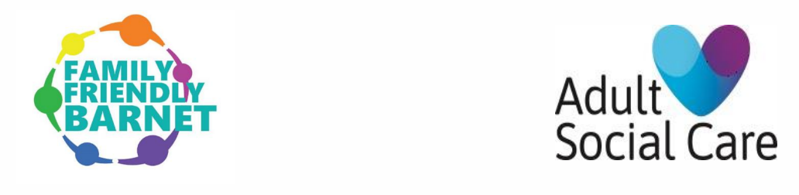

Young Carers
October 2024

Slide 18
Why is this important?
Our young carers are amazing!
They take on a massive amount of responsibility - this impacts on their lives, wellbeing and outcomes
We have a duty to identify carers (and assess their needs if required)
We are not identifying enough young carers
Some of our young carers are out of sight and vulnerable

Slide 19

Key stats
  Young miss 23 days of school every year on average
  Estimated 6,528 young carers in Barnet
  = 150,144 days per year missed
  = 1,801,728 days missed between Reception to year 12
  New report 'Caring and classes: the education gap for young carers' www.carers.org/yceducation.

Slide 20
Key messages
Identification is key
Support is available (mentoring tutoring, schools toolkit) Early Help
What do we want professionals to do?
  Champion the campaign and use resources
  Refer young carers to our Barnet Carers Centre
  If concerns, refer to MASH

Slide 21



Campaign
Posters creative for clear channels
https://youtu.be/AuV0gO5G85k

Slide 22

Resources for schools

Slide 23


Slide 24

Educational Standards in Barnet Schools 2024 (provisional)
October 2024
24
Notes:
24

Slide 25
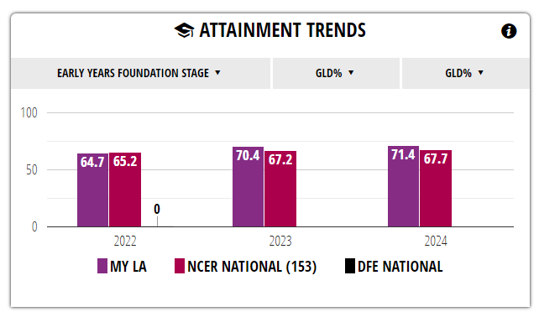
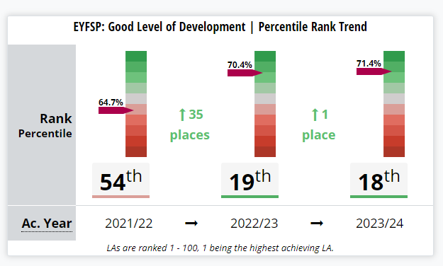
EYFS – Good Level of Development (GLD)

Slide 26
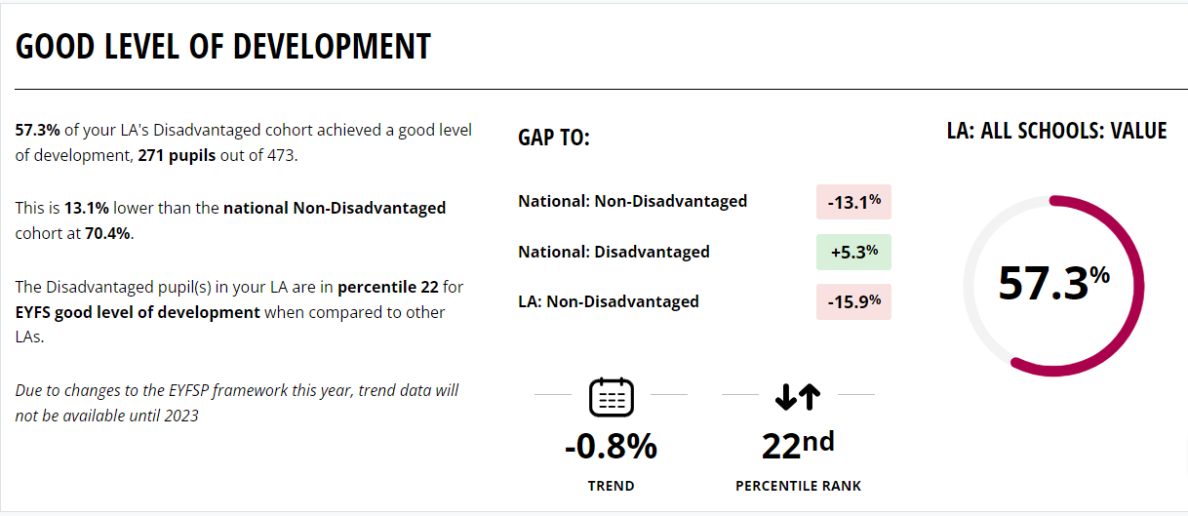
EYFS – GLD Disadvantaged pupils

Slide 27
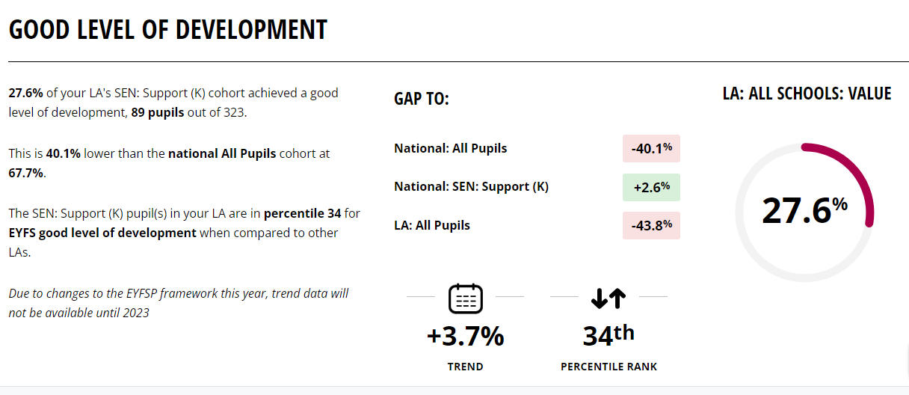
EYFS – GLD SEN Support pupils

Slide 28
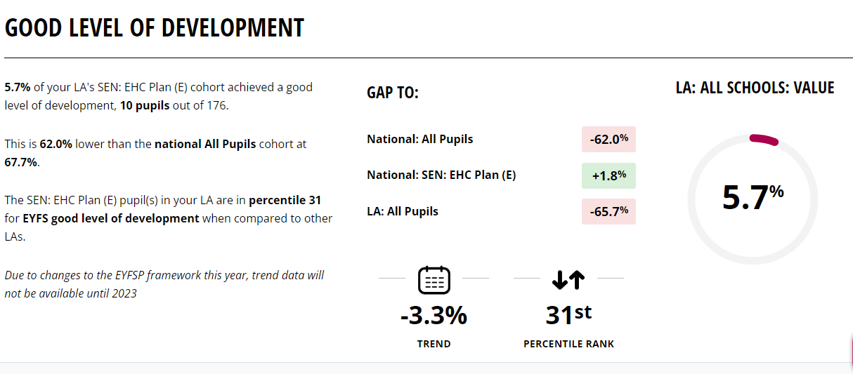
EYFS – GLD EHCP pupils

Slide 29
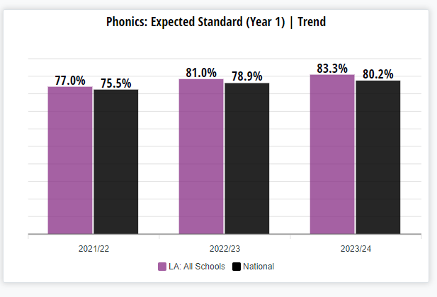
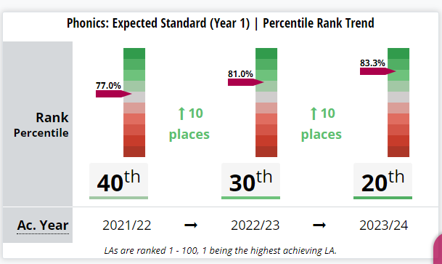
Year 1 Phonics

Slide 30
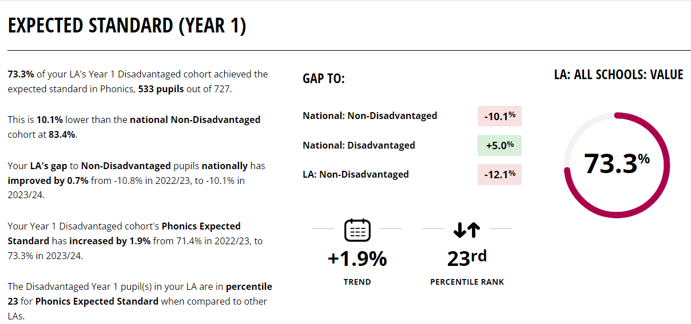
Year 1 Phonics – Disadvantaged pupils

Slide 31
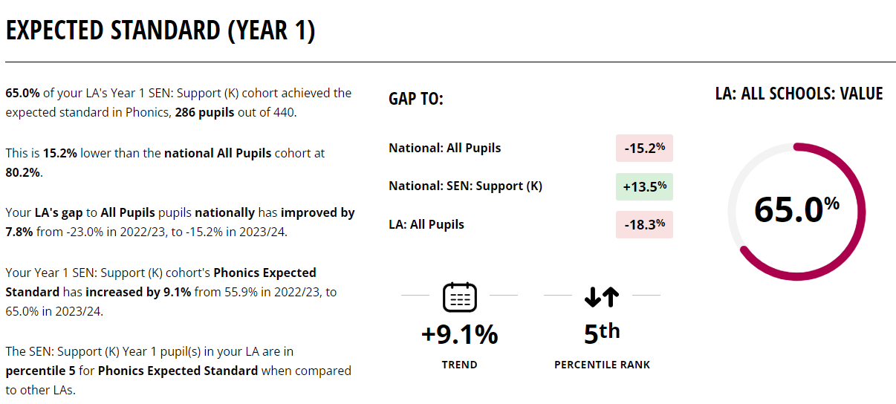
Year 1 Phonics – SEN Support pupils

Slide 32
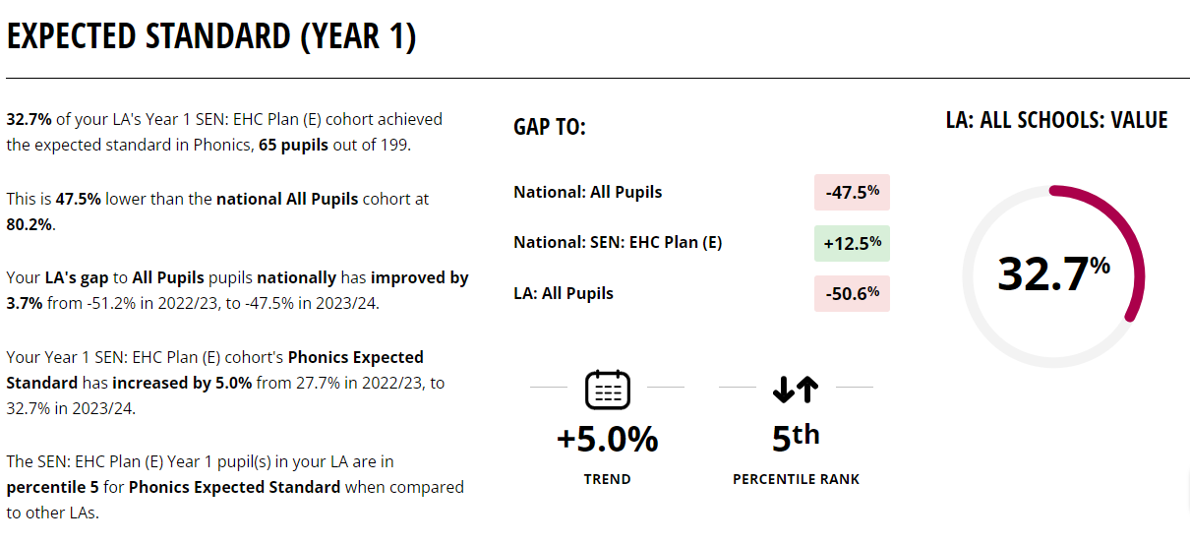
Year 1 Phonics – EHCP pupils

Slide 33
End of KS1 – from 2023-24 Key Stage 1 assessments were made optional to schools. Therefore, there was no requirement to carry out the assessments nor publish the outcome if they did carry these out.

Slide 34
End of KS2 – Expected Standard+
 | Barnet 2023 (at same time – provisional results) | Barnet 2024 | National 2024
Reading | 78% | 79.3% | 74%
Grammar, Punctuation, Spelling | 80.3% | 80.4% | 72%
Maths | 80.7% | 81.4% | 73%
Writing | 75.2% | 76.7% | 72%
RWM | 66.2% | 68.6% | 61%

Slide 35
End of KS2 – Higher Standard / Greater Depth
 | Barnet 2023 (at same time – provisional results) | Barnet 2024 | National 2024
Reading | 35.4% | 35.2% | 28%
Grammar, Punctuation, Spelling | 39% | 43.4% | 32%
Maths | 34.2% | 34% | 24%
Writing | 18% | 17.1% | 13%
RWM | 12.7% | 11.8% | 8%

Slide 36
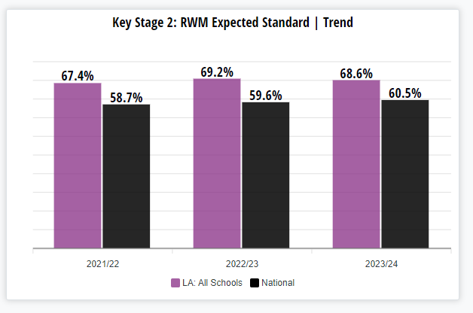
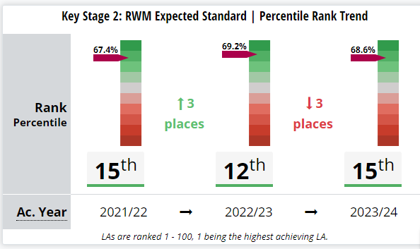
End of KS2 – RWM Trend data and ranking
Note: the 2024 data is provisional and previous years are finalized data. Usually Barnet results increase by between 2 to 3% when finalized due to pupils being removed (recent arrivals to country)

Slide 37
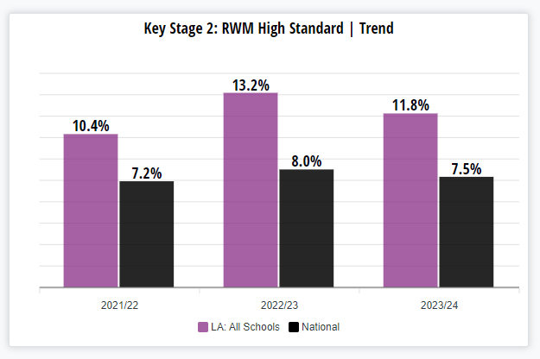
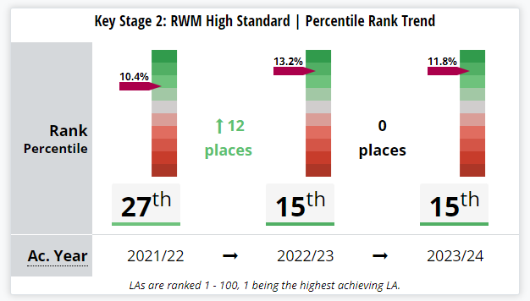
End of KS2 – RWM Trend data and ranking
Note: the 2024 data is provisional and previous years are finalized data. Usually Barnet results increase by between 2 to 3% when finalized due to pupils being removed (recent arrivals to country)

Slide 38
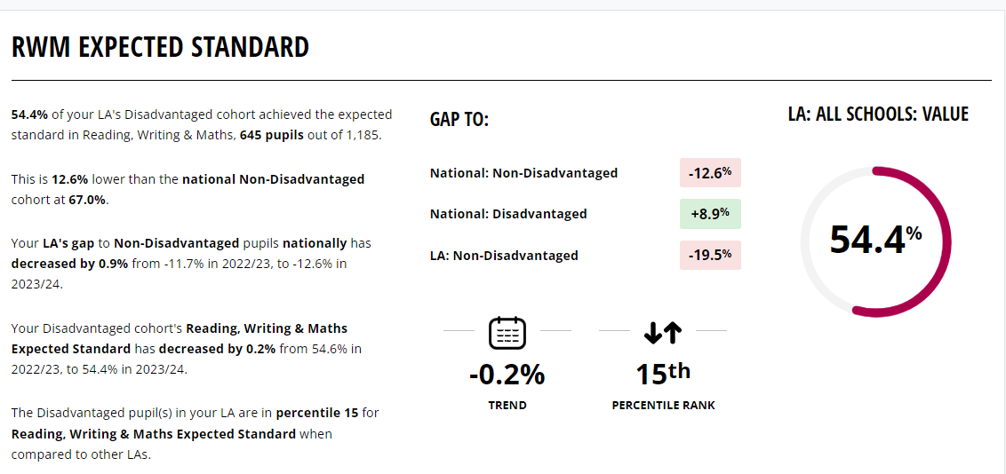
End of KS2 – RWM Disadvantaged pupils

Slide 39
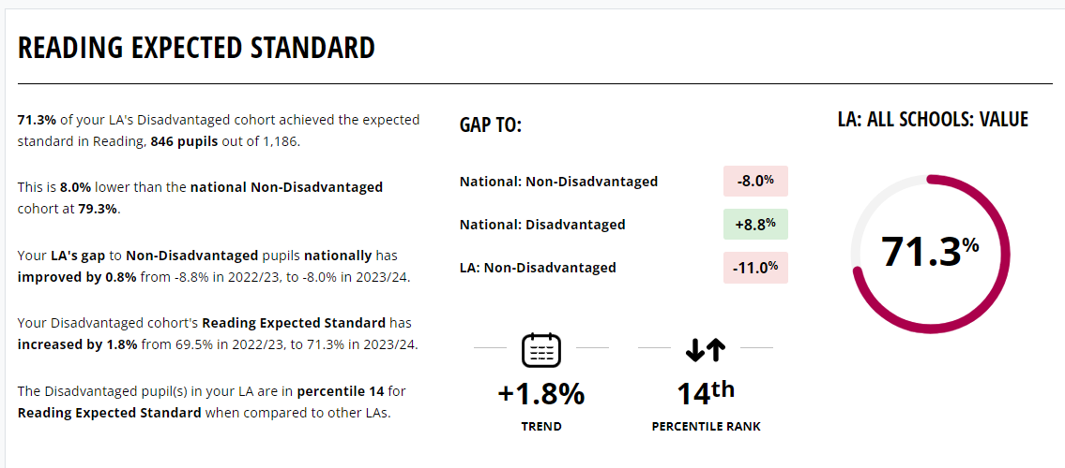
End of KS2 – Reading Disadvantaged pupils

Slide 40
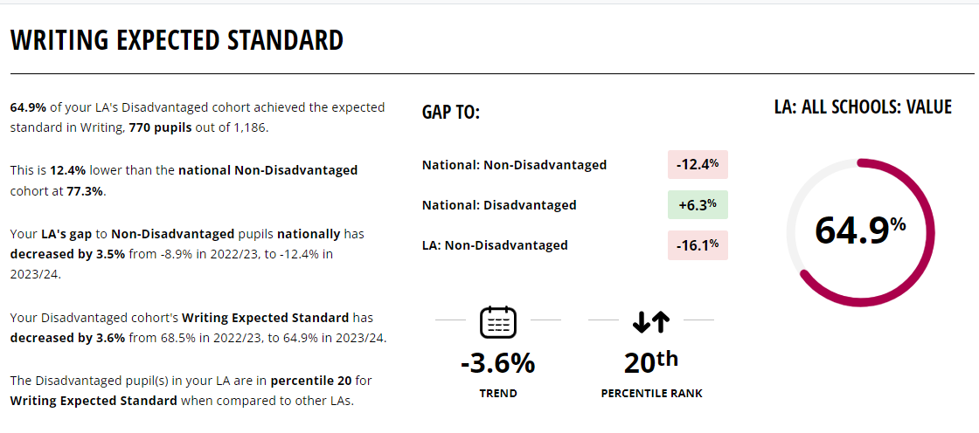
End of KS2 – Writing Disadvantaged pupils

Slide 41
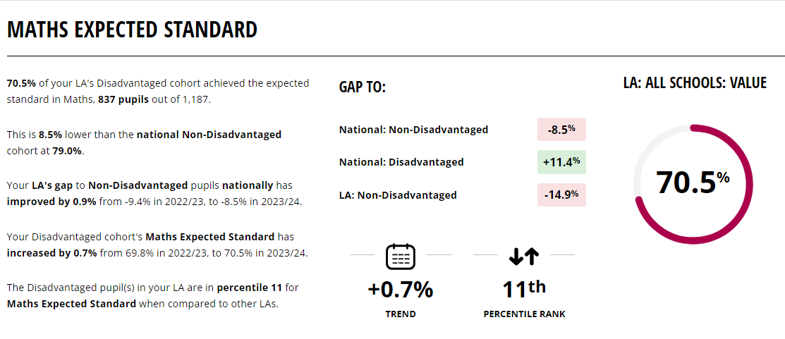
End of KS2 – Maths Disadvantaged pupils

Slide 42
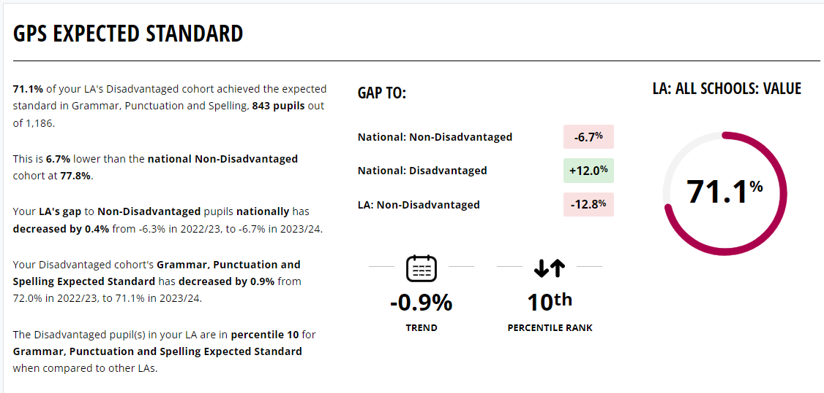
End of KS2 – GPS Disadvantaged pupils

Slide 43
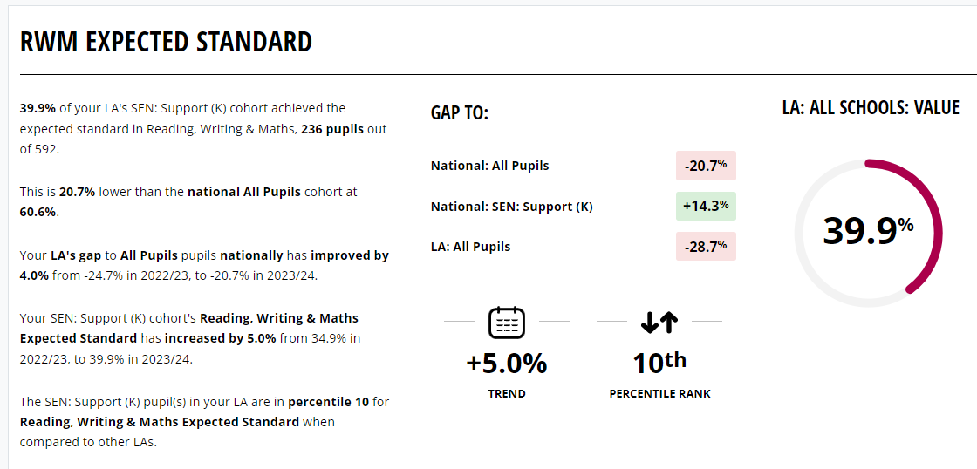
End of KS2 – RWM SEN Support

Slide 44
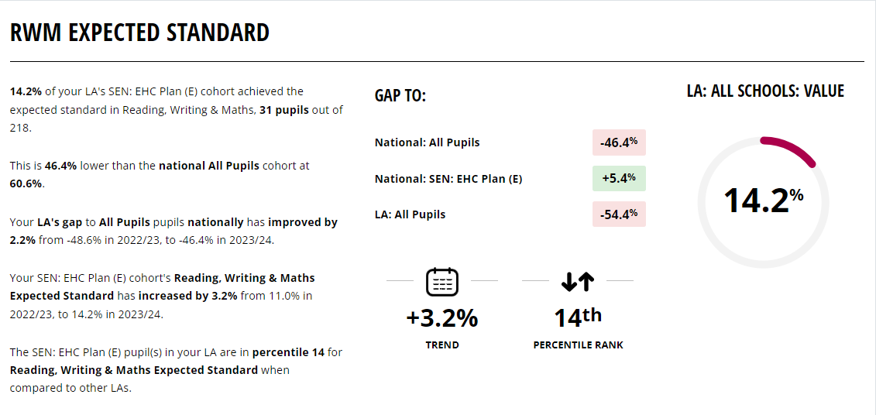
End of KS2 – RWM EHCP

Slide 45
End of KS4 – GCSE
Schools with results (2024) = | 26
Schools remaining (2024) = | 2
% returned (2024) = | 93%
 | Attainment 8 | Progress 8 | 9-5 Eng and Maths | 9-4 Eng and Maths
2019 Barnet | 57.1 | +0.57 | 62.7% | 78.8%
2019 National | 46.7 | -0.03 | 44.1% | 65.9%
2023 Barnet | 57.1 | +0.63 | 65.9% | 80%
2023 National | 46.5 | -0.03 | 45.6% | 65.5%
2024 Barnet | 53 | +0.84 | 60.4%
2024 National | 43.6 | +0.01 | 42.9%
London | 46.9 | +0.56 | 51.3%

Slide 46
End of KS5 – A Level
Schools with results (2024) = | 24
Schools remaining (2024) = | 1
% returned (2024) = | 96%
 | A*-A | A*-B | A*-C | A*-E
2019 Barnet | 32.2% | 58.9% | 81.2% | 98.0%
2019 National | 25.5% | 51.6% | 75.8% | 97.6%
2023 Barnet | 37.0% | 63.4% | 81.6% | 96.8%
2023 National | 27.2% |  | 75.4%
2024 Barnet | 39.8% | 65.3% | 83.2% | 98%
2024 National | 27.8% |  | 76.0%
London | 31.30%

Slide 47
Vocational Data – Summer 2024 Update

Slide 48
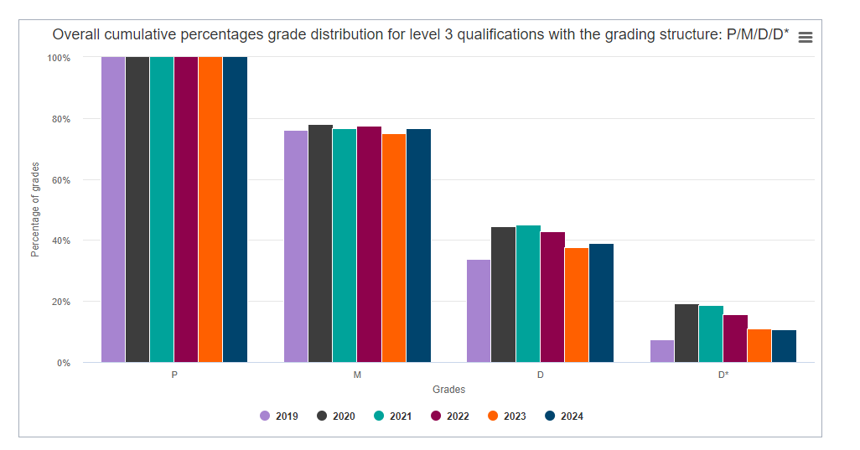
National Average Data: Pass – Distinction* Grades (source: gov.uk)
In 2023 38% of students nationally achieved a Distinction/Distinction *
The 2024 data available on gov.uk shows a slight increase from 2023
39% of grades are Distinction/Distinction *
77% of grades are Merit or better

Slide 49
Barnet Data 2024
We have received data from 13 Barnet schools and colleges thus far.
NB: Some Barnet schools have small cohorts which means that 1 student can have significant statistical impact.
Caution: we are missing data from two centres with large numbers
More schools performing above National in both measures in 2024 compared to 2023
6 Barnet schools which remain below National average at Dist* - Dist
3 Barnet schools which remain below National average at Dist* - Merit
Number of Barnet schools in line/ above National average Dist*/ Dist |  | Number of Barnet schools above National average Dist*- Merit
2023 (38%) | 2024 (39%) | 2023 (75%) | 2024 (77%)
4 schools | 7 schools (↑) | 7 schools | 10 schools (↑)
Number of Barnet schools improved % Dist*/ Dist between 2023 and 2024 | Number of Barnet schools improved % Dist*/ Merit between 2023 and 2024
9 schools | 7 schools

Slide 50
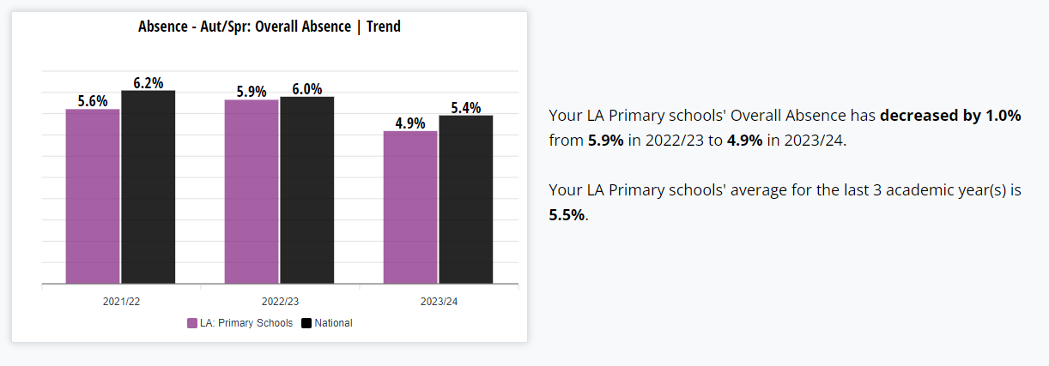
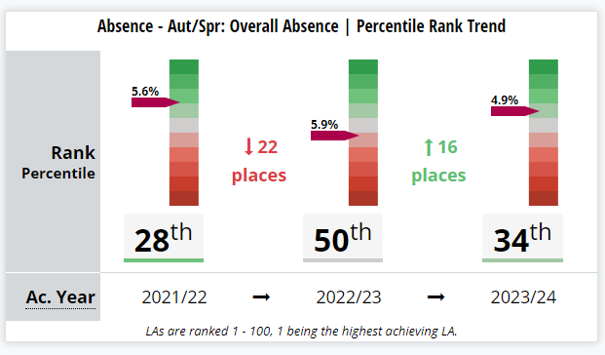
Primary Attendance – Aut/Spr Terms 2023/24

Slide 51
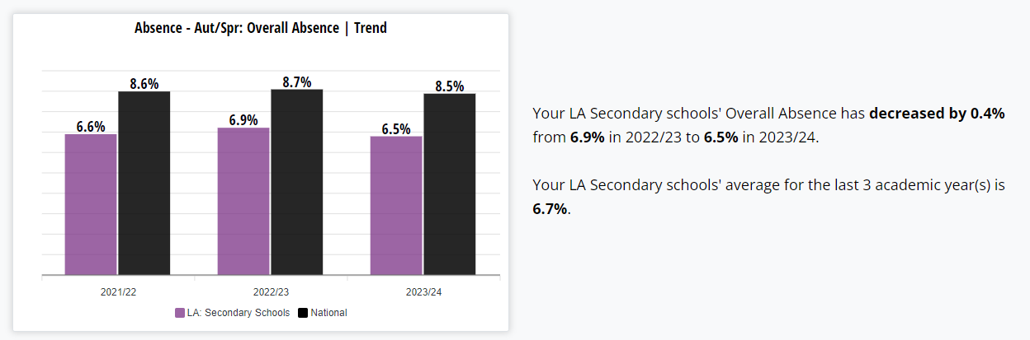
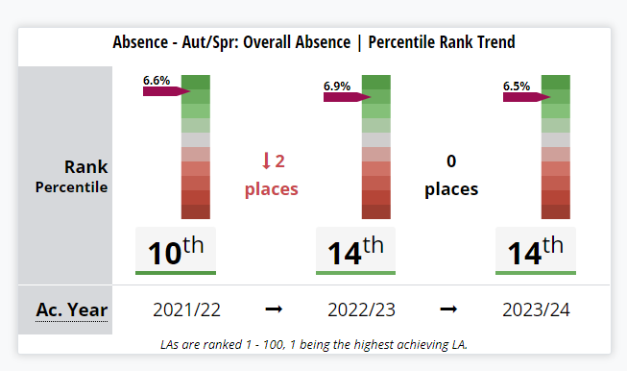
Secondary Attendance – Aut/Spr Terms 2023/24

Slide 52
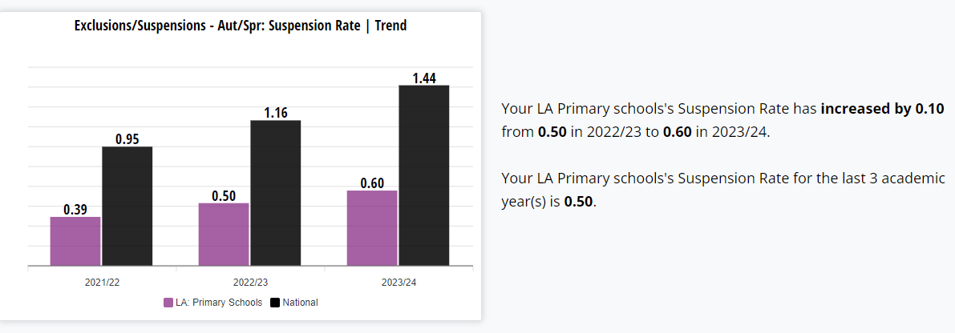
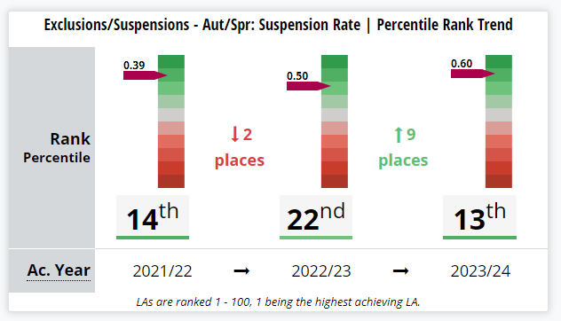
Primary Suspensions/ Exclusions – Aut/Spr Terms 2023/24

Slide 53
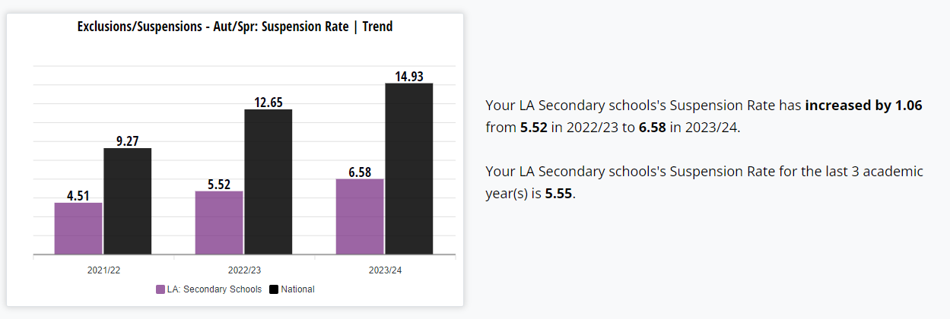
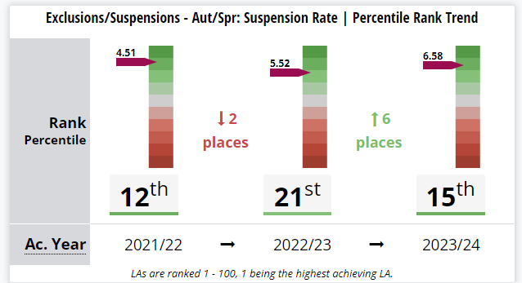
Secondary Suspensions/ Exclusions – Aut/Spr Terms 2023/24

Slide 54

School Admissions Update
October 2024
Update for 2018
Alison Dawes Director – School Access, Skills, & Corporate Services.
54
Notes:
54

Slide 55
Reception 2024/25 – application stats
On-time applications |  |  | Late applications
Barnet residents | Other LA residents | Total | As of 17 August 2024
3814 | 714 | 4528 | 375
Comparison to 2023/24
- 101 (-2.6%) | -57 (-7.4%) | -158 (-3.4%) | +47 (+12.5%)
Notes:
Primary demand has continued to fall

Slide 56
Reception 2024/25 – allocation stats
Offers on 16 April 2024
% 1st preference | % 1st to 3rd Preference | % Alternative (non-preference) offers | Barnet school offers to other LA pupils | Other LA school offers to Barnet pupils
86.21% | 96.39% | 2.15% | 281 | 374
Comparison to 2023/24
+0.77% | 0.35% | -0.61 | +19 | +52
Notes:
All applicants (on time and late) have been allocated a school place. Parental satisfaction rates are getting higher as demand and competition is falling

Slide 57
Primary National Offer Day Stats – yearly comparison
Year | On-time applications (Barnet residents) | On-time applications (other LA residents) | Total applications | Late applications | % 1st preference offers | % 1st to 3rd Preference Offers | Barnet offers to other LA pupils | Other LA offers to Barnet pupils
2024 | 3814 | 714 | 4528 | 375 | 86.21 | 96.39 | 281 | 374
2023 | 3915 | 771 | 4686 | 328 | 85.44 | 96.07 | 262 | 322
2022 | 4052 | 757 | 4809 | 335 | 83.88 | 95.36 | 269 | 408
2021 | 4044 | 785 | 4829 | 382 | 82.96 | 93.45 | 275 | 348
2020 | 4281 | 779 | 5060 | 301 | 83.6 | 94.16 | 281 | 374
2019 | 4172 | 737 | 4909 | 328 | 85.23 | 95.63 | 256 | 358
Notes:
There was a small peak in demand in 2020, but overall, we’ve seen a falling demand for primary applications. In the last six years, primary demand has fallen by nearly 9%.

Slide 58
Reception applications – yearly comparison
Notes:
The trendline shows an overall downward trend for Reception demand; with a small peak in 2020

Slide 59
Reception vacancies by faith (on 1 Oct 2024)
After PAN reductions at St Joseph’s, Menorah Foundation and London Academy
School’s religious character | Vacancies | Total places | % vacant places
None | 256 | 2745 | 9.3
Church of England (CE) | 64 | 560 | 11.4
Catholic | 57 | 465 | 12.3
Jewish | 47 | 551 | 8.5
TOTAL | 424 | 4321 | 9.8
Notes:
Overall, 1.3% more vacancies than this time last year. CoE vacancies have almost doubled; No faith and Jewish vacancies have also increased. Catholic vacancies are down by 4% but this is partly due to St Joseph’s reduced PAN

Slide 60
Changes to primary provision - 2024
Menorah Primary School
Formerly coeducational; split into two single-sex schools with split PAN
Deansbrook Junior
PAN reduction to 3FE to 2FE
Menorah Foundation
PAN reduction from 50 places to 1FE
St Joseph’s Catholic
PAN reduction to 3FE to 2FE
London Academy
PAN reduction from 2FE to 1FE
Notes:
Total reduction by 110 places

Slide 61
Changes to primary provision – future planned
From September 2025:
Deansbrook Infant
PAN reduction to 3FE to 2FE
Moss Hall Infant
PAN reduction to 3FE to 2FE
Wessex Gardens
PAN reduction to 2FE to 1FE
Date to be confirmed
Saracens Primary
New 2FE provision in Colindale
Notes:
Further reduction planned by at least 90 places in 2025/26. SPS was due to open in 2026/27 but is likely to be pushed back

Slide 62
Primary status conversion 2024
Former Status | Current Status | Sponsor
Bell Lane Primary Community | Saracens Bell Lane primary Academy Converter | Saracens MAT
Dollis Primary Community | Dollis primary Academy Converter | Ashmole Academy
Osidge School Voluntary Aided | Osidge School Academy Converter | Bellevue Place Education Trust
Notes:
SMSJ – joining the Wren Academy Trust sometime this academic year
St. Paul’s N11 – also probably joining the Wren Trust sometime this academic year
Broadfields – probably joining the Saracens Trust in Sept 2025

Slide 63
Secondary 2024– application stats
On-time applications |  |  | Late applications
Barnet residents | Other LA residents | Total | As of 17 August 2024
4238 | 3292 | 7530 | 290
Comparison to 2023/24
-168 (-4%) | -165 (-4.8%) | -334 (4.2%) | -7 (-2.4%)
Notes:
Secondary demand is now on a clear downward trajectory – both for home and out-borough applications

Slide 64
Secondary 2024 – allocation stats
Offers (on 1 March 2024)
% 1st preference | % 1st to 3rd Preference | % alternative (non-preference) offers | Barnet school offers to other LA pupils | Other LA school offers to Barnet pupils
74.8 | 91.3 | 5.4 | 1082 | 776
Comparison to 2023/24
+3.6 | +2.2 | -0.9 | +6 | +5
Notes:
Parental satisfaction getting higher with reduced demand / competition.
Barnet continues to be a net exporter of secondary school places; 22 to 25% places on average go to children outside the borough

Slide 65
Secondary National Offer Day Stats - comparison
Year | On-time applications (Barnet residents) | On-time applications (other LA residents) | Total applications | % 1st preference offers | % 1st to 3rd Preference Offers | Barnet offers to other LA pupils | Other LA offers to Barnet pupils
2024 | 4238 | 3292 | 7530 | 74.8 | 91.3 | 1082 | 776
2023 | 4406 | 3457 | 7863 | 71.72 | 89.06 | 1076 | 771
2022 | 4415 | 3630 | 8045 | 72.64 | 89.63 | 1174 | 756
2021 | 4312 | 3884 | 8196 | 70.43 | 89.01 | 1138 | 740
2020 | 4300 | 3742 | 8042 | 72.42 | 90.16 | 1168 | 756
2019 | 4301 | 3793 | 8094 | 67.10 | 85.28 | 1124 | 746
Notes:
Overall demand for Y7 places has fallen by nearly 7% in the last 6 years

Slide 66
Year Seven applications – yearly comparison
Notes:
Trendline shows secondary demand is declining with a small peak in 2021

Slide 67
Secondary vacancies and unplanned places 2024
After PAN reductions at FBS and St James’ Catholic)
Year 7 - permanent | Total places (permanent) | Vacancies (2 October 2024) | % vacant places (28 Sept 2023)
Year 7 (2022) | 4764 | 324 | 6.8%
Year 7 –Additional places | Offers over PAN | Total places (permanent + additional) | Percentage additional places
Year 7 (2022) | 168 | 4932 | 3.4%
Notes:
Several Barnet schools continue to offer over PAN in response to pressure and preference for places (Orthodox Jewish demand exceeds number of places available; some localised pressure for secondary places in Edgware)

Slide 68
Changes to secondary provision -2024
Changes to secondary PANs
Friern Barnet School
PAN reduction from 162 places to 150 places
St James’ Catholic High
PAN reduction from 8FE to 7FE
There are currently no confirmed plans for future changes to secondary provision
Notes:
Hasmonean High Schools have operating bulges year on year and are planning to permanently expand

Slide 69
In-year applications – children from overseas
Academic Year 2023/24
Category | Primary | Secondary | TOTAL
Ukraine | 50 | 40 | 90
Hong Kong | 79 | 44 | 123
Asylum-seeker | 196 | 124 | 320
Israel / Gaza | 120 | 48 | 168
Any other child from overseas | 1030 | 545 | 1,575
GRAND TOTAL | 1475 | 801 | 2,276
Notes:
In-year demand is consistently high with a significant number of children continuing to arrive from overseas. Figures refer to individual children; original application recorded where children have moved from primary to secondary school

Slide 70
In-year placements – Five Asylum hotel children
1 Sep 2023 to 2 Oct 2024
Hotel | Primary | Secondary | TOTAL
Holiday Inn, Brent Cross,NW2 1LP | 41 | 25 | 66
Holiday Inn, Regents Park Road, N3 3JN | 4 | 5 | 9
Stay Club, Colindale NW9 5WU | 44 | 12 | 56
Palm Hotel, NW2 2NL | 23 | 4 | 27
OYO Hotel, N12 0QZ | 14 | 19 | 33
TOTAL | 126 | 65 | 191
Notes:
In-year localised pressure in Colindale / East Barnet is being managed through the In-Year Fair Access protocol

Slide 71
Reception five-year mainstream forecast – Barnet
(2024 GLA School Roll Projections )
Year | Reception projections | Permanent places* | Projected surplus places | Projected surplus forms of entry
2024/2025 | 3977 | 4291 | 314 | 10.5
2025/2026 | 3837 | 4201 | 364 | 12.1
2026/2027 | 3884 | 4201 | 317 | 10.6
2027/2028 | 3798 | 4201 | 403 | 13.4
2028/2029 | 3922 | 4201 | 279 | 9.3
*Future anticipated PAN changes applied
Notes:
An overall fall in primary demand is anticipated across the borough over the next 4 years with a significant upturn in 2028/29 (probably due to expected child yield from new developments). The underlying reason will need to analysed further. The actual surpluses is likely to be lower as the figures shown as these do not account for SEND children in mainstream schools and unexpected increase in-year admissions (asylum-seekers / children from overseas arriving in high numbers)

Slide 72
Reception five-year forecast – Primary PA1
Burnt Oak, Colindale North, Colindale South, Hendon, West Hendon
(2024 GLA School Roll Projections)
Year | Reception projections | Permanent places | projected surplus places* | Projected surplus forms of entry
2024/2025 | 1032 | 1048 | 16 | 0.53
2025/2026 | 1001 | 1048 | 47 | 1.57
2026/2027 | 998 | 1048 | 50 | 1.67
2027/2028 | 997 | 1048 | 51 | 1.70
2028/2029 | 1035 | 1048 | 13 | 0.43
Saracens Primary – excluding 60 places to be delivered; date to be confirmed
Notes:
The overall surplus of places in Burnt Oak, Hendon, West Hendon masks a rising deficit in Colindale, where there is largescale regeneration and an increasing demand for school places. The new Saracens Primary Free School, opening on the Peel Centre site is needed to meet this anticipated increasing demand in Colindale.

Slide 73
Reception five-year forecast – Primary PA2
Edgware, Edgwarebury, Mill Hill, Hale, Totteridge & Woodside
(2024 GLA School Roll Projections)
Year | Reception projections | Permanent places | Projected surplus places | Projected surplus forms of entry
2024/2025 | 654 | 735 | 81 | 2.70
2025/2026 | 640 | 705 | 65 | 2.17
2026/2027 | 635 | 705 | 70 | 2.33
2027/2028 | 637 | 705 | 68 | 2.27
2028/2029 | 657 | 705 | 48 | 1.60
*Future anticipated PAN reduction applied - Deansbrook Infant -30 in 2025/26)
Notes:
A small surplus is reasonable in Barnet, given the in-year flow and high volume of movers-in from abroad.

Slide 74
Reception five-year forecast – Primary PA3
Childs Hill, Cricklewood, Garden Suburb, Golders Green
(2024 GLA School Roll Projections)
Year | Reception projections | Permanent places | Projected surplus places | Projected surplus forms of entry
2023/2024 | 576 | 613 | 37 | 1.2
2024/2025 | 554 | 583 | 29 | 1.0
2025/2026 | 583 | 583 | 0 | 0.0
2026/2027 | 554 | 583 | 29 | 1.0
2027/2028 | 579 | 583 | 4 | 0.1
*Future anticipated PAN reduction applied – Wessex Gardens -30 in 2025/26
Notes:
Planning area 3 places vs demand looks tight but this is partly due to PAN reductions. Surplus capacity can be re-cyled if a deficit starts to emerge

Slide 75
Reception five-year forecast – Primary PA4
East Finchley, Finchley Church End, West Finchley, Friern Barnet, Woodhouse
(2024 GLA School Roll Projections)
Year | Reception projections | Permanent places | Projected surplus places | Projected surplus forms of entry
2024/2025 | 793 | 900 | 107 | 3.6
2025/2026 | 765 | 870 | 105 | 3.5
2026/2027 | 776 | 870 | 94 | 3.1
2027/2028 | 742 | 870 | 128 | 4.3
2028/2029 | 760 | 870 | 110 | 3.7
*Future anticipated PAN reduction applied – Moss Hall Infant -30 in 2025/26
Notes:
PA4 demand is continuing to fall and surpluses are higher than in the other planning areas despite the planned PAN reduction at MHI

Slide 76
Reception five-year forecast – Primary PA5
Barnet Vale, High Barnet, Underhill
(2024 GLA School Roll Projections)
Year | Reception projections | Permanent places | Projected surplus places | Projected surplus forms of entry
2024/2025 | 304 | 335 | 31 | 1.0
2025/2026 | 295 | 335 | 40 | 1.3
2026/2027 | 301 | 335 | 34 | 1.1
2027/2028 | 287 | 335 | 48 | 1.6
2028/2029 | 292 | 335 | 43 | 1.4
Notes:
Some localised pressure on the border of Barnet Vale and East Barnet – being managed through Fair Access.

Slide 77
Reception five-year forecast – Primary PA6
Brunswick Park, East Barnet, Whetstone
(2024 GLA School Roll Projections)
Year | Reception projections | Permanent places | Projected surplus places | Projected surplus forms of entry
2024/2025 | 618 | 660 | 42 | 1.4
2025/2026 | 582 | 660 | 78 | 2.6
2026/2027 | 591 | 660 | 69 | 2.3
2027/2028 | 581 | 660 | 79 | 2.6
2028/2029 | 599 | 660 | 61 | 2.0
Notes:
Gradual decline in demand – small surplus

Slide 78
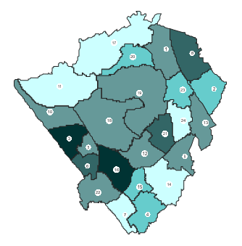
Reception 2024 applications by ward of residence
Low
High
Notes:
The intensity of the shaded areas represents the volume of applications. Highest number of Rec 2024 applications are mainly from residents in the west of the borough, Hendon, Burnt Oak and Colindale South, but also from East Barnet and West Finchley

Slide 79
Secondary pupil forecast – next five years
(2024 GLA School Roll Projections)
Year | Year Seven projections | Permanent places | Projected surplus places | Projected surplus forms of entry
2024/2025 | 4614 | 4764 | 150 | 5.0
2025/2026 | 4526 | 4764 | 238 | 7.9
2026/2027 | 4494 | 4764 | 270 | 9.0
2027/2028 | 4548 | 4764 | 216 | 7.2
2028/2029 | 4513 | 4764 | 251 | 8.4
Notes:
The secondary forecast indicates a downward trend over the coming year. This reflects the lower primary cohorts moving up to the secondary phase.

Slide 80
Ofsted Briefing
October 2024

Slide 81
Ofsted Inspections in Barnet 2023-2024
In 2023-24 Barnet had 40 Inspections (8 secondary, 1 all through, 28 primary, 3 special). The outcomes for inspections over the year are shown in the table below:
Outstanding | Good | Requiring Improvement | Inadequate | Report not published
8 | 32 (inc two Good+) | 0 | 0 | 0
In 2022-23 we had 45 schools inspected in the whole year

Slide 82

Schools Due Inspection 2023-24 (1)
School | Reason | Taken Place
Childs Hill | Academy conv (Feb ’20)
Ark Pioneer | New School
Hasmonean Girls | New school (Sept ‘19)
Moss Hall Infant | Outstanding (Feb ‘09)
Whitings Hill | Outstanding (Nov ’10)
Martin | Outstanding (Dec ‘11)
Monkfrith | Outstanding (Sept ‘11)
St John’s N11 | Outstanding (Feb ’12)
Menorah Primary Girls | Outstanding (Feb ’12)
Hasmo High Boys | Outstanding (Nov ’12)
Manorside | Outstanding (Jan ’13)
Barnfield | Outstanding (June ’13)
SMSJ | Good (July ’17)
Etz Chaim | Good (Nov ’17)
Copthall | Good (Feb ’18)
Dollis | Good (Feb ’18)
School | Reason | Taken Place
FCHS | Good (March ’18)
Livingstone | Good (April ‘18)
Brookland Infant | Outstanding (Oct ’13)
Orion | Outstanding (March ’15)
Holy Trinity | Outstanding (April ’15)
The Hyde | Outstanding (May ‘15)
Osidge | Good (June ’18)
Mapledown | Good (July ’18)
All Saint’s N20 | Good (Oct ’18)
Friern Barnet | Good (Oct ‘18)
Holly Park | Good (Nov ‘18)
Rimon | Good (Nov ‘18)
St Andrew the Apos | Good (Nov ‘18)
Woodcroft | Good (Dec ‘18)
Claremont | Good (Jan’19)
Compton | Outstanding (Jan ’18)

Slide 83
Percentage of schools Good or better (Sept ’24)
 | Percentage Good or better
Barnet | 96.9%
London | 96%
England | 90.4%

Slide 84
Ofsted Inspections in Barnet 2024-2025
In 2024-25 Barnet have had 0 Inspections (0 Secondary, 0 all through, 0 primary, 0 special). The outcomes for inspections over the year are shown in the table below:
Outstanding in all judgements | Outstanding and Good judgements | Good in all judgements | Requiring Improvement in some judgements (number in brackets shows number of RI judgements) | Requiring Improvement in all judgements | Any Inadequate judgements | Report not published
0 | 0 | 0 | 0 | 0 | 0 | 0
In 2022-23 we had 45 schools inspected in the whole year
In 2023-24 we had 40 schools inspected in the whole year

Slide 85
Schools Due To
Be Inspected

Slide 86
Due Inspection This Year
Due Inspection This Year
School | Type | Judgement | Done
All Saints’ NW2 | P | Good
Archer Academy | S | Outstanding
Ashmole Primary | P | Outstanding
Beis Yaakov | P | Good
Beit Shvidler | P | Good
Blessed Dominic | P | Outstanding
Broadfields | P | Good
Christ's College Finchley | S | Good
Coppetts Wood | P | RI
Frith Manor | P | Good
School | Type | Judgement | Done
Hyde The | P | Outstanding
IJDS | P | RI
Menorah Foundation | P | Good
Menorah High School for Girls | S | Good
Oak Hill | SN | Good
Oak Lodge | SN | Outstanding
Oakleigh | SN | Outstanding
Pardes House Primary School | P | Good
Parkfield | P | Good
Rosh Pinah | P | Good

Slide 87
Due Inspection This Year
May Also be Inspected This Year
School | Type | Judgement | Done
St Agnes' | P | Outstanding
Summerside Primary | P | Good
Totteridge Academy | S | Good
Tudor | P | RI
Wessex Gdns | P | RI
Woodridge | P | Good
Wren Academy | P/S | Outstanding
School | Type | Judgement | Done
Ashmole Academy | S | Good
St Joseph’s | P | Good
St Mary’s N3 | P | Good
Queen Elizabeth Girls | S | Good
Mapledown | SN | Good+
Mathilda Marks Kennedy | P | Good

Slide 88
Ofsted 2024-2025 General Points

Slide 89
The state of inspections this year
New framework published 16th September
Removal of the Overall Effectiveness grade for all school inspections.
No change to graded inspections methodology – subject deep dives continue.
Graded Inspections started again on 23rd September
Ungraded Inspections started again on 7th October
Grace period for safeguarding fixes
Clear focus on the basics in English and Maths
Schools will be called on a Monday by the lead inspector. Inspection will start on Tuesday.
All inspections will be for two days (unless it is a very small school / nursery).
Continued focus on actions to improve attendance
A continued focus on IMPACT (which includes any messages from your performance information)

Slide 90
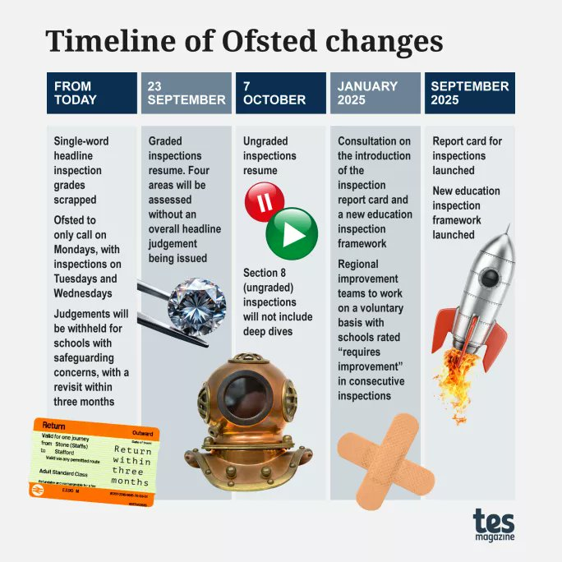

Slide 91
The Work of Governors
Inspectors will explore how governors/trustees carry out their functions. For example, the clarity of the school’s vision, ethos and strategic direction will have a significant impact on the decisions that leaders make about the curriculum. Inspectors will consider whether the work of the board of governors or the board of trustees in this respect is supporting the school to provide a high-quality education for its pupils.
In addition, the board of governors or the board of trustees are responsible for ensuring that the school fulfils its statutory duties, for example under the Equality Act 2010, and other duties, for example in relation to the ‘Prevent’ duty.
The board of governors or the board of trustees are also expected to exercise strategic oversight of all aspects of safeguarding. When inspectors consider whether the board of governors or the board of trustees are fulfilling this responsibility, they are not expected to construct or review a list of duties.

Slide 92
Use of Ofsted Logos
Schools judged to be outstanding or good for overall effectiveness before September 2024 can use specific Ofsted logos to promote that judgement, for example on their websites. You can find more information in our logo terms of use.
Schools that receive a graded inspection from September 2024 onwards may no longer use the Ofsted judgement logos as they relate only to overall effectiveness, which is no longer part of our judgements.

Slide 93
Ofsted definition of ‘disadvantaged’
Pupils with special educational needs and/or disabilities (SEND)
pupils who meet the definition of children in need of help and protection
pupils receiving statutory local authority support from a social worker
pupils who otherwise meet the criteria used for deciding the school’s pupil premium funding (this includes pupils claiming free school meals at any point in the last 6 years, looked after children (children in local authority care) and/or children who left care through adoption or another formal route)

Slide 94
Dealing with complaints
Inspectors will not:
investigate the circumstances of a complaint on a graded or ungraded inspection, or come to any conclusions about the complaint itself
follow up on complaints received before the inspection
use complaints (qualifying complaints or other) or information about complaints as evidence to support judgements or come to any judgements based on complaints (qualifying complaints or other). However, evidence we find on an inspection following a complaint can be used to support judgements

Slide 95
Exploring data
Inspectors will evaluate information on the IDSR prior to inspection and explore this with leaders
No schools will be marked down on the basis of the 2021/22 data alone.
Inspectors will not look at non-statutory internal progress and attainment data on inspections of schools.
Schools choosing to use more than 2 or 3 data collection points a year should have clear reasoning for:
what interpretations and actions are informed by the frequency of collection
the time taken to set assessments, collate, analyse and interpret the data
the time taken to then act on the findings
Inspectors will seek to understand how staff are supported and the steps that are being taken to remove the risk of additional workload.

Slide 96
Safeguarding – adults living on the premises
If adults do live on the premises, inspectors will consider the school’s risk assessment as part of evaluating its safeguarding arrangements. Schools will be expected to demonstrate they have fully assessed any potential risks to children. This risk assessment should include:
safeguarding checks of residents
access between the residential accommodation and the rest of the premises
which other individuals (such as family members and visitors) will access the residential accommodation

Slide 97
Addressing minor safeguarding improvements
Inspectors may identify minor improvements that need to be made to the school’s safeguarding practices during inspection, such as administrative errors in paperwork or out-of-date policies. Some of these improvements may be rectified easily before the end of the inspection.
Where this is the case, inspectors will have a constructive and professional conversation with leaders so that the school has every chance to make these minor improvements.
Where minor improvements are required but these are not able to be resolved before the end of the inspection, if the school has taken steps to resolve the issue, the school can still be judged effective for safeguarding.
Importantly, any minor improvements that need to be made, while strengthening safeguarding practice, will not have an immediate impact on the safety of pupils.

Slide 98
Safeguarding concerns – time to put it right
If safeguarding is judged as ineffective but all other judgements would have been good or outstanding, inspectors will need to consider, based on the information available to them at that time, whether leaders are capable of resolving the issues identified with safeguarding within 3 months.
If inspectors consider that this is the case, the inspection will be suspended to give the school an opportunity to resolve those issues and we will return within 3 months. “Suspend and Return” (currently a pilot).
The school will not be placed in a category of concern at this stage, as the inspection will not have concluded the inspection. Ofsted will send a letter to the school, copied to the Secretary of State, setting this out, and explaining the next steps. In order to be able to suspend the inspection, inspectors will need the school to agree, before the suspension is confirmed, that they will pass this letter to parents.
Ofsted will return to the school after 3 months as to complete the inspection by gathering additional evidence on whether safeguarding arrangements are effective
If there are no wider concerns (as set out in the first bullet), but inspectors consider that there is not a realistic prospect that leaders will be capable of resolving the issues identified with safeguarding within 3 months, they will conclude the inspection as normal and judge the school to have serious weaknesses. This is likely to lead to a judgement of inadequate for leadership and management.

Slide 99
Ungraded inspections

Slide 100
What is changing for ungraded inspections?
Removal of overall effectiveness grade for state funded schools only
Phone calls on a Monday (or Tuesday if a bank holiday)
A change to the wording of the report – it will no longer say ‘school remains good…’. The school has taken effective action to maintain the standards identified at the previous inspection.
No deep dives but focus areas instead

Slide 101
Ungraded Inspections – what is evaluated
Inspectors can focus on any areas of the evaluation schedule but will usually consider:
leadership and management – whether leaders take effective action to sustain and/or improve performance across all areas of the school’s work, and whether they make decisions in the best interests of children
quality of education – the extent to which pupils achieve well and are well prepared for their next steps
behaviour – whether the school is a safe and positive environment for pupils and whether pupils get the support they need
attendance – whether school staff are doing all they reasonably can to achieve the highest possible attendance
pupils’ personal development – the extent to which pupils are well prepared for life beyond the school
Staff’s well-being - including workload
Gaming and off-rolling – whether there is any evidence of this.
All aspects of Safeguarding set out in the inspection handbook.

Slide 102
Ungraded inspections - A move to focus areas
Three or focus areas chosen taking into account the school’s context and priorities (success, challenges, areas for improvement from the previous inspection).
They will stay within the scope of the EIF for ungraded inspections (QE and spotlight areas)
At least two focus areas will relate to the quality of education
Others will reflect what leaders have been working on related to other parts of the education inspection framework.
They will allow inspectors to evaluate whether leaders:
take effective action to maintain or improve performance in all areas of the school’s work
make decisions in the best interests of pupils.

Slide 103
Grouping Subjects
In primary schools, inspectors will normally consider:
early English and mathematics knowledge and skills
a group of subjects from the wider curriculum (based on strengths, areas for development and what best to look).
In secondary schools, groups of subjects may include, but are not limited to:
* recognised subject groupings (such as the arts or the humanities)
* early English (including reading) and mathematics knowledge and skills (regardless of age) may be a focus
* any other selection of subjects that are relevant given the school’s context

Slide 104
Ungraded Inspections
Focus Areas Example - Primary School
1. The impact of leaders’ work to improve the quality of education in art, music and MFL with a focus on the impact for pupils with SEND. Rationale: An AFI from the previous inspection when transition arrangements were used. Leaders indicate art/music are strong and MFL is following the same route of improvement. Provision for pupils with SEND appears less well developed.
2. The impact of leaders’ work in early English and mathematics. Rationale: Are pupils building on seemingly strong phonics provision and learning to read? Also, emphasis on maths. Start with look at EYFS and explore wider impact on KS1 and narrow to maths in KS2.
3. How effectively are leaders addressing identified concerns about the behaviour of a small number of pupils? Rationale: AFI from the previous inspection. Leaders explain that this remains a priority. Possible link to provision for pupils with SEND.
4. The impact of leaders’ work to develop a culture of respect, with a focus on the taught PSHE curriculum including that for pupils with SEND. Rationale: Leaders cite successes in this area – supporting a change in the culture in the school for most pupils.

Slide 105
Ungraded Inspections
Focus Areas Example - Secondary School
1.The quality of education in science, English, geography and history, including the impact of leaders’ work to address weaknesses in adaptive teaching pedagogy at key stage 3 (SEND). Rationale: IDSR showed science weaker compared to others while hums a strength, + conversation showed leaders have worked on SEND and adaptive teaching in particular.
2. The impact of the curriculum in vocational subjects, including the impact of leaders’ work to ensure they meet the needs of vulnerable pupils. Rationale: IDSR/AB and conversation shows high take up. Part of leaders’ approach to make the curriculum meet pupils’ needs and aspirations.
3. The impact of leaders’ work to improve the quality of careers education, including for pupils with SEND. Rationale: PIR, context, conversation all showed this needed to improve from where it was, to raise sustained destinations.
4. The effectiveness of leaders’ actions in improving pupils’ behaviour. Rationale. Was an area for improvement from PIR + leaders have focused on this post pandemic.

Slide 106
Ungraded Inspections
Focus Areas Example - Special School
A)The school’s work to develop strong communication and language. Rationale: Leaders emphasise this is a strength and one of increasing importance due to changing needs of pupils – particular focus communication. The school does not teach a traditional ‘subject’ curriculum so we will visit ‘communication and language’ lessons as well as the subjects in the creative curriculum (art, music and drama) where this is promoted strongly. That way we will see the breadth of the school’s work for the various needs pupils have.
B) The impact of the early years and KS1 curriculum provision for pupils with complex needs. Rationale: Evidence of growing school which is providing education for wider range of needs. How effectively have leaders adapted the curriculum and how it is taught, to help children learn the foundations for later learning. Are staff trained to deliver specialist approaches for these pupils?
C) The impact of the school’s work to improve pupils’ attendance. Rationale: Attendance is much improved – was AFI at PIR. Leaders say this has been a focus. They note a small number of PA – all with complex needs.
D) The school’s work to develop pupils’ character and ability to make informed, independent choices, including how the school achieves this through staff training and the use of therapists. Rationale: PSHE and life skills focuses on this and will enable us to see how provision aligns to pupils’ personalised needs in line with their EHCP personal outcomes. Staff turnover means that training to meet pupils’ needs is a constant priority.

Slide 107
Possible outcomes for an ungraded inspection
Outcome 1 – the school has taken effective action to maintain the standards identified at the previous inspection. This will mean either:
  there is no evidence that any key or provision judgement would be lower if a graded inspection took place
  there is evidence that one or more key or provision judgements may be lower if a graded inspection took place, but it would still be good
Outcome 2 – the school’s work may have improved significantly across all areas since the previous inspection. This will mean, if a graded inspection took place:
  at least one key or provision judgement would be higher
  none would be lower
  all would be outstanding
Outcome 3 –the school’s work may not be as strong as at the time of the previous inspection. This will mean:
  at least one key or provision judgement would be lower if a graded inspection took place
  that judgement would now be requires improvement or inadequate
Outcome 4 – the school may now be inadequate in one or more of the key judgements under a graded inspection. The ungraded inspection will usually be deemed to be a graded inspection within 48 hours.

Slide 108
BUILDING STRONG FOUNDATIONS
Ensuring the basics are in place for all pupils

Slide 109
Early English and mathematics knowledge
‘Inspectors will usually focus on the extent to which pupils, particularly those who are disadvantaged (including those with SEND) are able to read, write and use mathematical knowledge, ideas and operations to an age-appropriate level and fluency so that they are able to access a broad and balanced curriculum.’

Slide 110
Executive Function
Will not be used by inspectors as a term during inspection.
3 vital areas
Focusing attention – sustained periods
Working memory – how they hold info
Mental flexibility – work with info. represented in different ways
How does lesson planning relate to these 3 areas?
Deficits have an impact on Primary and Secondary education.
Executive Function makes it mentally possible to play with ideas
and successfully navigate challenges, and stay focused while doing so.

Slide 111
Ofsted Experiences
Clare Hegarty, Chair at Holly Park Primary
David Powell, Chair at Holy Trinity Primary
Sue O’Halloran, Chair at Mapledown Secondary Special School

