Slide 1
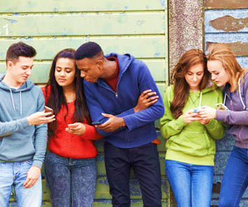

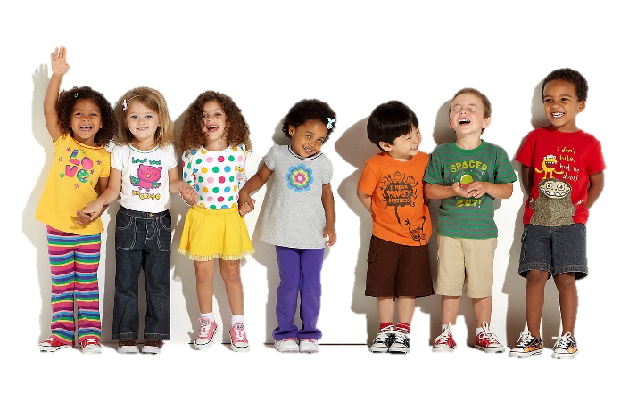
Jayne Abbott
Resilient Schools Manager
Children & Young People’s Suicide Prevention Lead

Slide 2




What is the Barnet Resilient Schools Programme?
The programme aims to:
Raise awareness and de-stigmatise mental health
Help school communities, pupils, staff, parent and carers to recognise their own and others mental health needs and be confident to seek support for themselves and others.
Through awareness be able to intervene early to prevent the escalation of poor mental health

Slide 3

Resilient Schools 2017 - 2024
Notes:
For Q3 (Oct-Dec)- now 83 schools so far. Need to update graphs.

Slide 4
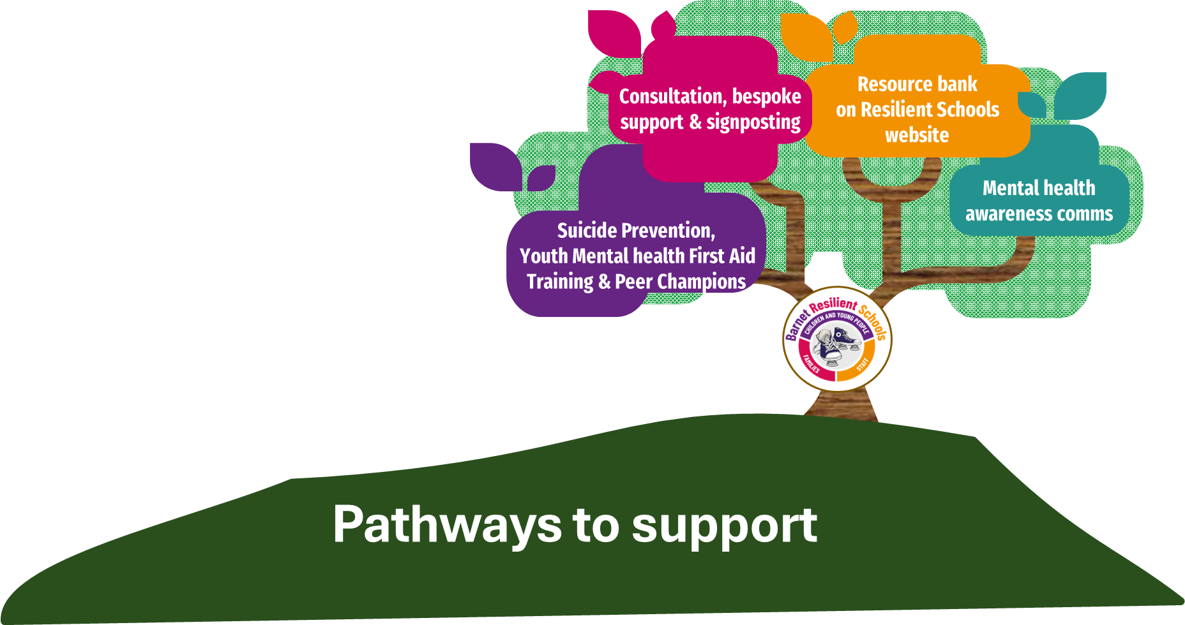
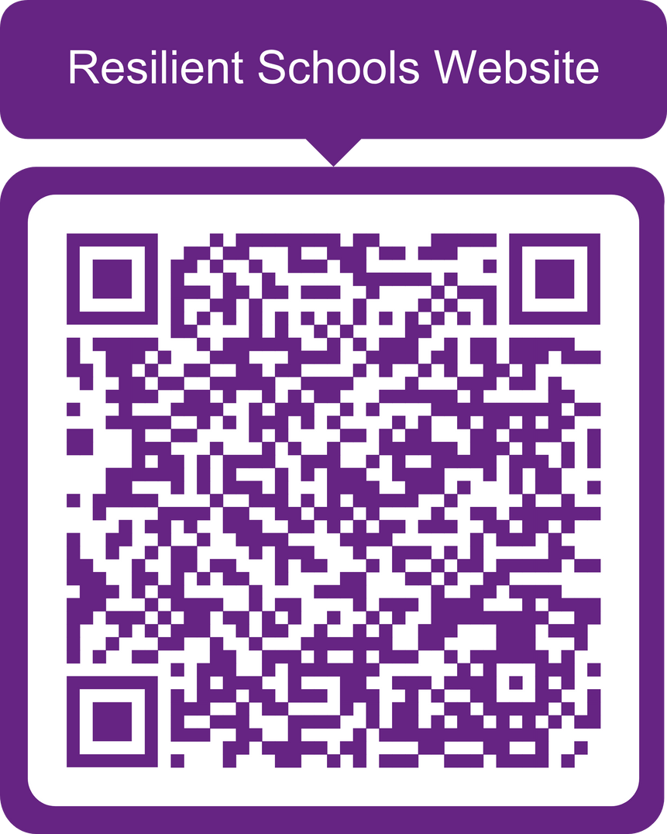

Slide 5

Resilient Schools – A Tiered Approach
Aims to help support schools and colleges ‘where they are at’ in their journey to developing a Whole School or College Approach to mental health and wellbeing.
Whole School Approach Self-Assessment Tool
Resilient Schools Core Component – Progress Tracker.
Universal Offer
Answers from the tool generate a jargon-free and accessible report
Evidencing schools' whole schools' approach to mental health awareness and gaining the RS Kitemark
Schools can make use of any of the Resilient Schools offer’

Slide 6
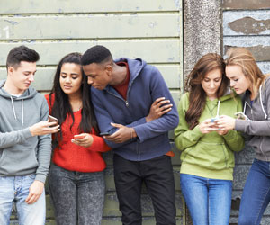
Digital Resilience Campaign
on, anger
Digital Resilience
An ethos and
environment that
Promotes respect
And values diversity
Curriculum,
teaching and
learning to promote
resilience and support
social and emotional
learning
Film ‘Generation Verified’
Signposting to lesson plans & resources
RS Focus sheet
Targeted
support and
Appropriate
referral
Leadership and management
that supports and champions
efforts to promote emotional
health and wellbeing
Enabling
student voice
to influence
decisions
Staff
development
to support their own
wellbeing and that
of students
Working with
parents/carers
Identify need and
monitoring impact of
interventions

Slide 7
Digital Resilience Campaign
Resilient Schools Programme Aim:
To support schools to build digital resilience in children & young people.
Film ‘Generation Verified’
RS Focus Sheet
on, anger
Signposting to lesson plans & resources
An ethos and
environment that
Promotes respect
And values diversity
Curriculum,
teaching and
learning to promote
resilience and support
social and emotional
learning
Digital Resilience
Targeted
support and
Appropriate
referral
Leadership and management
that supports and champions
efforts to promote emotional
health and wellbeing
Enabling
student voice
to influence
decisions
Digital resilience is the ability when online to:
Bounce back from difficult times
Understand when you are at risk
Know what to do if anything goes wrong
Learn from your online experiences
Recover from any online-related difficulties or upsets.
Staff
development
to support their own
wellbeing and that
of students
Working with
parents/carers
Identify need and
monitoring impact of
interventions
Notes:
We want digital resilience to be considered as part of a whole school approach to mental health & wellbeing

Slide 8
National Context

Slide 9

Feedback from the Childwise Monitoring Report 2024
Notes:
The Childwise monitoring report is a comprehensive annual report focused on children and young people's media consumption, purchasing habits, attitudes and activities.
More than 2000 children aged 5-16 in schools across the UK complete the survey.

Slide 10
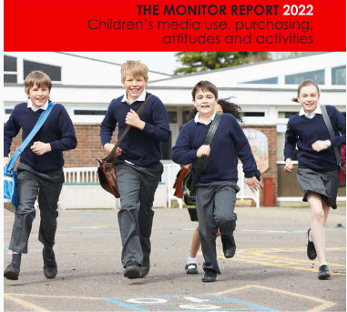
Feedback from the Childwise Monitoring Report 2022
WhatsApp was the most common social networking sites but now replaced in 2023 by TikTok
Notes:
The Childwise monitoring report is a comprehensive annual report focused on children and young people's media consumption, purchasing habits, attitudes and activities.
More than 2000 children aged 5-16 in schools across the UK complete the survey.

Slide 11






Key findings
9 in 10 teenagers have their own computer
Over 50% of teens own a tablet device
Most young people have a mobile phone and reported they could not live without it
WhatsApp was the most common social networking sites but now replaced in 2023 by TikTok
7 in 10 teens have their own games console, and play games for 2.5 hours a day
Young people are online for almost 4.5 hours a day
Notes:
The researchers asked young people what social networking sites they normally used. WhatsApp was the most common followed by Tiktok
Almost all teenagers have their own mobile phone and the majority of young people reported they could not live without their mobile phone
7 in 10 teens have their own games console, and play games for around 2.5 hours a day on average

Slide 12


Key Findings:
Apps, Websites and Technology
Almost 9 in 10 (86%) Children and Young People (CYP) aged 5-18 have their own computer.
Almost 3 in 5 CYP (59%) have their own games console, and play games for ~2.3 hours a day
The game console is most important for nearly one in five 5–10-year-olds and the most important for boys aged 9-10 years (34%)
More popular in boys than girls.
The average time spent online for CYP is 3.4 hours per day (approx. 204 minutes) – with 13–14-year-old have the highest usage peaks.
Video sites such as YouTube (82%), Netflix (71%) and Whatsapp (63%) are used by most children comparatively to other apps.
TikTok is rated the favourite app among CYP and on average they spend ~2.3 hours a day on it.
70% of CYP have a mobile phone and around half reported they could not live without it.
Notes:
The researchers asked young people what social networking sites they normally used. Youtube, Netflix and WhatsApp was the most common app and Tiktok is the rated favourite app among CYP.
Almost all teenagers have their own mobile phone and the majority of young people reported they could not live without their mobile phone.
Almost 3 in 5 teens have their own games console, and play games for around 2.3 hours a day on average.

Slide 13
Local Context

Slide 14
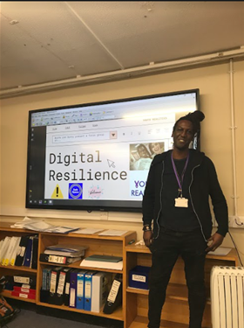
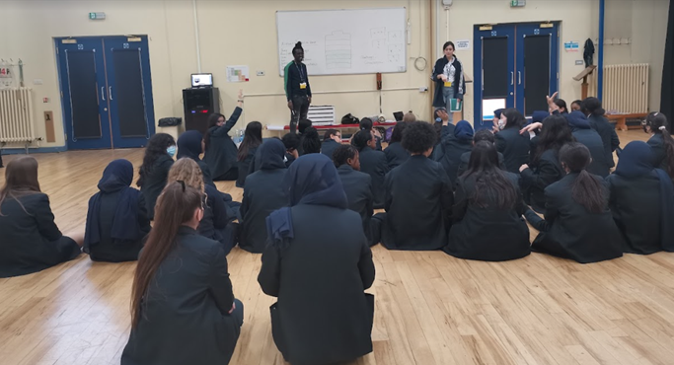
Key Findings
91% of young people surveyed felt more connected to people via technology than offline.
An overwhelming majority of young people were honest that on occasions, checking their Instagram, snapchat and other social medias were the highlights of their day.
They were aware of potential risks but also realise that more advice is needed to safely navigate the online world.
Top two concerns were online identity and gaming

Slide 15
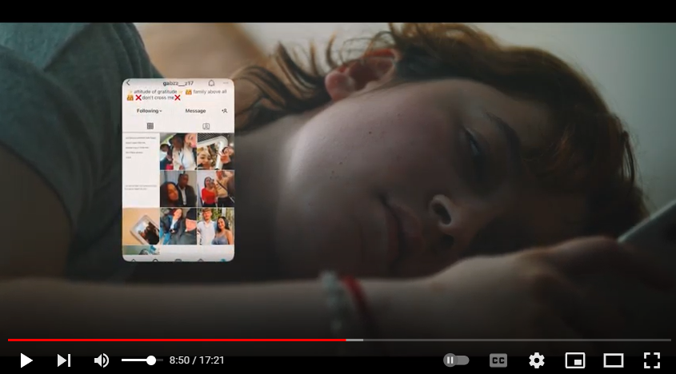

Generation Verified
“I like being able to share creatively and network online, but dislike how quick negativity can spread”.
Andrea Mircas, Generation Verified film cast
“I enjoy being able to connect with people all over the globe, but dislike how ruthless the online world can be”.
Leon Abbott, Generation Verified film cast
Notes:
OP
The digital resilience campaign aims to support schools to build resilience in children and young people. A short film was co-produced by young people to raise awareness for the impact the digital world can have on young people’s mental health. The themes were directed by the Childwise report highlighting gaming, x x/

Slide 16
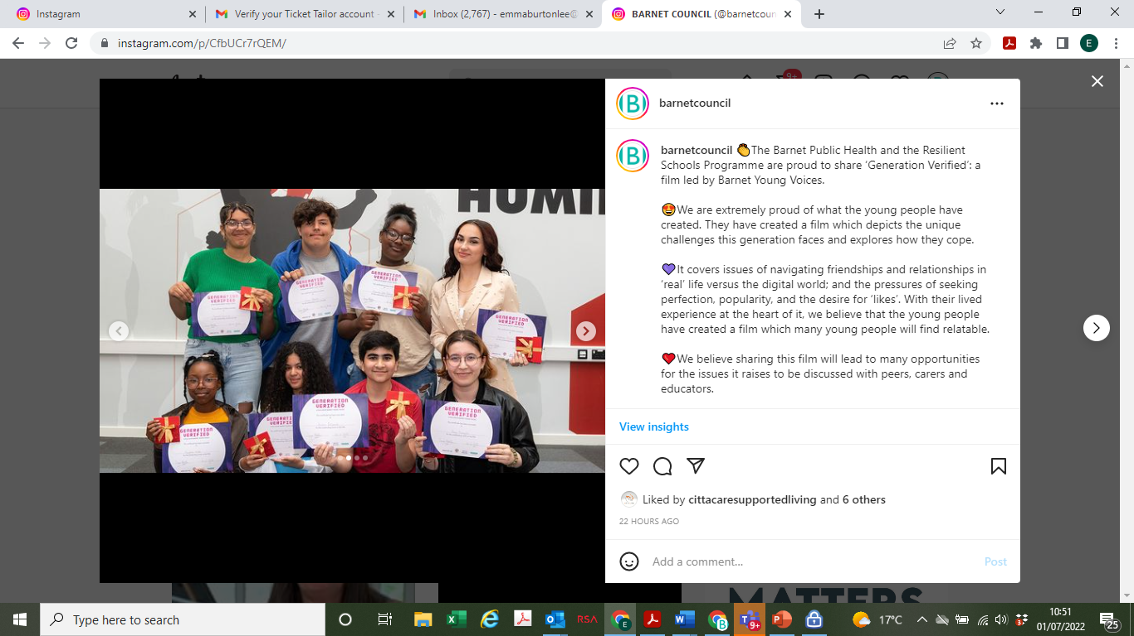

Slide 17
Generation Verified
Youth Realities and Pink Productions film ‘Generation Verified’.
From identity to pressure for perfection, popularity, and the desire for likes, Generation Verified is a short film that explores young people’s experiences of the online world and how they cope with the unique generational challenges that they must navigate in their day-to-day lives.
This short film has co production at its heart ensuring that a group of young creatives experience all aspects of scriptwriting, acting and film making to explore the online world and the effects it has on young people’s wellbeing.
Resource packs for schools, parent, carers and families were developed to stimulate discussion around the themes of the film.
Jayne Abbott, Resilient Schools Manager says
“I wanted to showcase what young people experience online in a way that was meaningful and had the lived experience at the heart of it. This film reinforces that co production and ensuring that young people's voices are heard is central to all we do in supporting our youth.”
Notes:
We wanted to create some resource packs which would support conversations with parents, young people and teachers after viewing the film. In these links contains lesson plans, advice and guidance for topics that feature in the film.
Youth realities ran focus groups with a group of parents, teachers and young people individually for their opinions and improvements to the resource packs we created. The top image is what they looked like before, and the bottom image shows the changes after the focus group feedback. These are still currently being worked on but should be ready over the next few weeks.

Slide 18
Generation Verified
The Resilient Schools Programme, Barnet Public Health is proud to showcase a Youth Realities and Pink Productions film ‘Generation Verified’.
Themes explored on Generation Verified
Identity
Pressure for perfection
Popularity
Desire for likes and external validation
Generation Verified is a short film that explores young people’s experiences of the online world and how they cope with the unique generational challenges that they must navigate in their day-to-day lives.
This short film has co production at its heart ensuring that a group of Barnet young creatives experience all aspects of scriptwriting, acting, film making and directing. They have owned this process from the start.​
The film benefits from being used as a ‘standalone talking tool’ between peers, families, and communities as well as a resource with the additional support of lesson plans and additional resources and signposting.
Notes:
Change
‘Generation Verified’. Explores From identity to pressure for perfection, popularity, and the desire for likes, this is a short film explores young people’s experiences of the online world and how they cope with the unique generational challenges that they face.
Co produced group of young Barnet creatives, who experienced all aspects of scriptwriting, acting, film making and directing

Slide 19
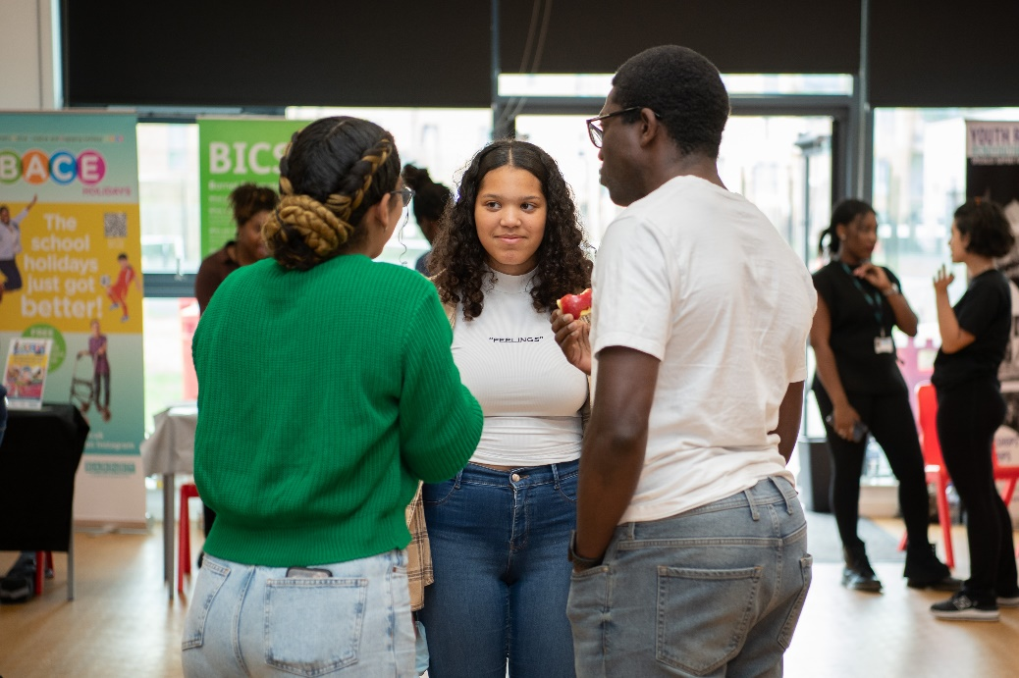
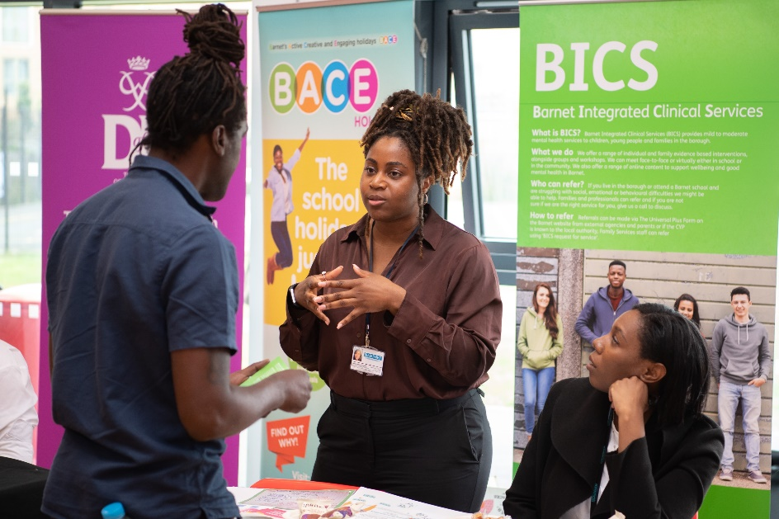
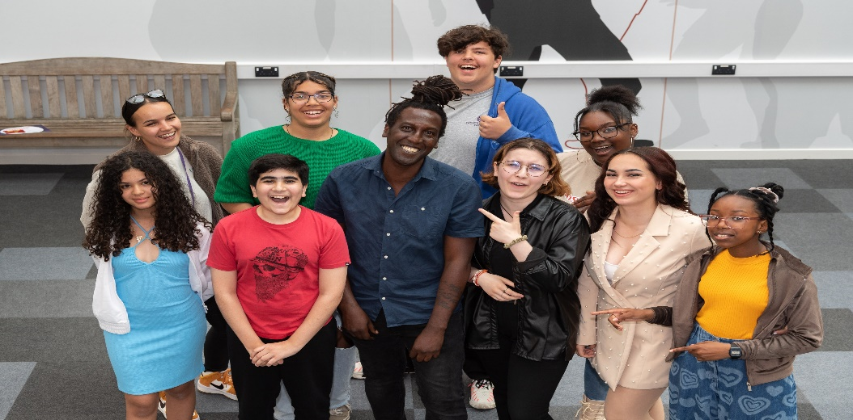
Generation Verified Dissemination
Shared on
Twitter
Facebook
Instagram
Uploaded to Youtube

Slide 20
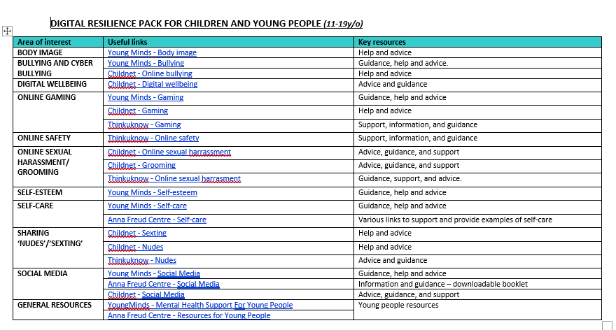
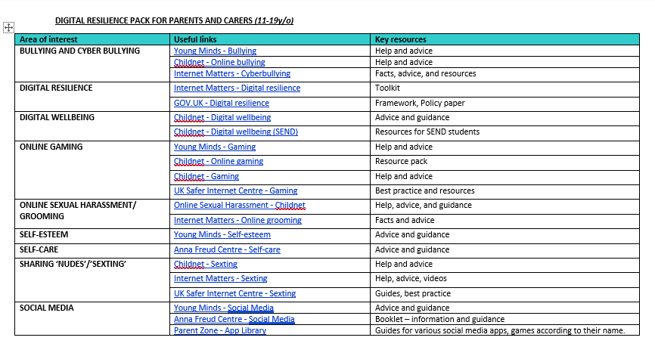
Digital Resilience Resource

Slide 21
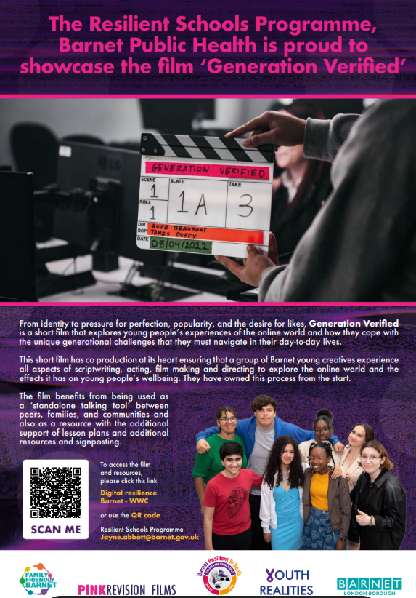
Generation Verified Resource Posters

Slide 23
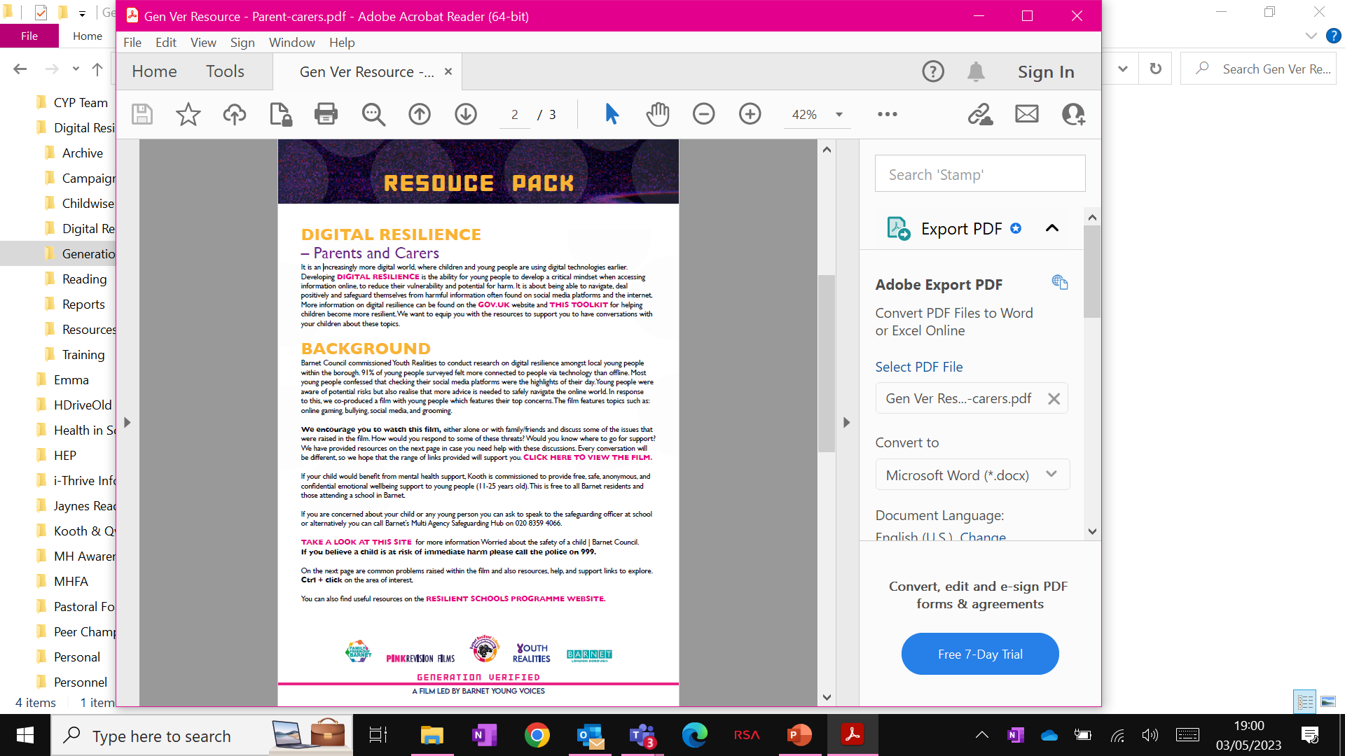

Slide 24
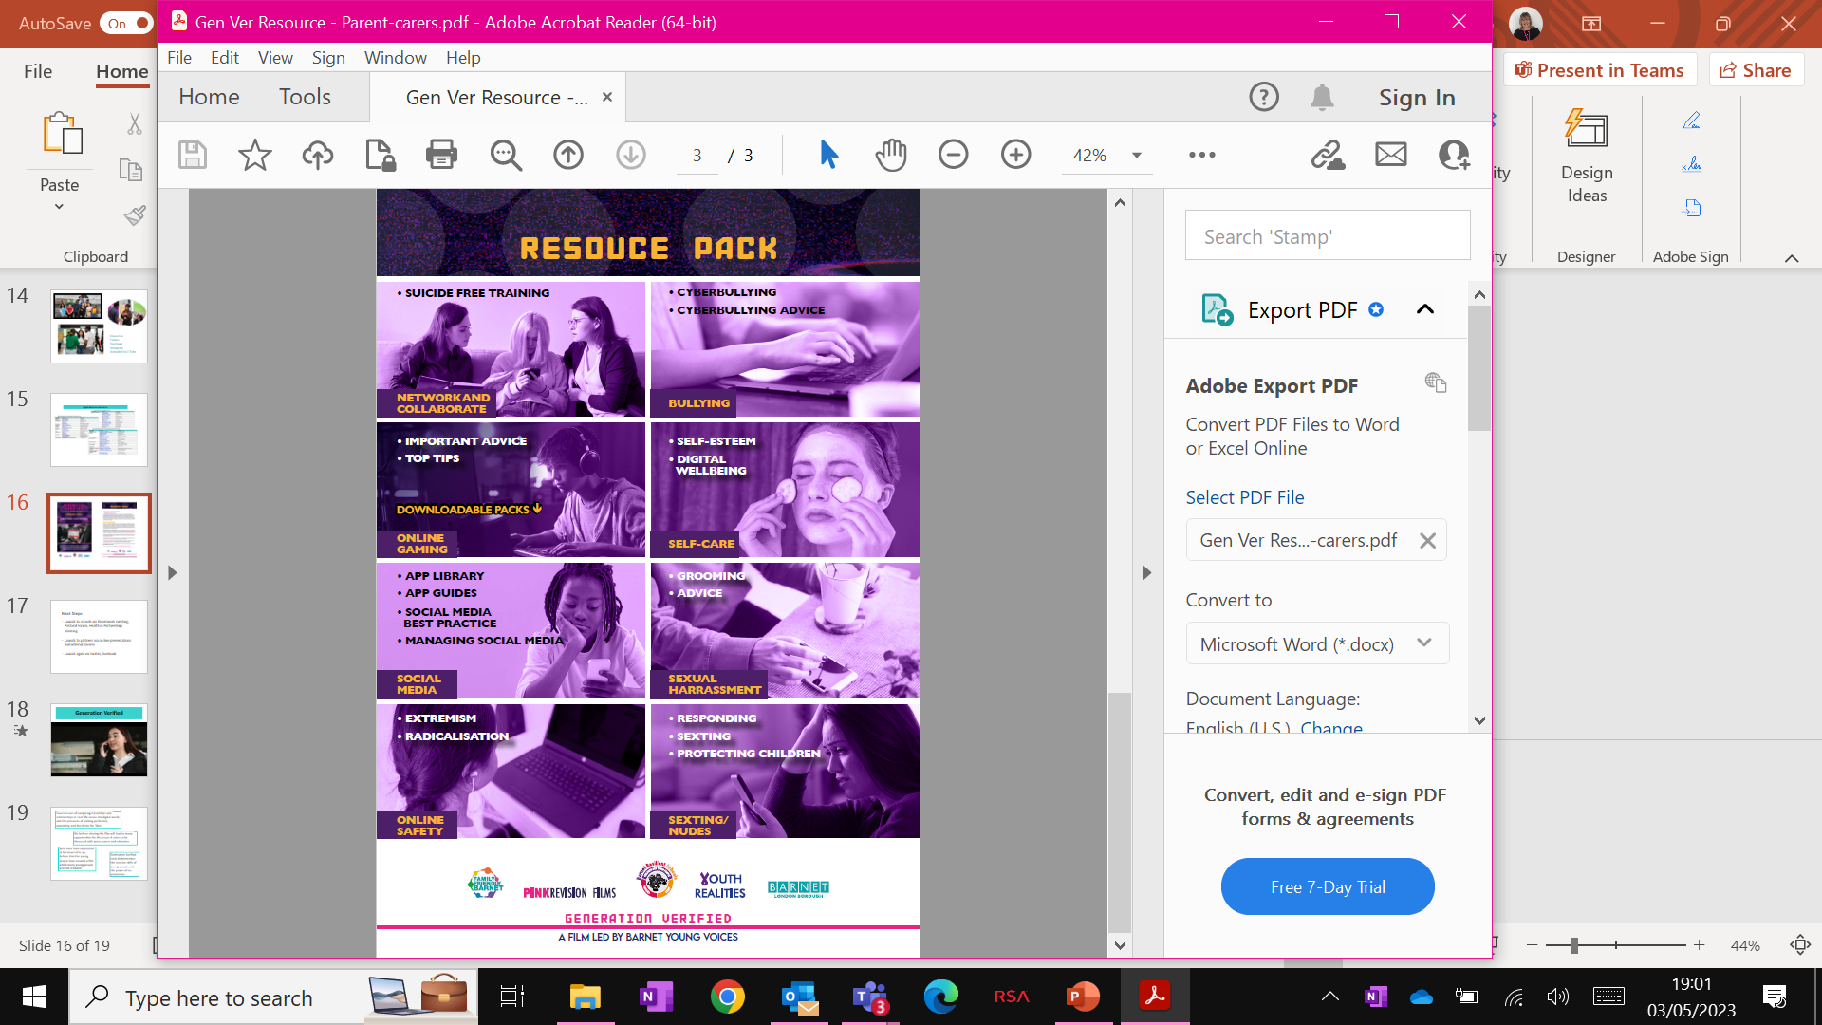

Slide 26
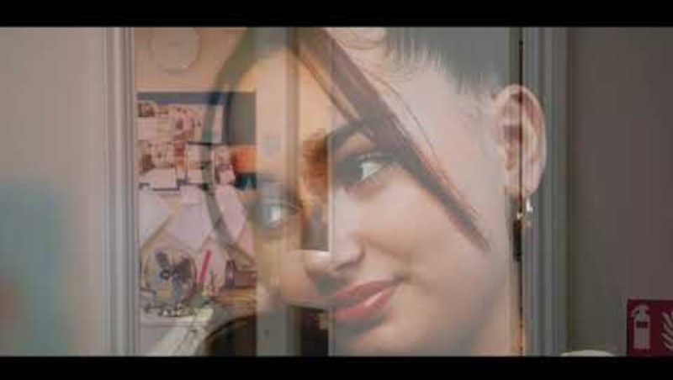
Generation Verified Film Led by Barnet Young Voices
Notes:
Poster?
(9) Generation Verified: A film Led By Barnet Young Voices - YouTube

Slide 27
Covers issues of navigating friendships and relationships in ‘real’ life versus the digital world; and the pressures of seeking perfection, popularity, and the desire for ‘likes’
We believe sharing this film will lead to many opportunities for the issues it raises to be discussed with peers, carers and educators
With their lived experience at the heart of it, we believe that the young people have created a film which many young people will find relatable
Generation Verified truly demonstrates the creative skills of young people and the power of co-production

Slide 28
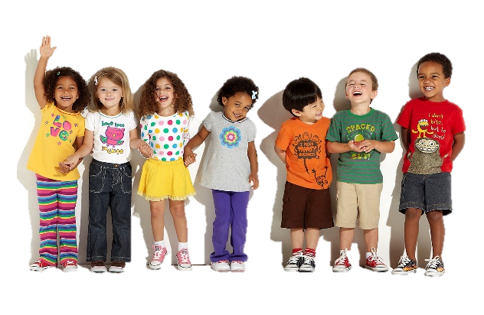
Any Questions?
Jayne.Abbott@barnet.gov.uk
Resilient Schools Programme Manger
CYP Suicide Prevention Lead

Slide 29
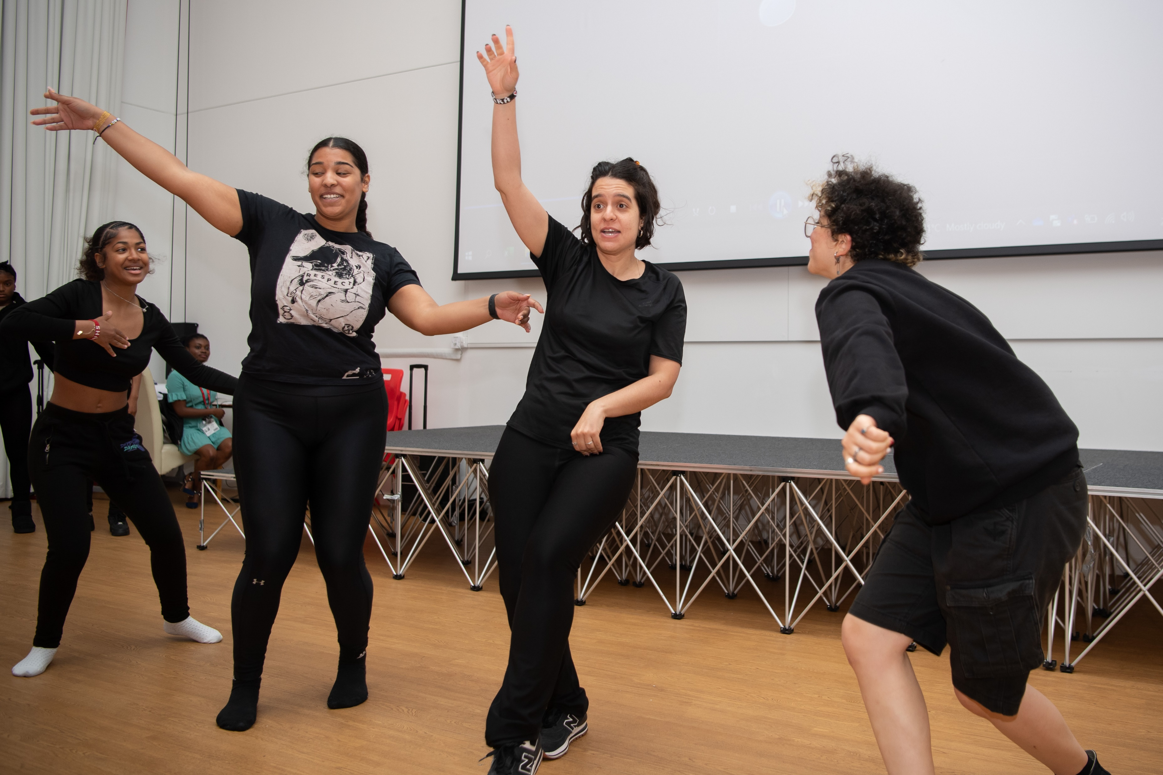

Slide 30
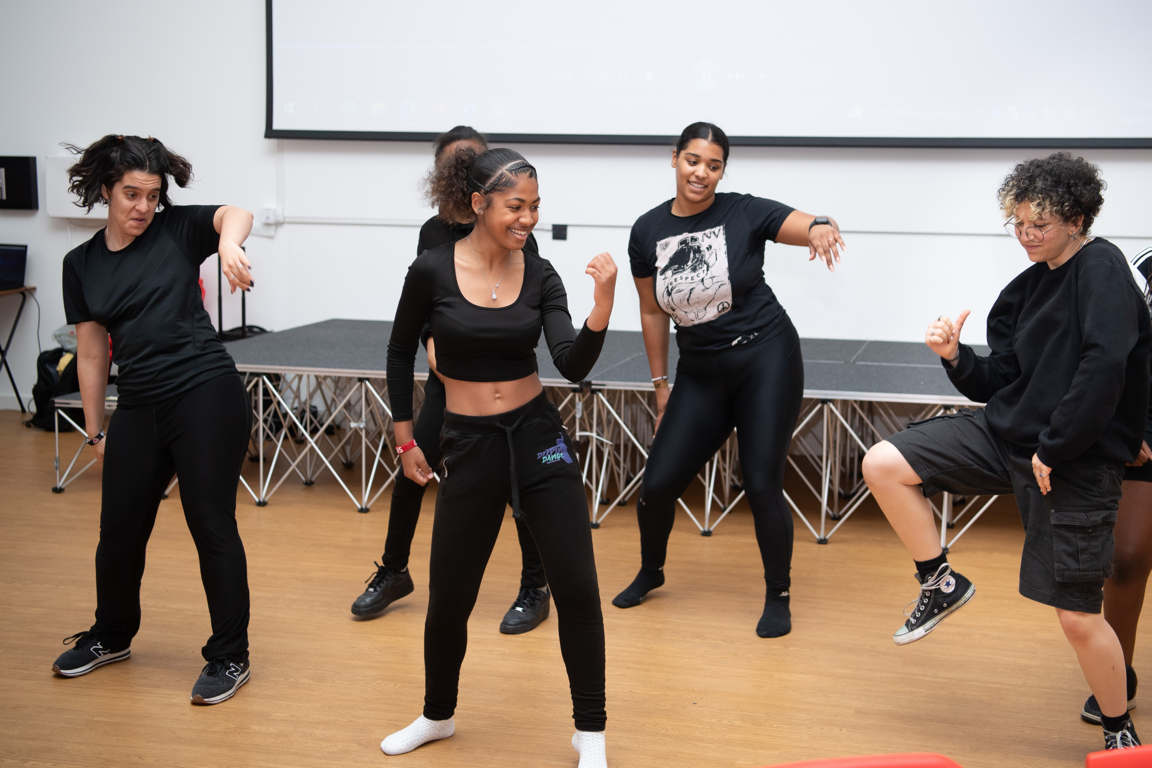

Slide 31
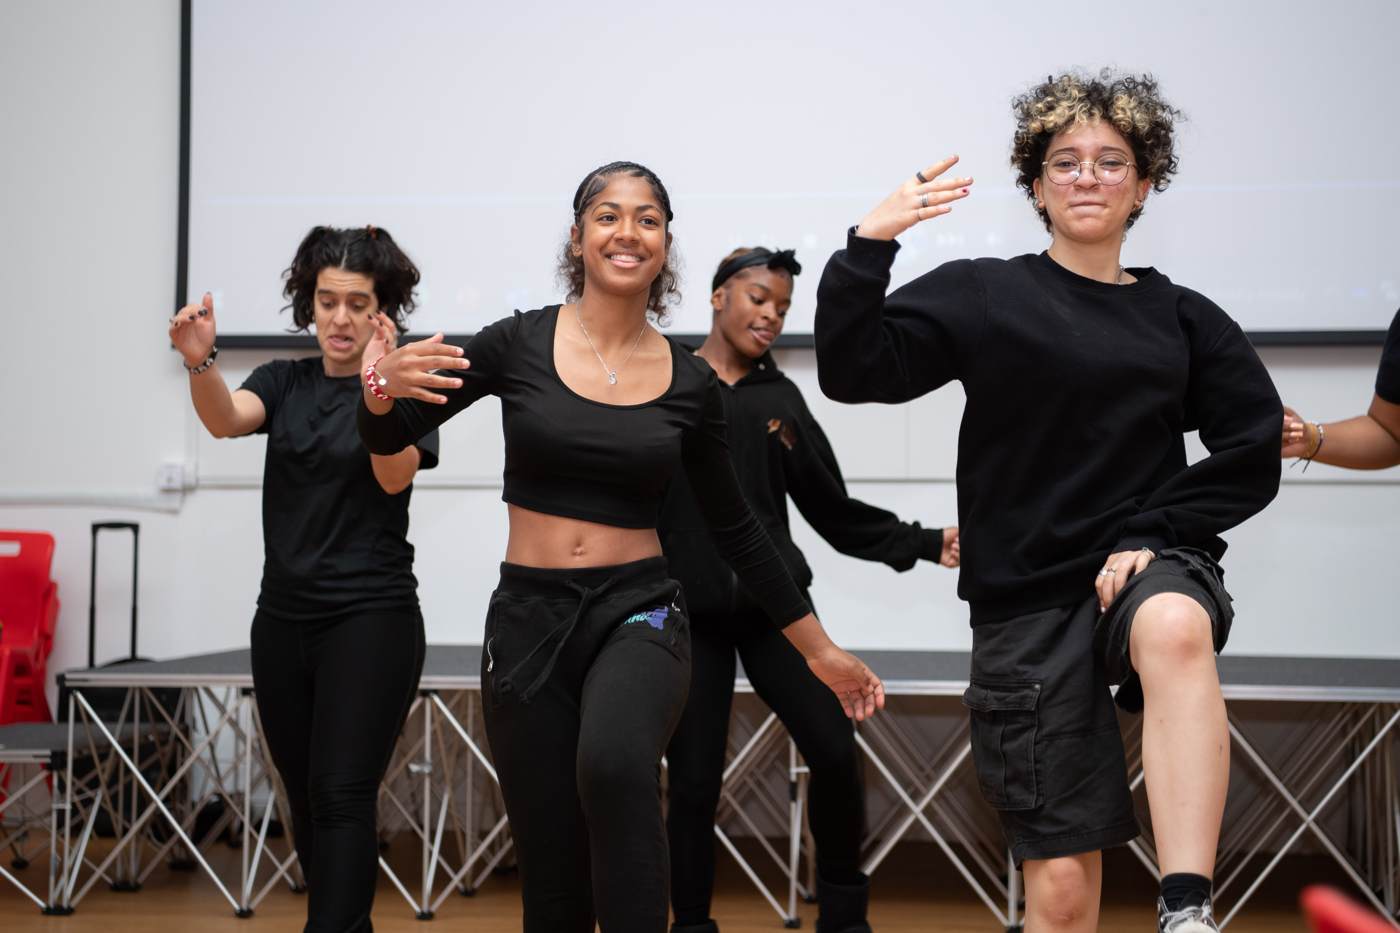

Slide 32
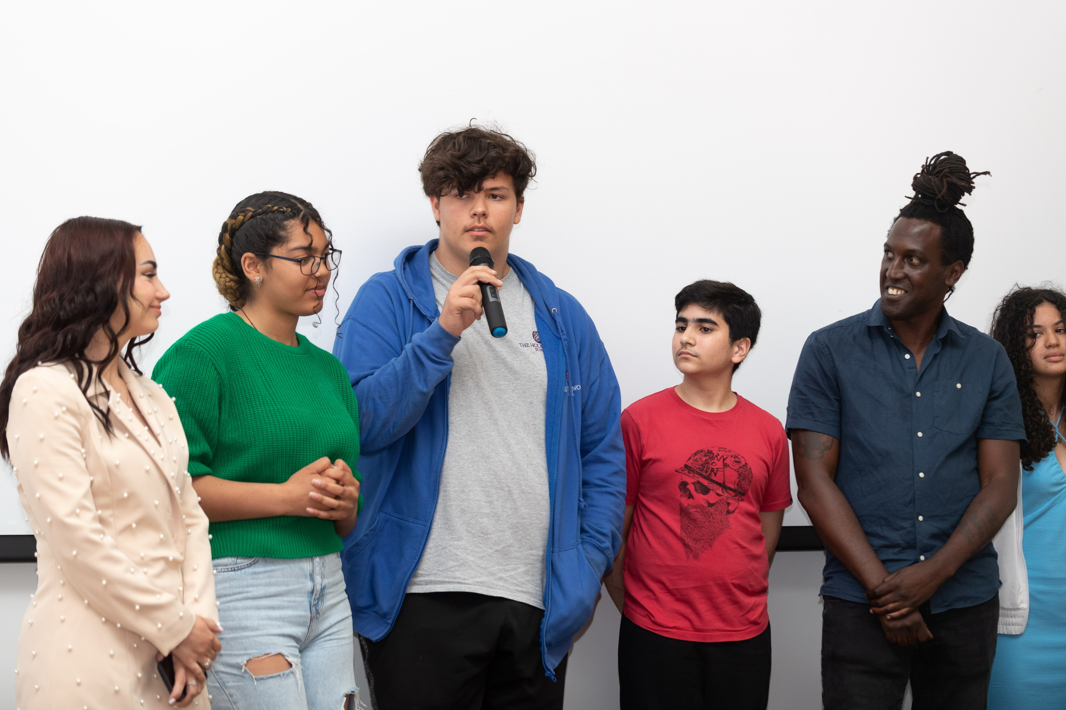

Slide 33
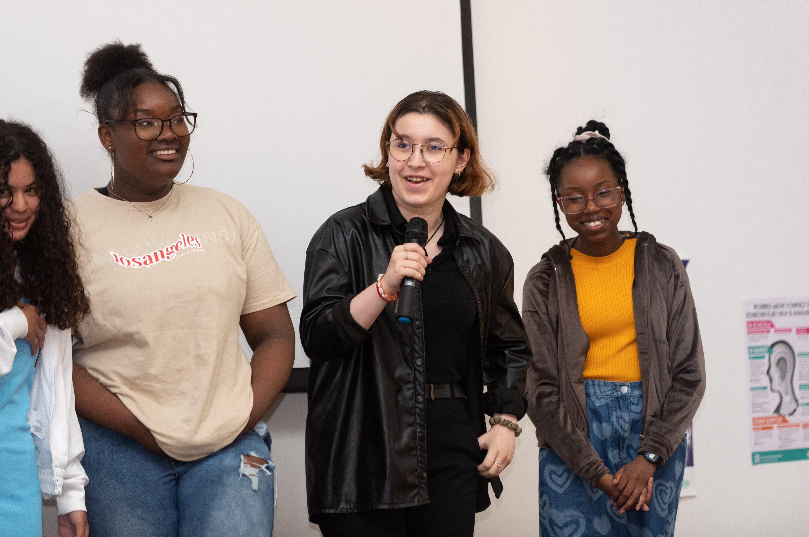

Slide 34
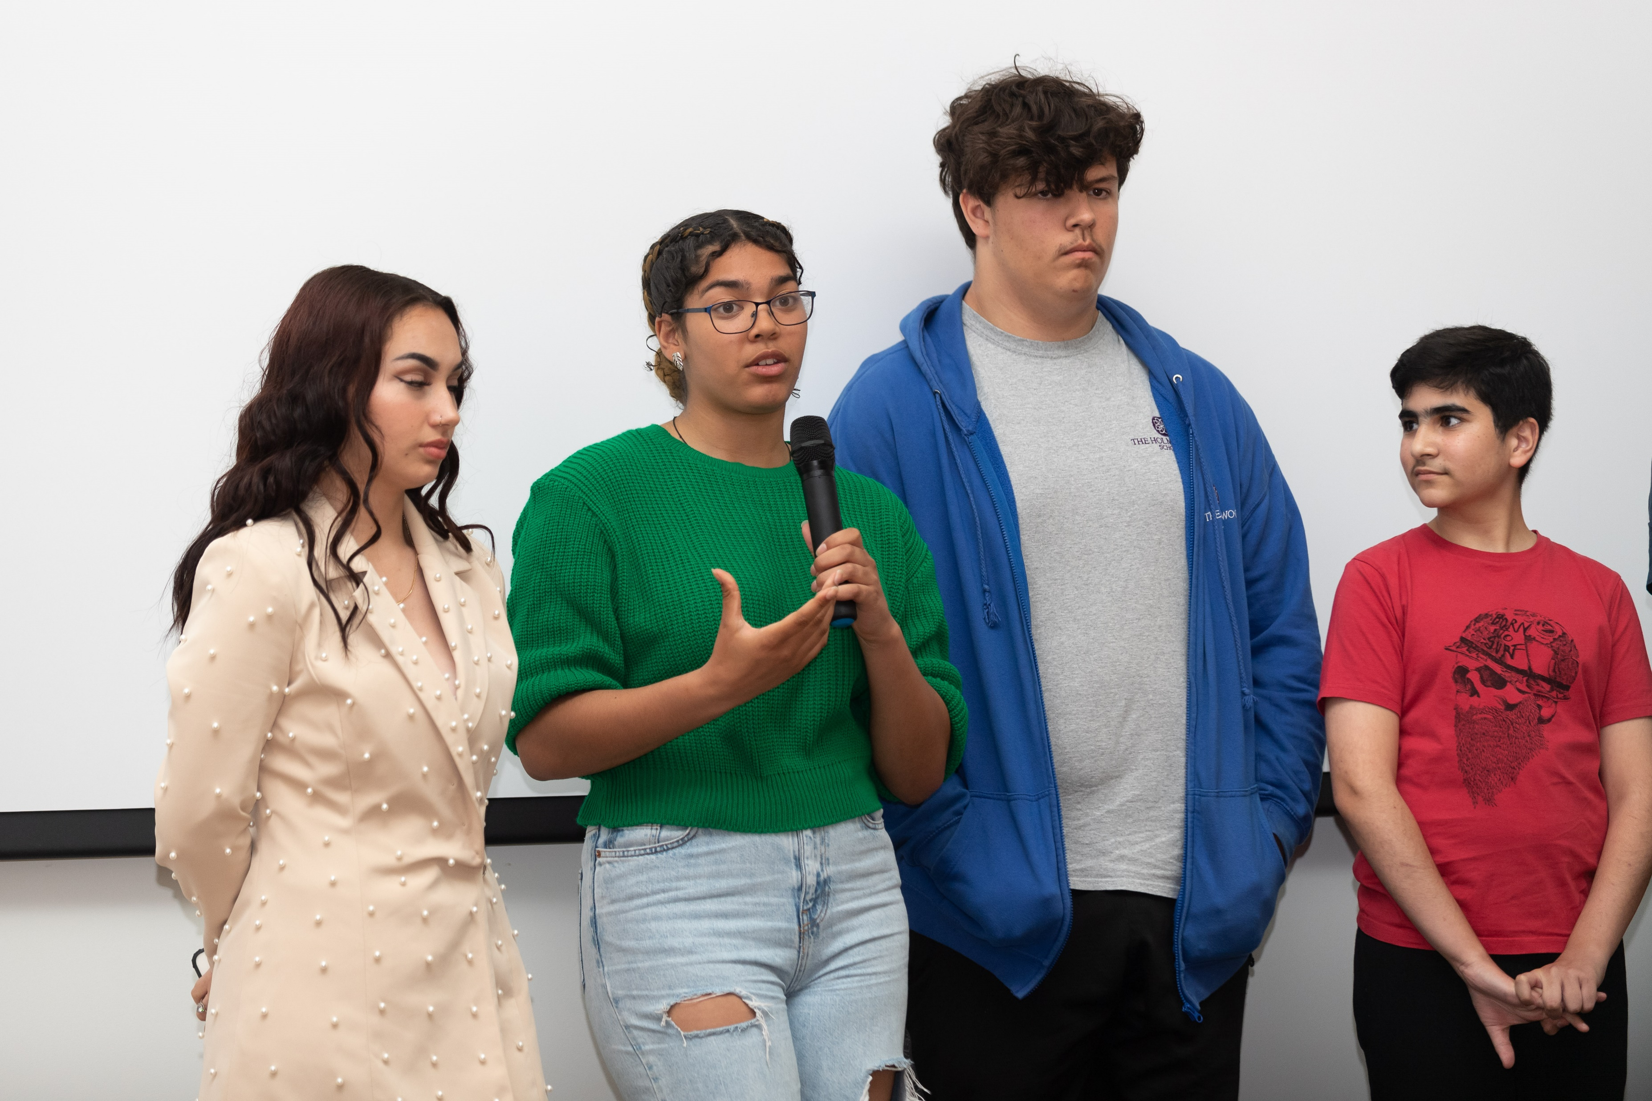

Slide 35
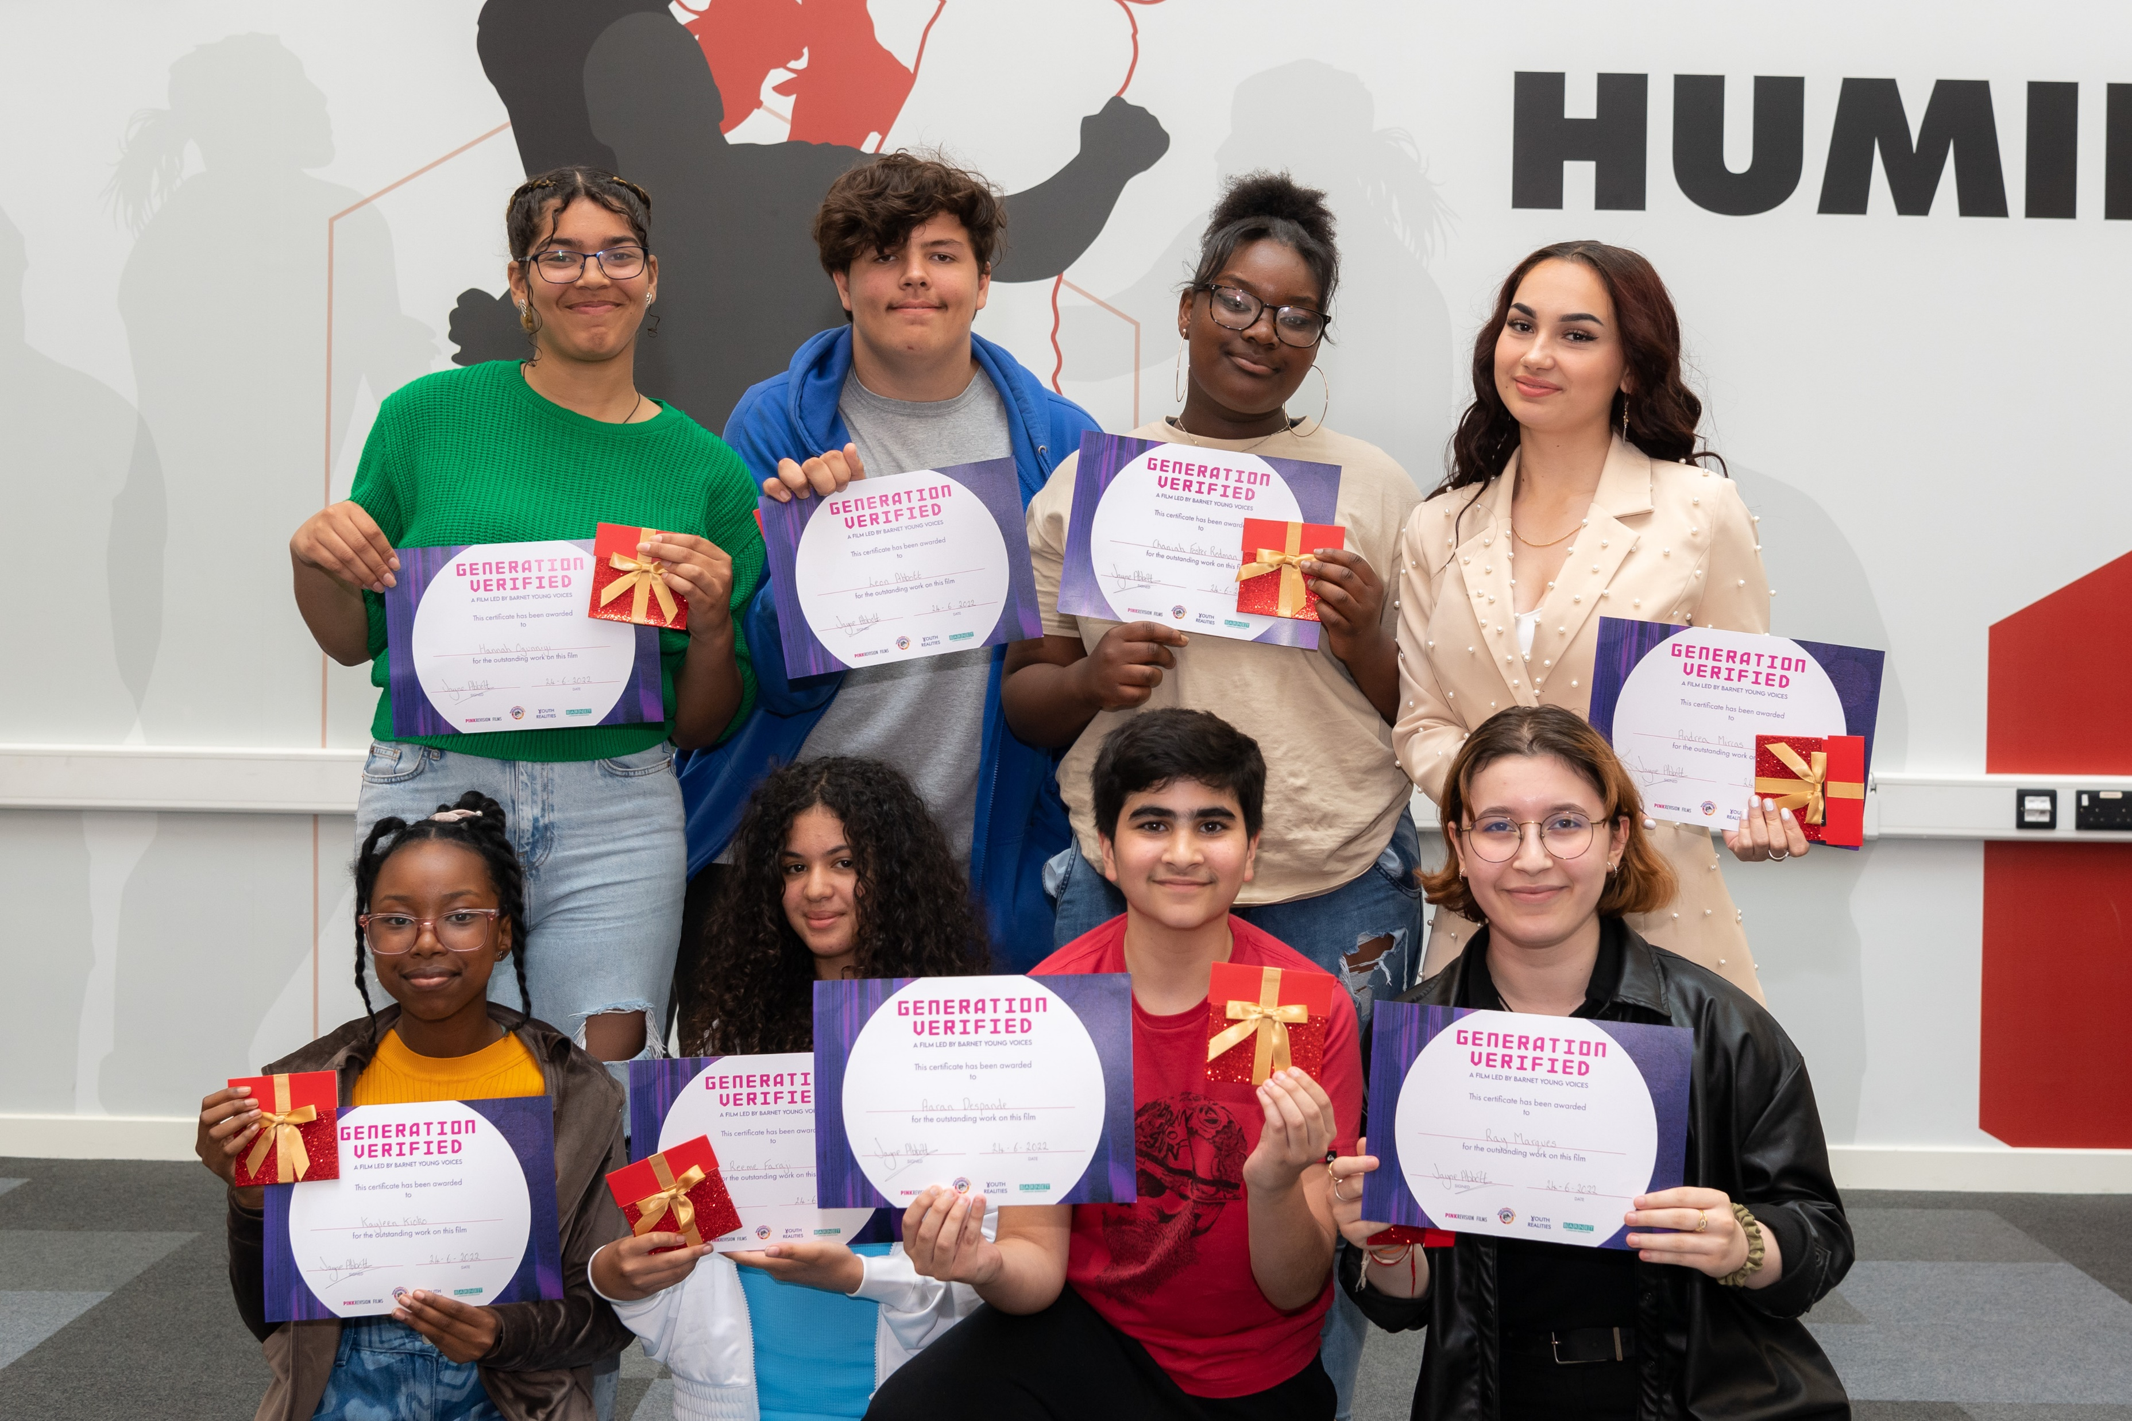

Slide 36
