Slide 1
Positive use of Digital Media
BICS MHST
Notes:
We're highlighting a selection of apps and websites recommended by NHS/CAMHS, covering various different strategies and techniques to support with a range of mental health difficulties.
We have received positive feedback from young people about some of the apps and they can be shared with young people and their families
We have selected these apps to highlight the range of positive digital media that is available and a Link to CAMHS website with more apps and resources can be found at the end of the powerpoint
All apps within the powerpoint can be access by clicking on their name

Slide 2

Support with mental health and wellbeing
Kooth - online platform
  1:1 support – Connect to a practitioner to receive support for mental health.
  Activities for wellbeing and helpful habits
  Forum – Talk with others about their experiences (e.g. anxiety)
  Articles – written by young people about their experiences
  Podcasts- Episodes discussing mental wellbeing and self-care
  Journals – A personal diary where young people can track their mood
  Kooth has its own TikTok and Instagram page dedicated to feel-good content and wellbeing tips
Notes:
Home – Kooth
Some of you are likely to be familiar with Kooth which offers various different types of support
Activities for wellbeing and helpful habits – e.g. creating a self-coping box
There is a forum for young people to share their experiences and read about other young people’s experiences.
The app/site has articles filled with themes of people who are going through similar difficulties.

Slide 3
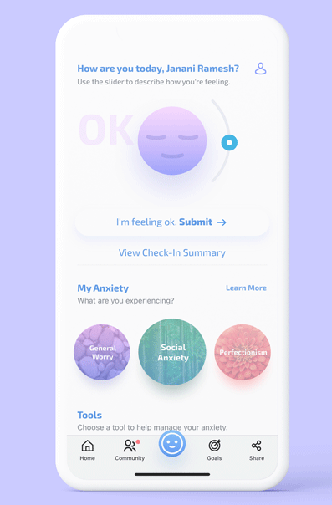
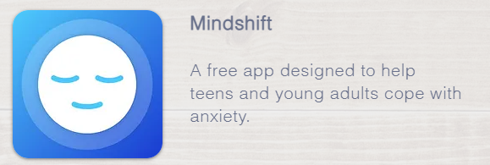
Support with Anxiety
MindShift App
Free Anxiety management app for teens and young adults developed by Anxiety Canada
Uses core CBT tools to manage anxiety
Has tips to manage different types of anxiety, facing your fears and building healthy habits
Includes a thought journal
Relaxation techniques
Notes:
Free Anxiety management app for teens and young adults developed by Anxiety Canada
Uses core CBT tools to manage anxiety (challenging thoughts and behaviours )
Has tips to manage different types of anxiety, facing your fears and building healthy habits
Includes a thought journal
Relaxation techniques
MindShift® CBT App | Anxiety Canada

Slide 4
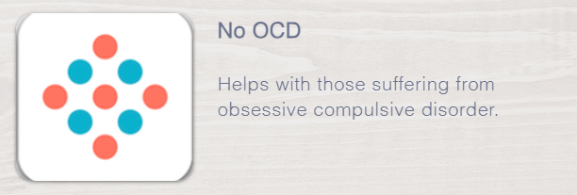
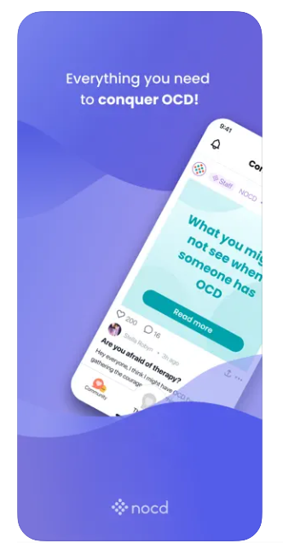
Support for OCD
No OCD
Specific help for children, young people, adults and families suffering with Obsessive Compulsive Disorder (OCD)
American app with possibility of receiving online support from therapists
Notes:
OCD Treatment and Therapy | NOCD (treatmyocd.com)

Slide 5

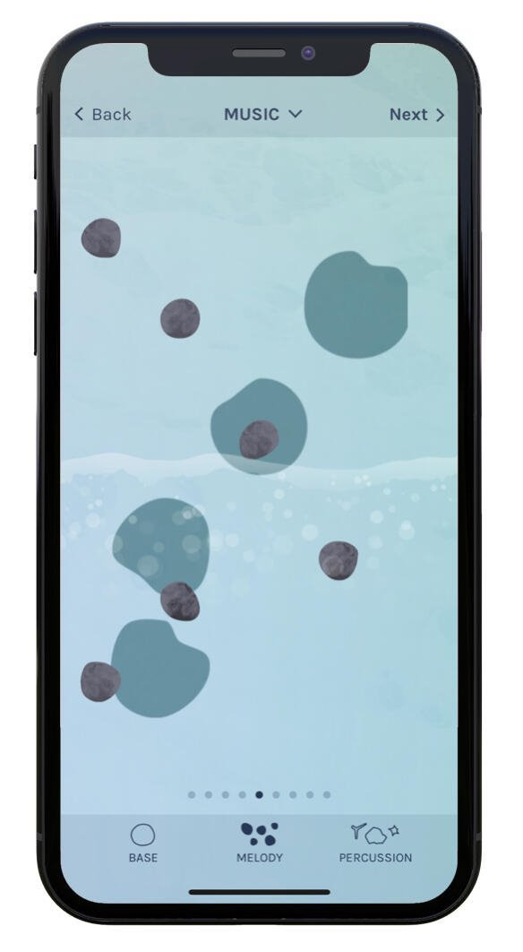
Support for expressing emotions
COVE
Create music to reflect emotions and help express how you feel
It can be easier for some to use if they struggle with emotional literacy or if they struggle to find the right words to speak about their emotions
Notes:
Can recommend to YP who don’t like journalling their thoughts or talking to people about how they feel
Cove (cove-app.com)

Slide 6

Introducing mindfulness to your daily life
Smiling Mind
A meditation program developed by psychologists and educators to help bring mindfulness into your life
The app has audio lessons to teach mindful meditation in different daily routine settings (e.g. in class, during sports).
The lessons range from short 1 minute lessons to longer lessons (e.g. 40 minutes).
Notes:
Lessons include calming breathing exercises and visualizations
App — Smiling Mind

Slide 7

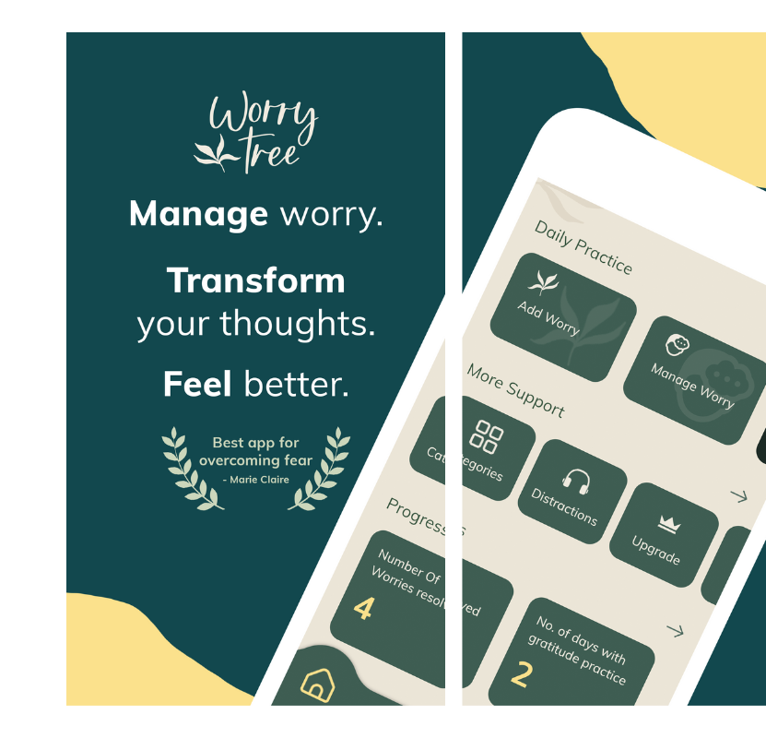
Helping you untangle your worries (and problem-solve)
Worry Tree
The WorryTree app aims to help you take control of worry wherever you are.
This app can help you challenge your worries using CBT techniques, supporting you to come up with solutions to tackle problems
Notes:
WorryTree Mobile App — WorryTree (worry-tree.com)

Slide 8
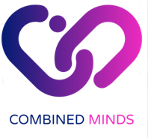
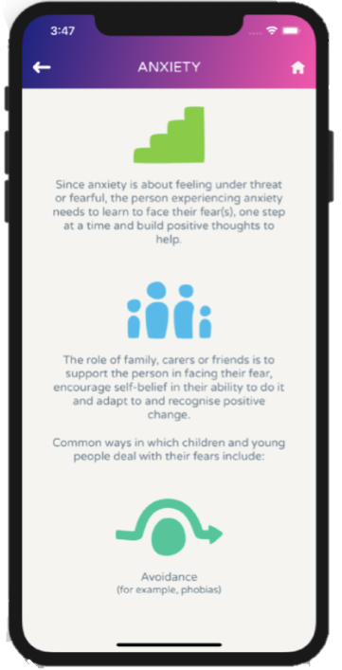
Guidance for Families
Combined Minds
Helps families and friends to provide the right environment to support young people affect their own change.
A ‘Strengths-Based’ Approach helping families and friends to search for their own strengths as well as the young persons, building resourcefulness and resilience.
Notes:
Home - Combined Minds App (stem4.org.uk)

Slide 9

Additional apps to explore
#
APPS | CAMHS Resources camhs-resources.co.uk
Mood Gym - An online cognitive behaviour therapy program for YP from ages of 16+ to learn skills to manage anxiety and depression. Developed by the Royal Australian and New Zealand College of Psychiatrists
Notes:
HOME | CAMHS Resources (camhs-resources.co.uk) a list of Apps, websites and videos for young people, covering a range of different emotional and mental health difficulties and to support with Self
Mood gym is for 16+ years so sixth form moodgym - Interactive skills training for depression and anxiety

