Slide 1

Team Around the School
Restorative and Relational Practices in Educational Settings

Slide 2



Introduction
19 years as a secondary school teacher and Pastoral Leader
RJC Approved Facilitator Training (2015)
Essex Restorative and Mediation Practitioner Training (2023)
  Appointed in December 2022 to lead on Restorative Justice at Barnet Council.
  Passionate advocate of restorative approaches working across education, criminal justice, social care and community groups
Annie Henken
BA (Hons) Applied Social Science/Sport Science
PGCE
NPQSL
DSL

Slide 3
What is Restorative Practice?
A social science used to explore the creation of positive communities through the building, maintaining and repair of robust, resilient relationships that are resistant to challenge.
It works by tuning into and applying the basic principles of humanity such as kindness, openness, empathy and sincerity.
When conflict occurs, RP provides a framework in which to resolve it, prioritising the voice of those involved, supporting accountability and finding a solution to resolve the harm and minimise the chance of a reoccurrence.
RP is not simply as a response to undesired behaviour but an embedded philosophy that governs all interactions in staff rooms, classrooms and playgrounds.
Concepts that feed into restorative approaches include, Social Learning Theory, Operant Conditioning Theory, Cognitive Dissonance and Non-Violent Communication.
Notes:
1. Restorative approaches have been used for many years in indigenous communities around the world as a system of government, a method of law enforcement and as a way to share traditions and moments of cultural significance. It is characterised by the normalising of proactive, deliberate dialogue by never missing an opportunity to connect and it starts with a desire to do things differently.
2. It works because we actively and explicitly apply the basic principles of humanity to our interactions with others. Sometimes we are so fixated on what is going wrong and so conditioned to react to challenging situations, that we ignore the simple solution which is to invest in building a culture that is overwhelming positive and takes a proactive and relentless approach to securing the wellbeing of others.
3. Conflict is an inevitable part of life but when it occurs in an environment that has explicitly invested time in strengthening the bonds between its members, where a shared language enables the safe exploration of the impact of behaviour, both positive and negative, and where a standardised and repeatable framework for resolving conflict is applied, the outcome is overwhelmingly
positive.
4. When you choose to act with restorative intent, the personal benefits are huge. The intrinsic satisfaction you get from noticing and acknowledging things that add value to the community, instead of always defaulting to calling out things that detract from it is so fulfilling. Helping resolve a conflict by enabling those affected to have a voice and to take an active role in solving the problem, not only reduces the likelihood of a reoccurrence but supports significant emotional growth and the development of empathy, leading to better self-regulation and consideration for others.
5. As I mentioned, RP has it’s roots in social science taking the key principles from these theoretical approaches and packaging them up in a single achievable model for building a thriving community.

Slide 4


Schools are a microcosm of society and a place where children and young people can learn and practice social norms and expectations in relative safety.
Schools that operate restoratively can create a positive and productive environment in which to work and learn which has a measurable, positive impact on wellbeing.
People thrive in an environment that is unified, consistent, predictable, and fair – these conditions create emotional safety and can help relationships flourish, even when things go wrong.
Reduced number of incidents that that negatively affect the goals, values, attainment and ambitions of individuals and the wider community.
What are the benefits of Restorative Approaches in schools?
Notes:
If their frame of reference is a restorative and relational approach to relationships and they experience this in their daily interactions, as their characters develop, this behaviour should become grooved, part of their intrinsic sense of self. If we create daily opportunities for positive interactions that highlight the behaviours that add value to the community, these behaviours are likely to be adopted and when we treat conflict as a problem that needs to be solved between those affected, we can develop approach behaviour which is crucial for building emotional resilience. When we make it safe to take responsibility for harm that we cause and resolve it according to the wishes of those affected, we send a strong message about responsibility, developing empathy along the way.
2. When we make a daily investment into building, maintaining and repairing relationships, people experience a sense of belonging and these conditions can give comfort to those facing personal difficulties and challenges. This approach is not overly nurturing, in fact the degree of challenge is high, but it is mitigated by the application of appropriate support. When expectations are high, the chance of failure is also high, restorative and relational approaches create space for failure because we remove the fear associated with blaming and shaming by externalising these failures. If failure is not part of our intrinsic character, then it’s just another problem that needs to be solved. This further strengthens the development of approach behaviour leading to greater risk taking around complex problems. The intrinsic satisfaction of solving a difficult problem in a safe environment leads to emotional and academic growth.
3. I have spent a lot of time thinking about what I need as an adult to help me feel emotionally safe in a work environment and I keep coming back to these. If people at all levels of an organisation are unified in pursuit of a shared purpose or common goal, if they operate with consistency within agreed parameters and behave in ways that are predictable and fair, then the organisation and individuals who are part of it, will flourish. If my behaviour or output falls short of expectations and my superior offers challenge in a predictable and fair way, I will be more likely to accept the challenge and take steps to address my behaviour, especially if I know my superior’s intention is to help nudge me back on course to achieve our shared aims. Furthermore, if my superior has spent time building a relationship with me and routinely acknowledges the successes I have, when I need a nudge, I will not feel resentful and that my achievements have been overlooked.
4. One of the most significant benefits of RA is a reduction in conflict. When negative incidents are reduced, we can spend more time in the pursuit of goals and the fulfilment of ambitions.

Slide 5

When Restorative Practice drives our culture, ethos and values, we can:
Develop emotional literacy, truth telling, accountability, responsibility, self-awareness, empathy;
Improve behaviour, attendance, learning environment, teaching, self-esteem, social and communication skills;
Increase, happiness, pro-social behaviours, safety;
Reduce bullying, exclusions, conflict, need for sanctions, risky behaviour;
Create a safe climate in which to work and learn that has meaningful and robust relationships able to withstand challenge.
Notes:
Home | Restorative Justice 4 Schools adapted from.
1. Some of the benefits of a restorative culture are difficult to measure, but they are evident in the things we can measure. For example, young people operating in a restorative culture have a greater sense of self awareness and empathy and the safety created by restorative conferencing following conflict leads to a greater likelihood of truth telling since the process is predictable and fair. When children don’t tell the truth, it is because they have a fear of the unknown. They feel if they tell the whole truth, they will land themselves in greater trouble. In a restorative system, the child is reassured that their voice will be heard and the sanction will be proportionate and fair. This means that even if a sanction is applied following an incident, pupils are more likely to accept it and contribute to solving the problem because they have had a chance to tell their part of the story.
2. The measurable data consistently shows reductions in the number of behaviour incidents and reductions in the seriousness of incidents, decreases in suspensions and permanent exclusions and increases in attendance. This is down to pupils feeling more connected to school, having better relationships with adults and peers and a trusted system for dealing with conflict.
3. Strong relationships are the cornerstone of a restorative school that is why we need to view this as a culture change and not a behaviour management system (although it is pretty good at that too!). While these outcomes are desirable for the children, there is also a lot to take away in terms of what we want from the culture as adults. In restorative workplaces, the benefits include lower levels of stress and absenteeism due to stress related mental health conditions and better staff retention. Shared processes, shared language and a culture that values curiosity and problem solving approaches over punitive responses will attract and retain the best people and this is especially important in the current climate locally and globally.

Slide 6

What does RP look like in school settings?
Focuses on recognising and normalising behaviour that adds value to the community or helps individuals and the community achieve their goals.
Adopts a shared (affective) language to support the safe communication of feelings to resolve conflict or reinforce positive behaviour.
Commits to the use of a restorative conferencing framework to resolve conflict and harm, placing the onus on those affected to solve the problem.
Notes:
A daily commitment to engaging in activities and processes that prioritise meaningful communication and concern for the wellbeing of others creates a climate that is overwhelmingly supportive and when we give people a voice, we better understand their needs. This can help us fine tune our interventions but it also grows connections between the children that might not have existed before. When children connect with others outside of their immediate friendship group, in a classroom circle for example, it’s less likely they will end up in conflict with each other.
Restorative and relational approaches are further characterised by the use of affective language. This has its roots in the principles of NVC, developed by Marshall Rosenberg in the late 1960s and is a communication tool with the goal of first creating empathy in a conversation. The idea is that once people hear one another, it will be much easier to talk about a solution which satisfies all parties’. For example, ‘You’re always tapping your pen on the table, it’s so annoying, stop it’, invites conflict, while, ‘When you tap your pen on the table, I feel irritated because its hard for me to concentrate, so I need you to hold it still or put it down please,’ identifies the behaviour that is causing the problem in that moment, connects it to the impact it is having and provides a reasonable resolution to the situation. By regulating our own behaviour before we respond and responding with language that is non confrontational, we can preserve the relationship while achieving the desired outcome.
This format for resolving conflict reduces the likelihood of the behaviour being repeated and supports the recovery of those who experienced the harm. It works by supporting those who have caused harm to accept responsibility and creates an opportunity for the harmed to share the impact of the behaviour. It removes blame and shame, externalises the wrongdoing (you did a bad/silly/unkind thing, you are not a bad person) and treats it as a problem that needs to be solved. The onus is on the wrongdoer to suggest a way to repair the harm and once this has been agreed, they should be further supported to fulfil their promise. It has to be a tangible and realistic action, not just an apology, since this does not affect change.

Slide 7



Three Restorative Processes
Notes:
Here are three simple restorative process that can be easily inserted into any school culture. The beauty of restorative approaches is that you can repurpose existing systems and make very small changes to your normal interactions and routines with massive impact.

Slide 8
Circles
Conferencing
Affective Language
Notes:
1. A circle is a powerful tool for promoting connection and engagement. Restorative schools use them in various ways, for example, pupils can come together in a daily check in circle so that everyone has an opportunity to connect with the teacher and each other before the chaos of the day begins. This can yield important information about the mood of the children and can highlight any concerns that need to be followed up, before they escalate. It can also be a low stakes environment to quiz the children on their worries and concerns (show of fingers for nervousness about SATS), before workshopping those concerns with the children in a later session. Circles can be used to celebrate successes, problem solve around conflict or explore thoughts, feelings and emotions. The circle is a visual representation of togetherness. By removing the tables and chairs, we can promote engagement and participation. The use of a talking piece can further promote engagement by giving children time to speak uninterrupted. This is powerful.
2. Affective language is a great way to highlight behaviour that adds value to the community or behaviour that presents challenge. If you have ever done supply in another school or taught a class you don’t normally teach, you will be familiar with this infuriating scenario. ‘Can you stop talking please (pointing)?’, ‘Who, me?’, ‘No, you…’ and so on. The lack of connection here means that your intervention has missed the target and created a larger disruption that the one you have attempted to remove. Successful interventions start with an attempt to connect with the individual and it doesn’t matter how small this connection is, it will change the dynamic. ‘Hi, it’s Luca isn’t? Luca, when you talk over me, I feel really frustrated because its hard for me to make sure everyone understands so I’m going to need you to be quiet for a minute, thank you.’ Once Luca has complied, you can go back to him and check he has all the information he needs.

Slide 9
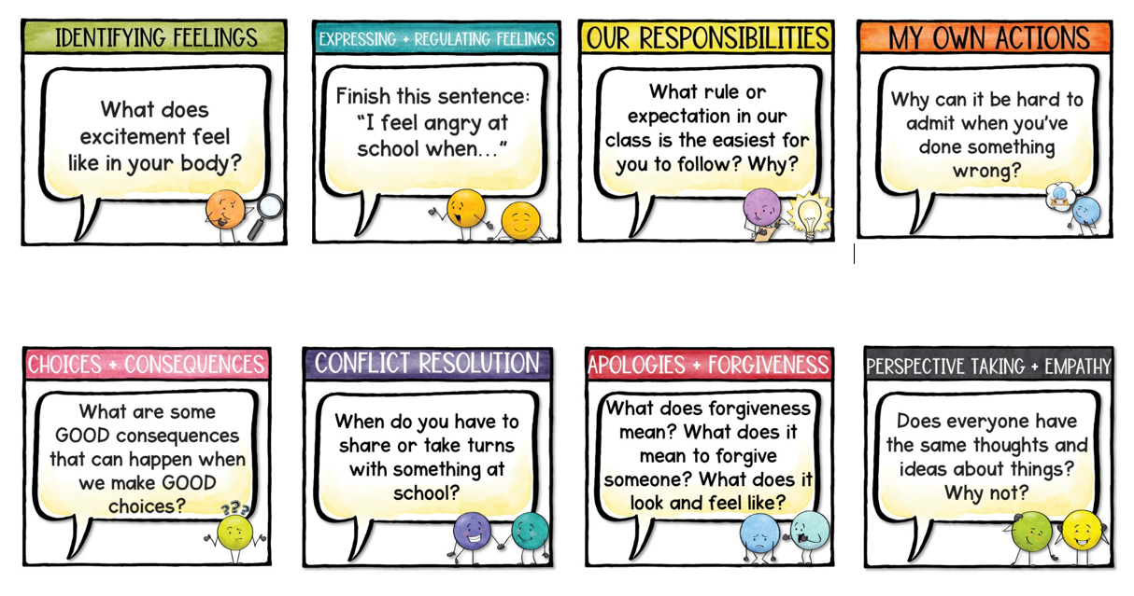

The Responsive Counsellor

Slide 10
When you…
Identifies the issue
Highlights your emotional connection to the issue
I feel…
I need…
The route to a satisfactory resolution or conclusion
Notes:
‘When you’ is an observation and it is important to be specific and avoid sweeping generalisations. For example, you always arrive late becomes, when you arrive late…It targets a specific behaviour that needs to be addressed.
‘I feel’ is your emotional connection to the issue which communicates feelings. When you arrive late, I feel frustrated. Notice the absence of the word ‘make’. You make me feel frustrated creates the possibility for debate or dispute (I didn’t make you feel anything…). Most people will be triggered into a feeling of remorse at the thought of causing another person to be upset or in this case frustrated. It’s linked to a useful concept called cognitive dissonance which is the feeling when two modes of thought contradict each other to create discomfort. In this case, the person arriving late may fully understand that being on time is important yet they still arrive late. When this is pointed out to them, they experience cognitive discomfort and usually seek to resolve the issue in order to return to a state of cognitive consonance.
‘I need’ states the action or the change in behaviour that has to occur in order for the harm to be repaired. I need you to arrive on time so no time is wasted and you don’t miss anything.
You could add two further parts here, ‘is that OK’ seeks to create an informal agreement or acknowledgement (try also, can we agree on that, do you think you can do that or something similar).
You could also seek to uncover if the person wants to communicate a need or a problem with arriving on time by asking, ‘is there something you need?’ You need to use your judgement here because if time is the issue, this may delay things further. You could offer to meet with the person privately after the lesson to discuss their needs or to explore the situation further.
It is important to remember your tone of voice, calm yet with a sense of purpose, your posture, maybe get down to the level of the person you are speaking to, to make the communication personal. We are not trying to generate feelings of shame and we are not blaming, we a trying to encourage refection and empathy in order to change behaviour around a particular situation.

Slide 11
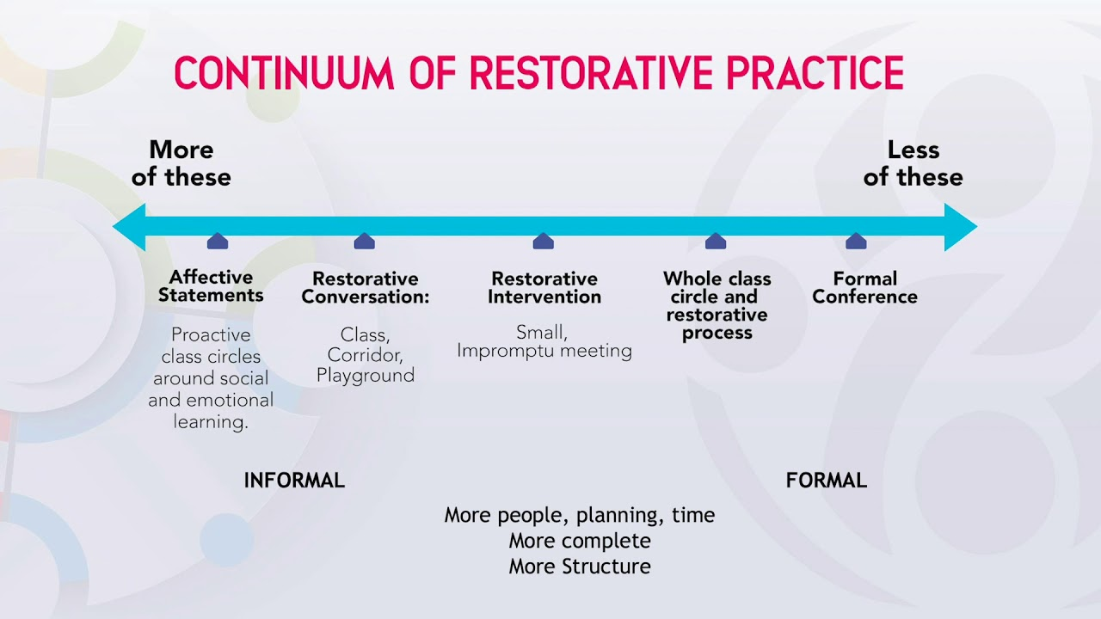
Notes:
I’ve talked briefly about the use of restorative conferences to resolve conflict and harm and it is useful if we view these on a continuum to really begin to appreciate how circles, prosocial modelling and the use of affective language all contribute to the creation of a restorative environment. If we invest time in building strong relationships, noticing the 20 children doing the right thing before privately correcting those who are not, create opportunities for children to listen to others and be heard, then we will spend the majority of our time in this side of the continuum. When things go wrong, if we treat it as an opportunity to come together to find out how those most impacted think it should be resolved, we encourage accountability, empathy and emotional growth.
Credit School Culture Solutions

Slide 12
Examples of good (restorative) practice
Line management meetings reorganised to prioritise ‘check in’;
Year 6 pupils co-designed new reward and recognition chart;
Pupils use affective language prompt card to resolve their own conflict;
Secondary school created RP delivery team to support colleagues with high numbers of behaviour points.
Painted RP resource on playground helping pupils to resolve incidents quickly so they don’t disrupt learning time.
Notes:
Building robust, resilient relationships – you matter to us.
Removing the shame and promoting ownership – working with leads to greater buy in. Behaviour has improved as a result.
A reduction in behaviour incidents needed further intervention and numbers of reported behaviour incidents on CPOMS reduced.
Trained colleagues in de-escalation and relationship building and have experienced a reduction in negative behaviour incidents and an improvement in relationships between teachers and pupils.
Feet activity embraced by most schools.

Slide 13
Restorative Practice and Safeguarding
Restorative interventions around bullying should invest time in working with the harmer to develop empathy, truth telling and personal accountability
Schools should normalise ‘telling’ as a way to create a safe culture for all and encourage talking through proactive circles
Family conferences can have significantly positive effect in reducing bullying. It is important to involve parents and carers to ensure the message is consistent
Separating the behaviour from person leaves the door open for acceptance of the wrongdoing by the harmer, reconciliation, repair and reintegration into the community – belonging is crucial
Peer mediation and trusted peer programmes can create high levels of safety in the community
Zero tolerance is largely incongruent with restorative approaches. A high challenge/high support framework is more inclusive, although the need for safety is paramount
Allyship can be used to develop an understanding of cultural and identity differences and can be a powerful antidote to conflict
Bystander training can create safety for those at risk of harm in the moment
Sanctions need to be supported by restorative conferencing to ensure that the harmer acknowledges their role in the wrongdoing and the harmed feels safe and reassured
The development of character feeds directly into the Ofsted inspection framework and schools who have robust, pupil centred anti-bullying policies can meet personal development objectives (although this should not be the driver)
All schools have values. To what extent are these values modelled on a daily basis so they become ‘who we are’?
Notes:
In relation to safeguarding, there are a few benefits that really stand out such as the creation of conditions where telling is normalised and communication skills, especially talking are actively practiced in safe proactive community building circles. Creating a safe space for the harmer to talk about their experiences without the fear of additional consequences (presuming there has already been a sanction issued because we are using RP to support the entire behaviour process), is a powerful and effective tool in tackling bullying. And as you can see there is a big emphasis on creating a space where everyone can belong, since separating the behaviour from the individual makes it external to the individual, not an ingrained part of their character which leaves the door open for amongst other things, reintegration into the community.
I would add that the process of building community through restorative practices places a large emphasis on dialogue circles. Dialogue circles are a way to check in and out with students. The protocols require the strict adherence to collaborative rules around participation so that everyone feels safe and empowered to contribute. When we normalise talking about thoughts and feelings around different, everyday issues in a safe space such as that we create in well managed dialogue circles, when it comes to resolving conflict or discussing more serious issues, the familiarity and safety of this approach can yield really good results.
So, RP can really support effective safeguarding through the formation of an open and nurturing culture that values the thoughts and opinions of the members. Creating more frequent and structured opportunities for dialogue builds trust which can support young people with their mental health. It could even give young people greater confidence to make a disclosure.

Slide 14


