Slide 1

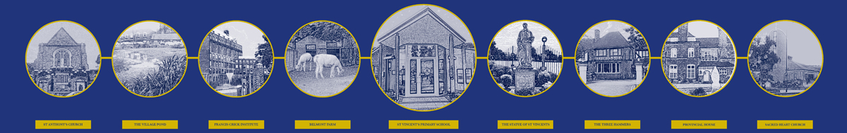
St Vincent’s Catholic Primary School
Supporting children’s wellbeing and supporting safeguarding through the outdoor environment.

Slide 2

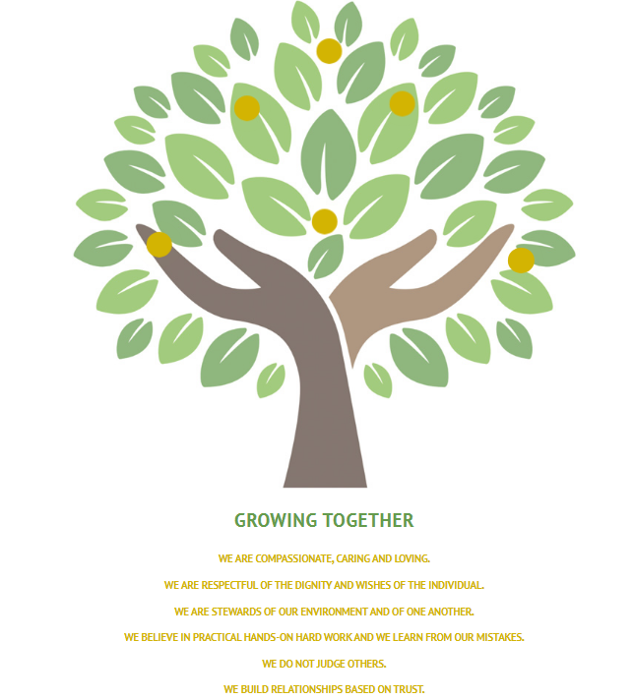
Our school
Ours is a popular primary school catering for pupils from the age of 5-11. The school is situated on the Ridgeway and has been operating for over 125 years.
The school and children use our Vincentian Values as guidelines on how to be the best that we can be.
Notes:
Context

Slide 3
Context
Our school currently operates on a one and a half form entry schedule.
E.G
Year 1 (30 of the youngest Year 1 children)
Year ½ (15 of the oldest Year 1’s are paired with 15 of the youngest Year 2’s)
Year 2 (30 of the the oldest year 2s)
This repeats throughout the years with one mixed age class in each key stage.
We currently have 275 children on roll.
10% of our school population have an EHCP and over 25% have an identified SEN need.
13% Pupil premium.

Slide 4
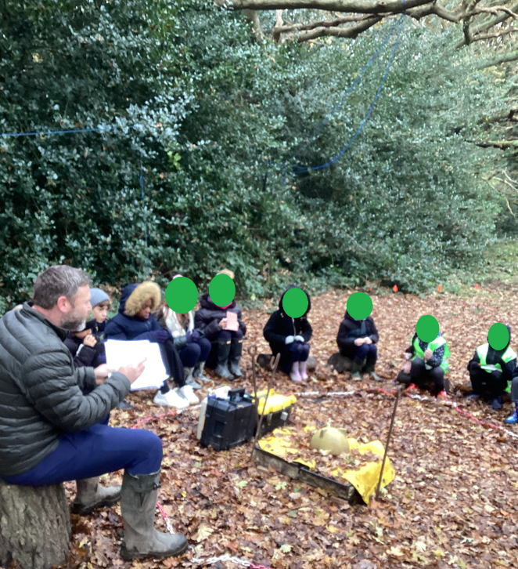
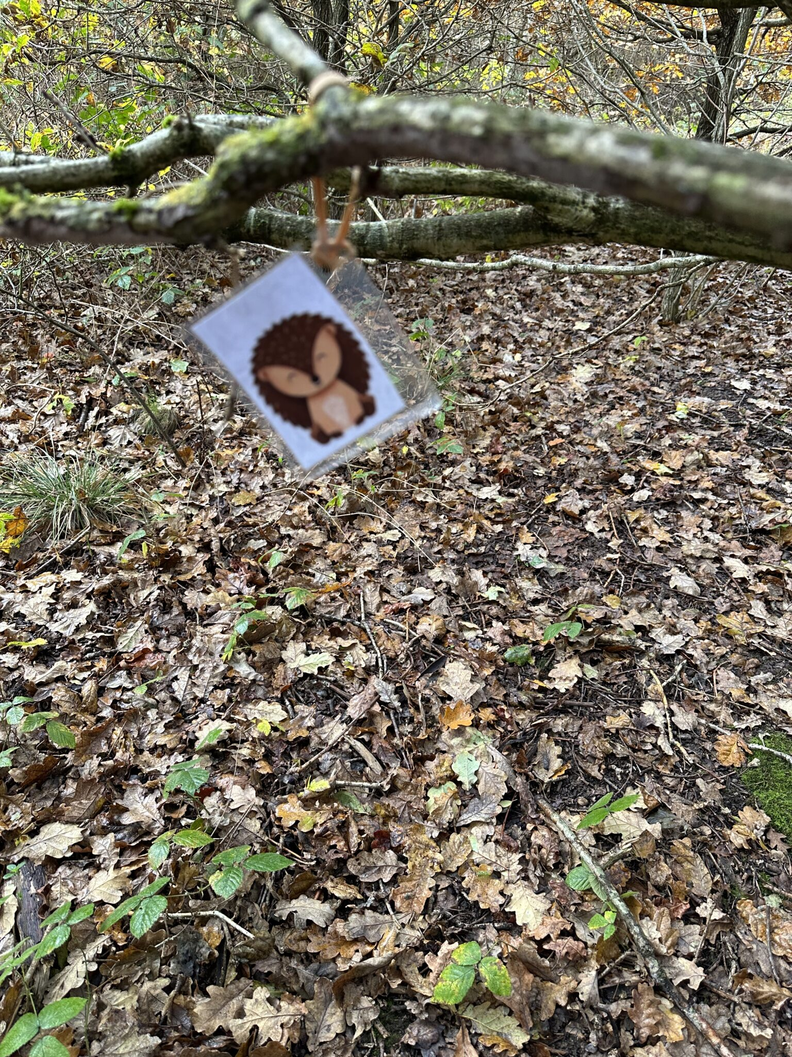
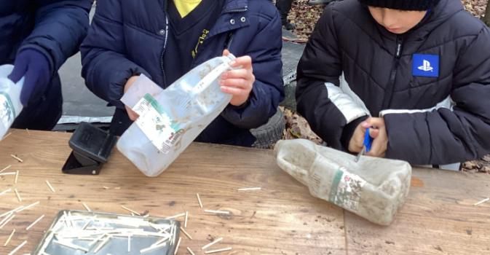
Utilising the outdoors
Our outdoor learning initiative aims to foster children’s love of learning. At St Vincent’s Catholic Primary School, we believe that all children have the right to experience the unique and special nature of being outdoors. We further believe that it is important to enable children to use the outside environment as a context for learning.
Children in Nursery and reception visit the forest every week with our fantastic forest lead and class staff to build upon their understanding of the world around them, resilience and how to build effective relationships.
This occurs in sun, rain and even snow and is rarely postponed. Each session ends up in a cold or warm drink for children and a biscuit. On special occasions they may make smores!
It coincides well within our project based curriculum where children may be tasked with building shelters, reading maps, identifying the flora and fauna present or even comparing human and physical geographical features of another country to ours.

Slide 5
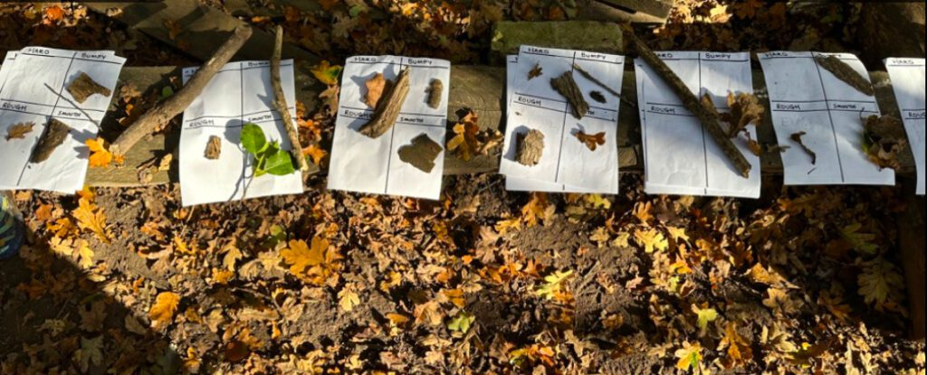
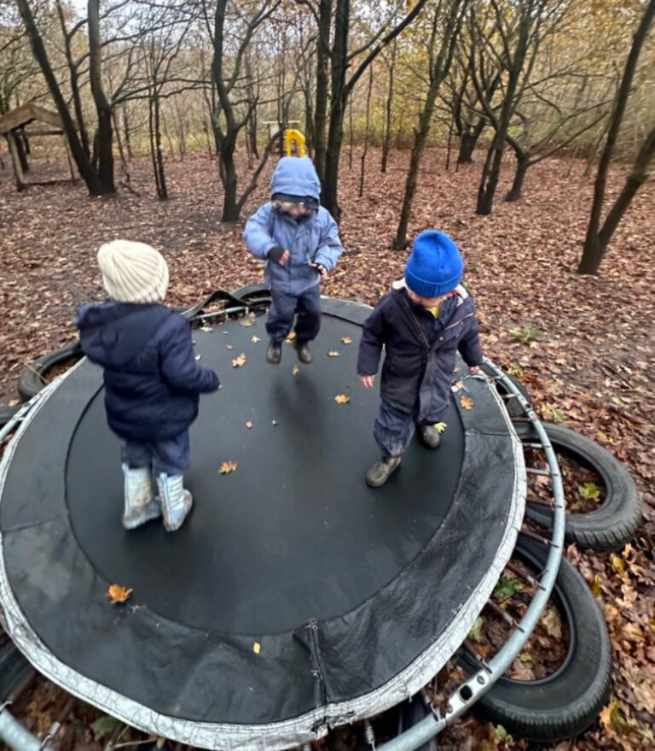
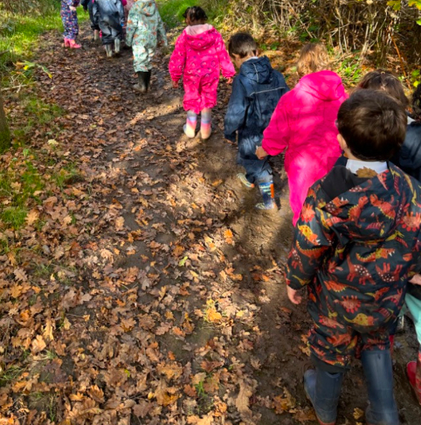
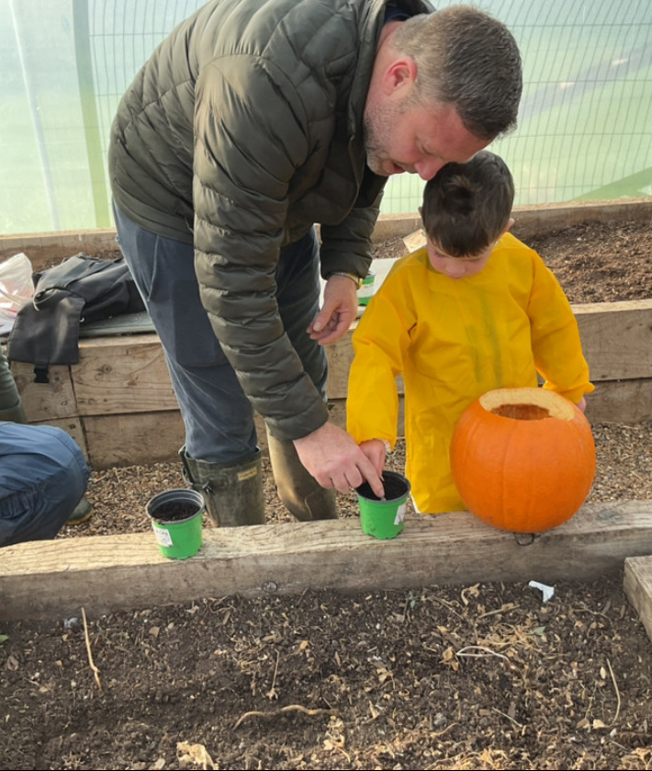
Children in Year Six have developed the forest and each year our leavers will add something new of their own design to the forest as they leave their mark on the school.

Slide 6
Wellbeing and safeguarding
Our intended results are
To empower children to take ownership of their learning, allowing their minds and bodies to thrive
To encourage children to develop the skills to solve problems, and become resilient and reflective learners
To develop skills of communication, cooperation and collaborative learning.
To provide a challenging, safe and secure environment within which children can take and manage risks.
To encourage close links with parents and the school in celebrating our outdoor space and the rich learning that can take place within it.
To encourage children to care for their environment.
What actually has happened?
Children receive an opportunity to connect with the outdoors in a way they may not have at home.
Children (and adults) have learnt resilience and how to get up when they literally fall on their face.
Intervention groups to support particular children who struggle within the class environment.
Growing clubs in our polytunnel
A number of safeguarding disclosures made by children while in the outdoors with time shoulder to shoulder with adults.
Walking and talking informal therapeutic like interventions.
Identifying children who have marks on their bodies when changing and this is addressed.

