Slide 1







Slide 2

Agenda
09:00 | Refreshments & Networking |  | 30
09:30 | Updates (feedback from Menti Slides) | Debra Davies Sarah Leighter Jayne Abbott | 40
10:10 | Big Dog Little Dog – Peer Champions | Kevin Moore | 20
10:30 | Be Brave Be Bold Resilience Programme Thrive and Rise Therapy Programme | Laura Spencer | 20
10:45 | Round up of Services in the Room | All | 15
11:00 | Networking with services and colleagues / Comfort Break
11:30 | Sharing Best Practice | Schools | 30
12:00 | Case Consultations / Support from Services | All | 30
12:30 | Close
Notes:
Next meeting – Housing and homelessness (recognising statutory obligations)

Slide 3



Team around the School
Community of Practice Meeting
Reduce the amount of times schools attend meetings
Advice and support in one place
Building relationships with services
Building relationships with each other
Sharing best practise
Sharing new initiatives
Celebrating what we do together
Case Consultation

Slide 4
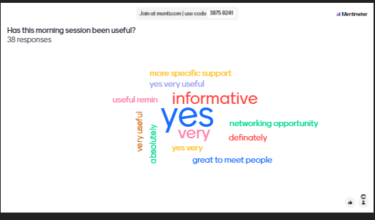
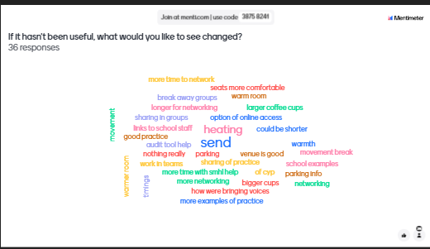
You Said (menti responses)……..

Slide 5

Child and Family Early Help

Slide 6
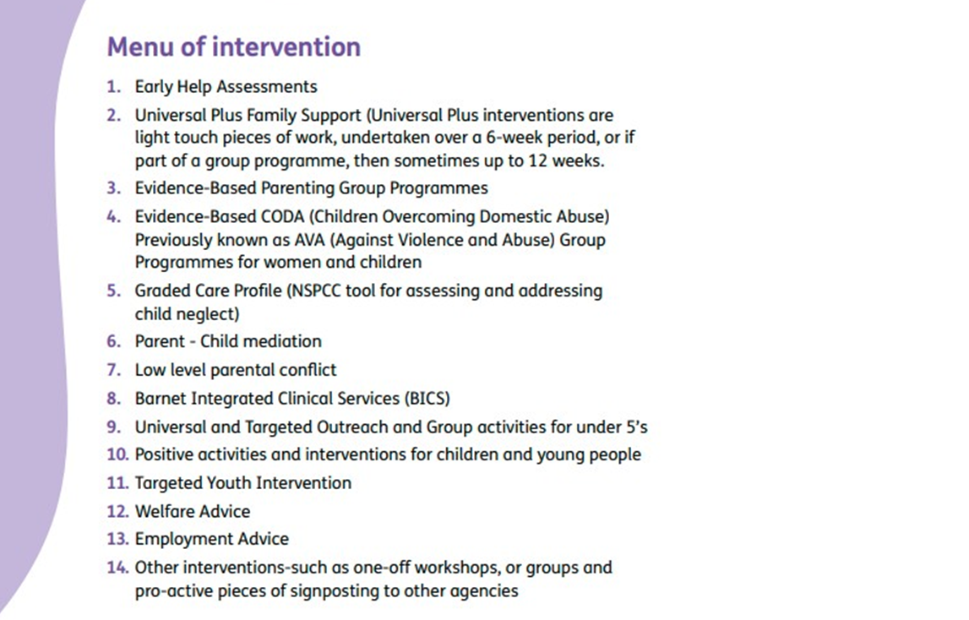

Slide 7

Overall Data: Summary of Performance
Type | All Hubs
Open Cases | 726 Open Cases 299 cases in the East 215 cases in the West 193 in the South
Step Up | 71 Cases stepped up in the last 6 months
Step Down | 170 Cases Stepped down in the last 6 months
Needs Met | 802 closures in the last 6 months 619 cases where needs were met 124 cases where needs were partially met 59 families did not wish to engage.

Slide 8
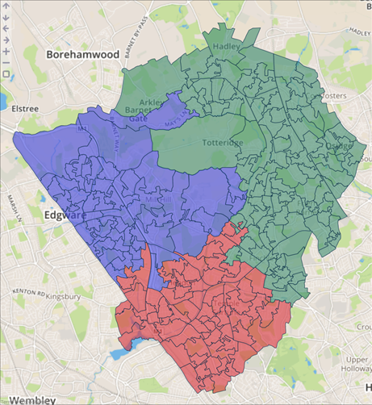

Location of the 3 Hubs
January 2018
West Hub
East /Central Hub
South Hub

Slide 9
What next?
By integrating Early Help and BICS services, we will create multi disciplinary teams that will be able to respond to need and provide a truly preventative service to children and families in Barnet.
Staff will have opportunities to further develop and deepen their knowledge of support and systems which will give them opportunities for their own professional development.
By creating a single referral pathway, children and young people will get the right help and support at the earliest possible time

Slide 10

“Team around the School”: a proposal
Link C&F EH practitioners and link BICS practitioners working together across groups of schools in each locality
Combination of schools with higher-level/lower-level needs enabling higher/lower intensity of support
Feeder primary and receiver secondary schools sharing link practitioners, following the journey of the child
Bespoke service for schools:
    Regular meetings/sessions at schools
    Consultations, advice, training for staff
    Supporting parents
    Providing information, signposting, supporting access and knowledge of local services

Slide 11

BYCAS
https://barnetyoungcarers.org.uk/think-young-carer/

Slide 12
Notes:
BICS is a Children, Young People and Family (CYP) Mental Health service
If you would like to contact the BICS team, please e-mail BICS@barnet.gov.uk
If you need to talk to us, please call our Support Line on 020 8359 3130
The BICS Support Line is currently open from 09:00 to 17:00 hours.
For further information please see www.barnet.gov.uk/bics CYPs can visit Talk about it | Barnet Council for resources
If you/your child are under 18 and need urgent help in a mental health crisis, please call either 999 for emergency services or the 24-hour Barnet CAMHS crisis service on 0800 151 0023.
Use of the self assessment tool within MHST schools already (to be talked about in more detail by Resiliant Schools who use the same tool), access to our support line, linked BICS practitioners for many schools already in place, referrals for targeted group, 1-2-1 and family support, as well as train the trainer sessions for schools and parent/carer workshops in the community. Support available in schools, the community and in social care and youth justice settings. CI support as needed.

Slide 13
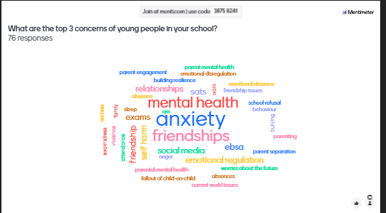
You Said (menti responses)…………
Notes:
Train the Trainer sessions last term ran on EBSA. Previously Friendship covered for primary schools with a secondary schools and parent workshop currenlty in development. Parent led anxiety workshops run every term as standard, as well as an EBSA workshop last term.
For those schools who are part of the PINS project (Partnership for Inclusion of Neurodiversity in Schools), the mental health offer includes workshops for parents and school staff on either anxiety, EBSA or emotional regulation.
Will be interesting to look at the results of the your voice survey and whether this matches these answers.
How have individual schools taken and further steps towards managing any of these worries?

Slide 14
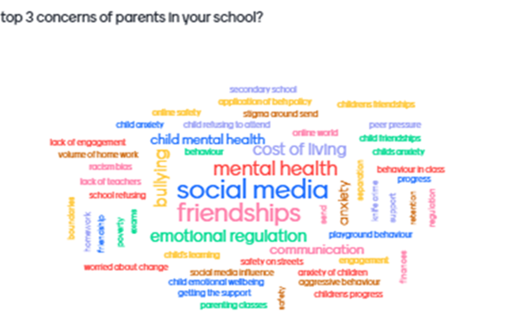
You Said (menti responses)…………
Notes:
Parent/carer workshops
Coffee mornings
How have individual schools taken and further steps towards managing any of these worries? Did any schools involve parents in anti bullying week last term?

Slide 15
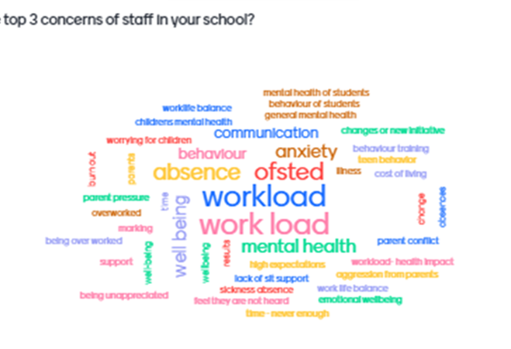
You Said (menti responses)…………
Notes:
How have individual schools taken and steps towards managing any of these worries?

Slide 16

Dates for the Diary
3rd- 9th of February : Children’s Mental Health Week
12th Feb: Low Mood/Low self-esteem parent/carer workshop
5th and 12th March: Two-part Anxiety Management parent / carer workshop
April: Stress Awareness Month
2nd April: Supporting your child to manage difficult emotions parent / carer workshop
5th of May: Self-Compassion train-the-trainer session for school staff
2nd of June: Aggression train-the-trainer session for school staff

Slide 17
Parent/Carer Workshop | Date/Time | Sign-Up Link
BICS Family Minds: Understand Low Mood and Self-Esteem Workshop | Date: Wednesday 12th February 2025 Time: 12:00pm - 2:00pm | https://www.eventbrite.co.uk/e/bics-family-minds-understand-low-mood-and-self-esteem-workshop-tickets-1116475731969?aff=oddtdtcreator
BICS Family Minds: Understanding and Managing Anxiety Workshop | Part 1: Wednesday 5th March 2025 Time: 12:00pm - 13:30pm Part 2: Wednesday 12th March 2025 Time: 12:00pm - 13:30pm | https://www.eventbrite.co.uk/e/bics-family-minds-understanding-and-managing-anxiety-workshop-tickets-1116525591099?aff=oddtdtcreator
BICS Family Minds: Supporting your Child to Manage Difficult Emotions | Date: Wednesday 2nd April 2025 Time: 12:00pm to 1:30pm | https://www.eventbrite.co.uk/e/bics-family-minds-supporting-your-child-to-manage-difficult-emotions-tickets-1116654717319?aff=oddtdtcreator

Slide 18
YOUR VOICE SURVEY
The Your Voice Survey was initially created to understand the mental health needs of the students attending MHST schools in Barnet. Schools were offered the option to either use this survey or to run their own as a way to gather feedback from the whole student body.
Students were asked questions such as:
  What supports you to have good mental health?
  What makes it difficult to have good mental health?
  Who would you go to in school, if you needed support?
The survey was repeated this academic year, with over 1000 responses coming in from students across primary and secondary settings so far. The survey will remain open until the end of March, so please do encourage your schools to take part!
ANTI BULLYING WEEK
Development and distribution of resource pack to all Barnet schools
Questionnaires for both primary and secondary ages pupils designed and distributed to MHST schools
Over 1000 responses received from 5 secondary schools
Only 45 responses from 2 primary schools
Data analysis to be shared with the schools to inform planning
Notes:
Lasy year we received over 4000 responses to the Your Voice Survey
Primary – bad dreams were highlighted as the biggest issue for primary school aged children. We have developed a sleep manual for parents/ carers to guide them in supporting their children with their sleep.
Secondary – we are basing our train-the-trainers for the next academic year on the results we received from the survey e.g., around overthinking, emotion recognition etc.

Slide 19


Jayne Abbott
Resilient Schools Manager
Children & Young People’s Suicide Prevention Lead

Slide 20



What is the Barnet Resilient Schools Programme?
The programme aims to:
Raise awareness and de-stigmatise mental health
Help school communities, pupils, staff, parent and carers to recognise their own and others mental health needs and be confident to seek support for themselves and others.
Through awareness be able to intervene early to prevent the escalation of poor mental health

Slide 21
Resilient Schools Universal Offer
Training
Support
Core Components
Youth Mental First Aid training | ✔
Suicide Prevention | ✔
Peer Champion | ✔
Links to evidence base, low cost or free training | ✔
Support through Programme Manager & Health Improvement Officer | ✔
Peer to Peer support | ✔
Resilient Schools Website | ✔
Link to new evidence-based support and resources | ✔
Resilience in Schools Support – Inclusion Advisory Team | ✔
Team Around the School Meeting (case consultation) | ✔
Self-Assessment Tool | ✔
Mental Health First Aid | ✔
Suicide Prevention | ✔
Digital Resilience | ✔
Kooth & Qwell | ✔
Physical Health | ✔
Evidence of being a Resilient School
Notes:
Use Colours for Resilient Schools -

Slide 22
Resilient Schools – A Tiered Approach
Aims to help support schools and colleges ‘where they are at’ in their journey to developing a Whole School or College Approach to mental health and wellbeing.
Whole School Approach Self-Assessment Tool
Resilient Schools Core Component – Progress Tracker.
Universal Offer
Answers from the tool generate a jargon-free and accessible report
Evidencing schools' whole schools' approach to mental health awareness and gaining the RS Kitemark
Schools can make use of any of the Resilient Schools offer’

Slide 23
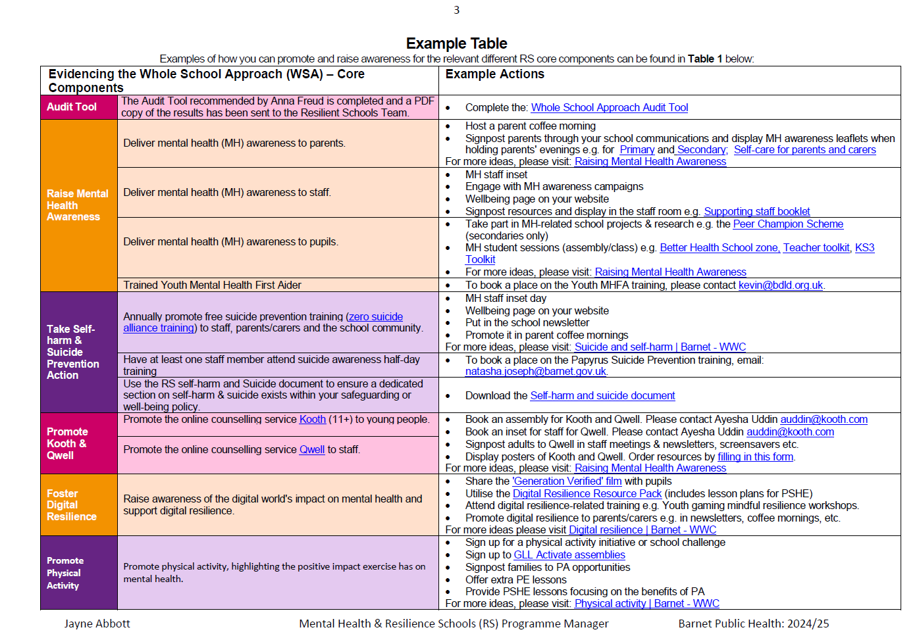

Slide 24
Self-Assessment Tool
Self-Assessment Audit Tool: nationalwsa.com
Aims to help schools and colleges to work towards developing a Whole School or College Approach to mental health and wellbeing.
on, anger
Provides a series of questions relating to each of the Department for Education’s 8 Principles
Progress is scored on a scale from ‘not in place’ to ‘fully embedded’
Answers from the tool generate a jargon-free and accessible report
Provides information on areas to consider with implementing and embedding each principle
Can be used to develop plans to implement and sustain a whole school or college approach to mental health and wellbeing, tailored to the setting’s needs
Opportunity to monitor impact and sustain improvements in each setting whilst working with support networks, peers and professionals.
Curriculum,
teaching and
learning to promote
resilience and support
social and emotional
learning
An ethos and
environment that
Promotes respect
And values diversity
Targeted
support and
Appropriate
referral
Leadership and management
that supports and champions
efforts to promote emotional
health and wellbeing
Enabling
student voice
to influence
decisions
Staff
development
to support their own
wellbeing and that
of students
Working with
parents/carers
Identify need and
monitoring impact of
interventions

Slide 25






Benefits of the Self-Assessment Tool
User-friendly interface & efficient time management
Opportunity to evidence good practice & provide recognition of adopting a whole school approach via the kitemark
Reflective tool to map journey towards improving whole school approach
Used by BICS and Resilient Schools
Notes:
Consistent colours with logo

Slide 26
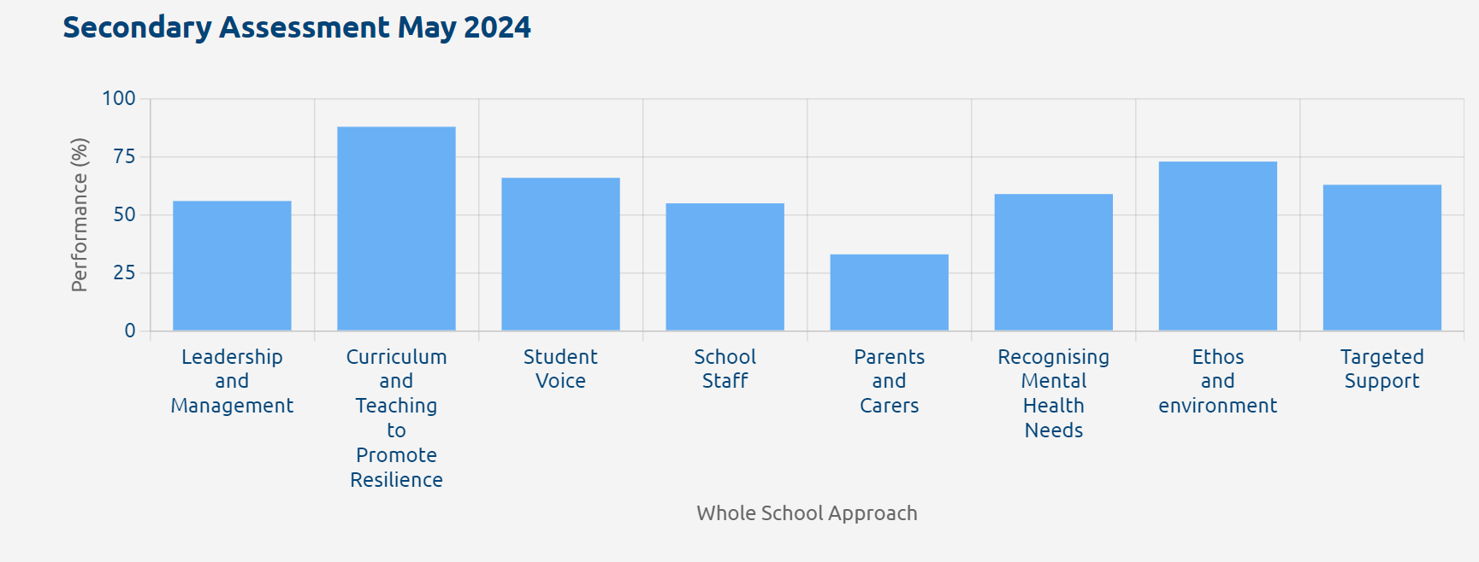

Slide 27
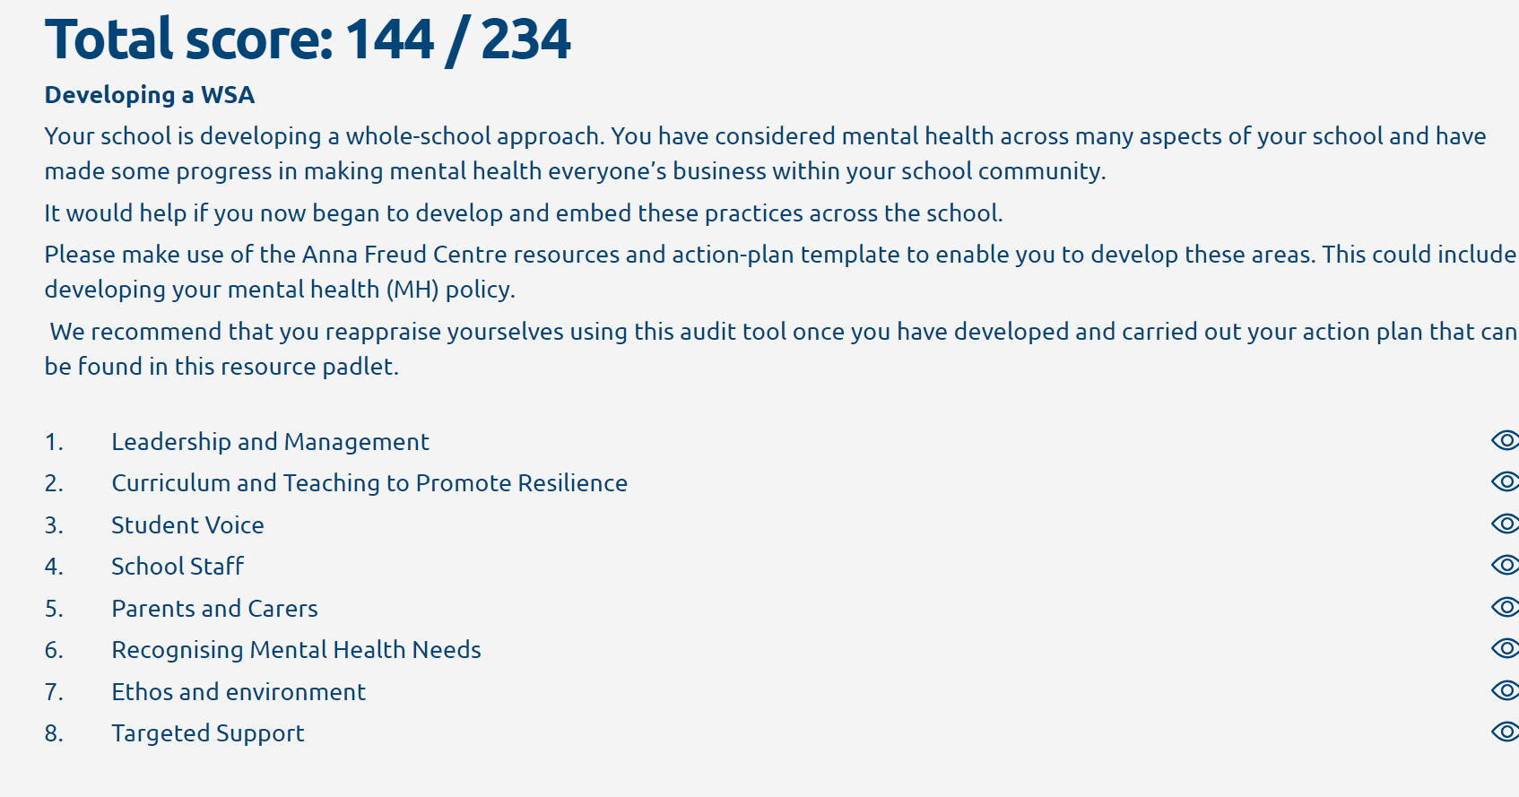

Slide 28
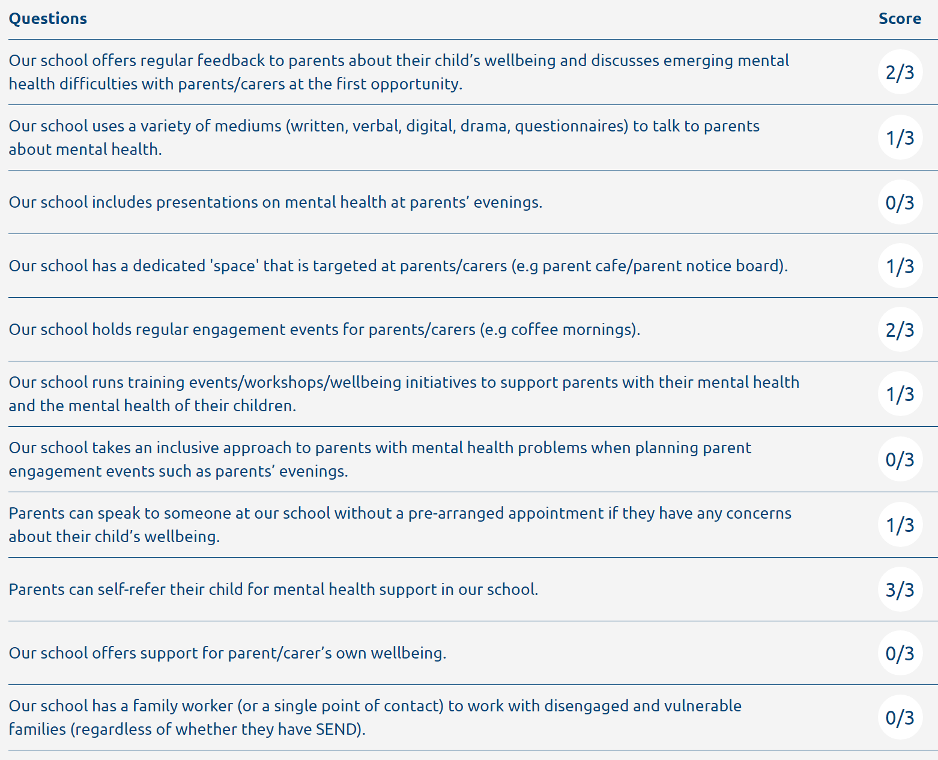

Slide 29

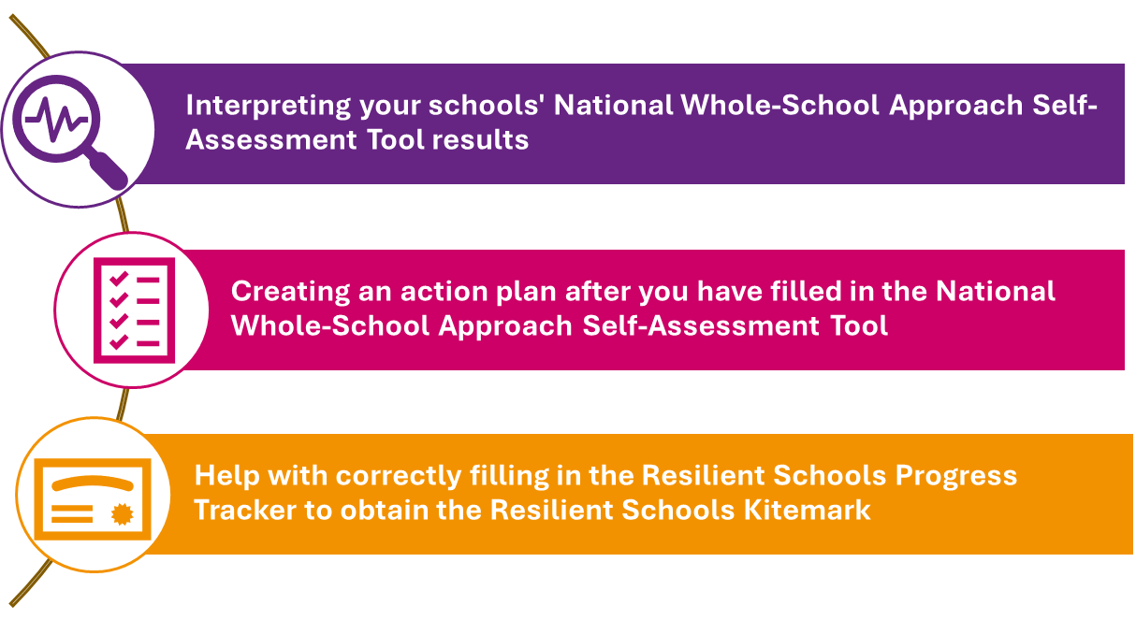

Resilience in Schools Audit Consultations
Lucy.baker@barnet.gov.uk
Inclusion Advisory Team

Slide 30
Links with Resilient Schools
BICS: Working with your MHST practitioner, sending us your audit tool and completing the RS progress tracker
Healthy Schools London – If you have an up-to-date bronze, you can use Resilient Schools to gain a silver or gold
Trauma Informed Schools: Using your training to help complete the RS progress tracker

Slide 31

Notes:
4 minute long tutorial on resilient schools self-assessment tool
Tutorial on whole school approach audit tool– Video 3:50 mins long
Chapters:
00:00:01 Introduction
00:00:35 Whole School Approach 8 Principles
00:01:04 Sign up to the audit tool
00:01:28 Questionnaire section
00:02:35 Summary report
00:03:02 Send PDF to Resilient Schools Team
00:03:16 Kitemark and Support opportunities

Slide 32
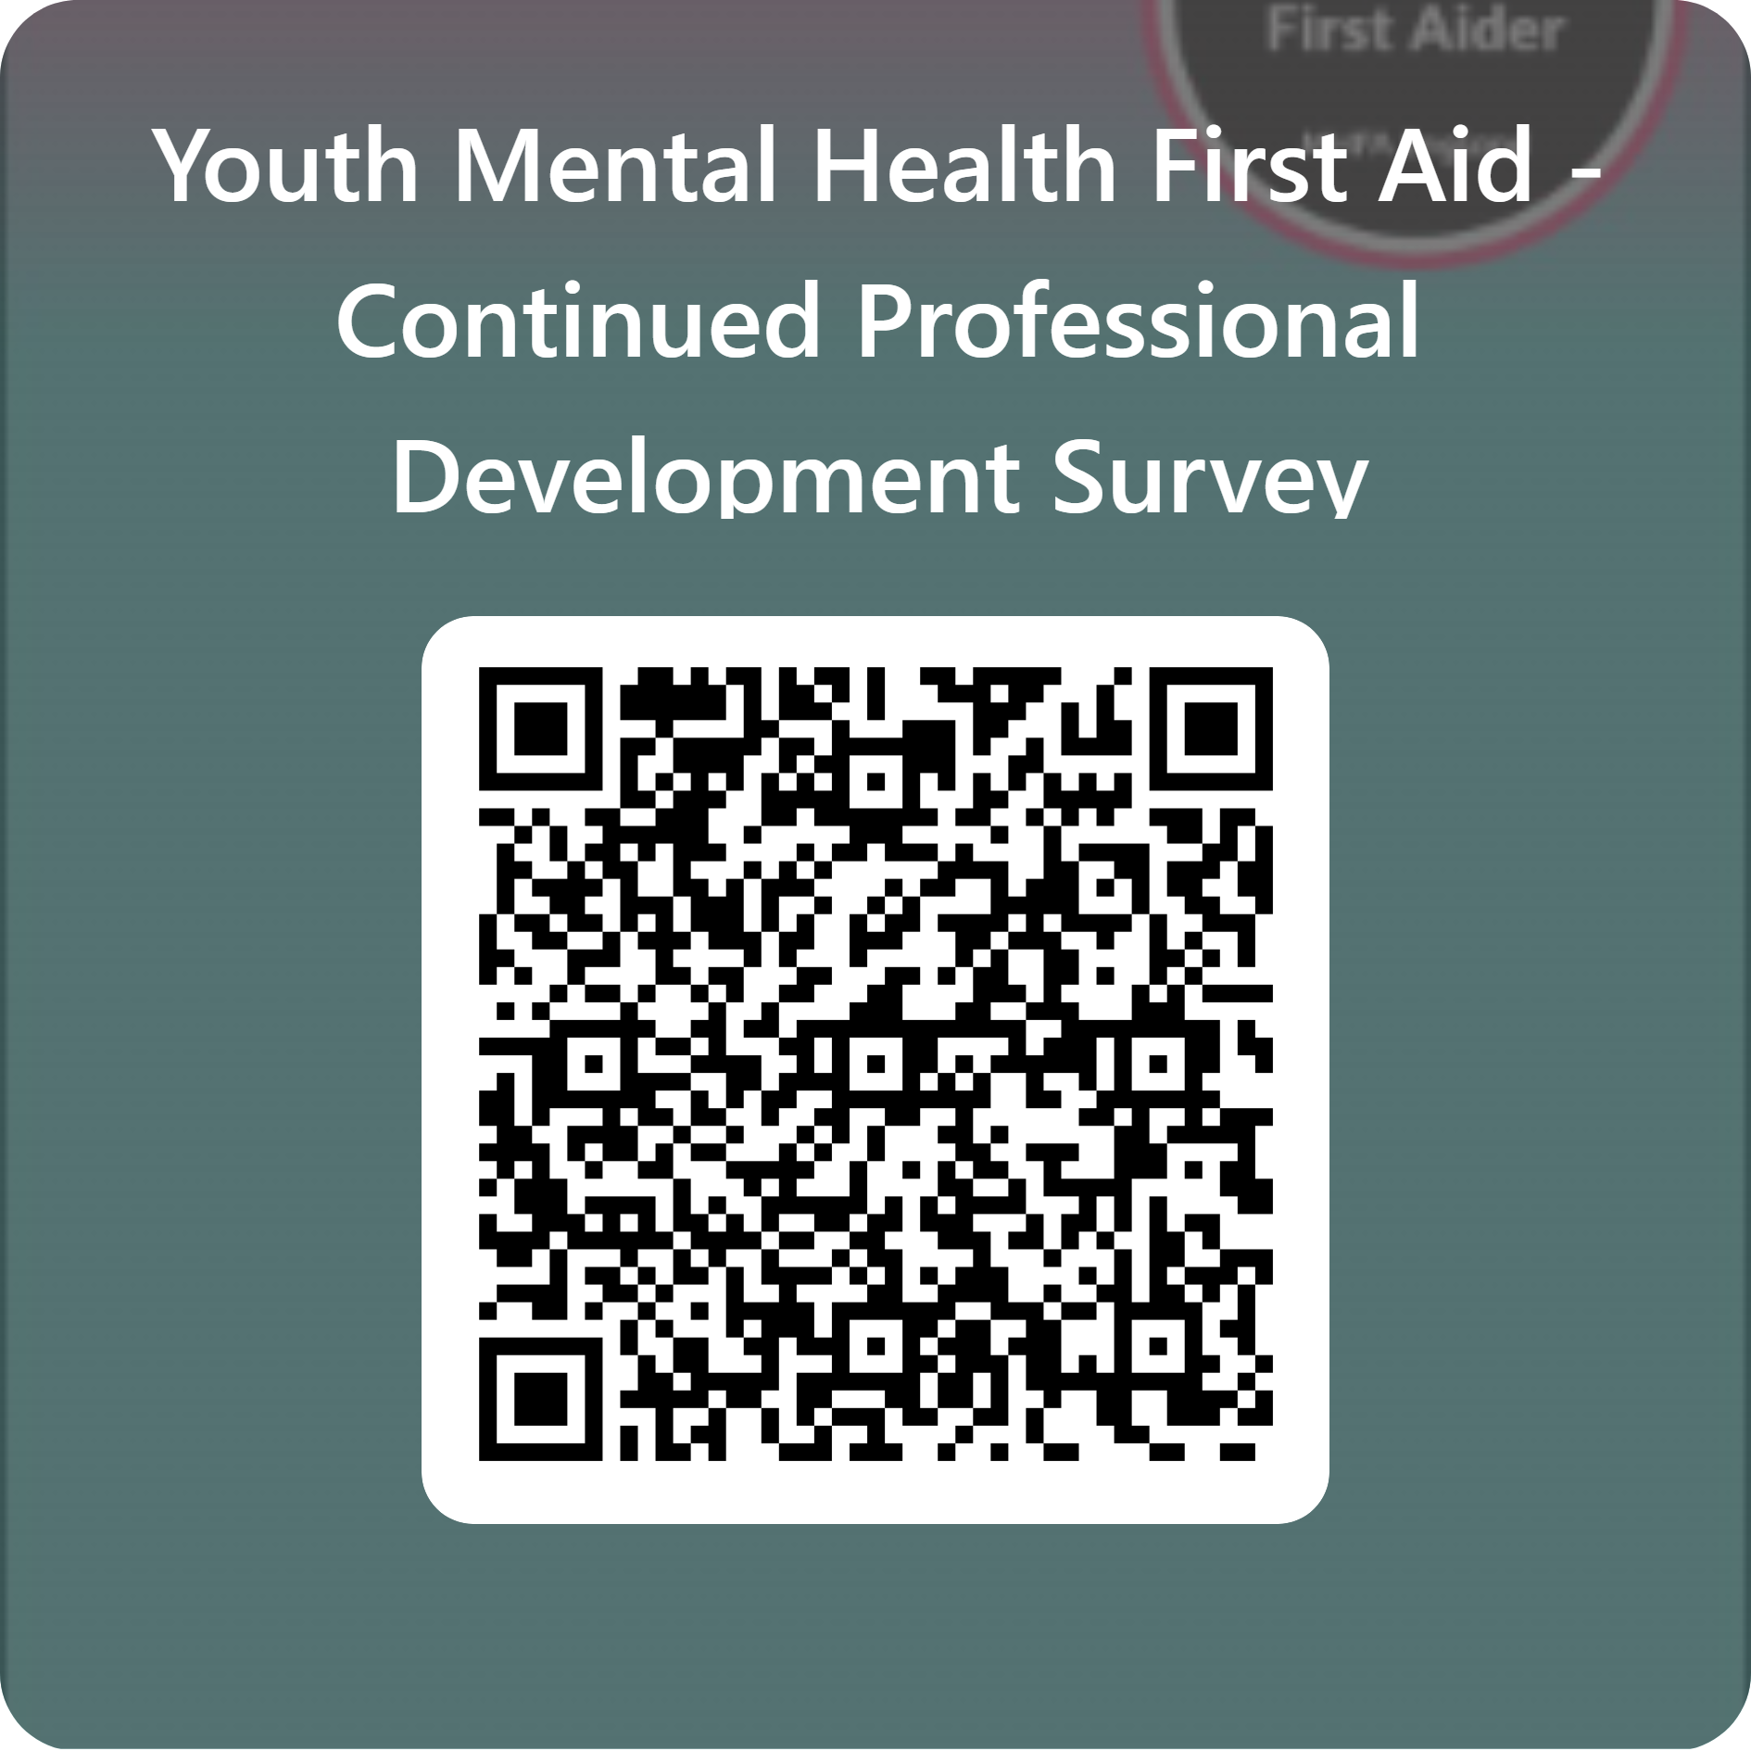
CPD Support for Youth Mental Health First Aiders
We’ve created a short survey to understand the experiences and professional development needs of YMHFA.
This is an opportunity to share what would help school staff continue to enhance YMHFA skills, so we can shape resources and support that can make a difference.
1. Tailored support – Influence CPD content to address the challenges
2. Professional growth - Shape resources and access content that reflect real-world needs and experiences
3. Early updates - Be the first to hear about new opportunities.
Notes:
Consistent colours with logo

Slide 33

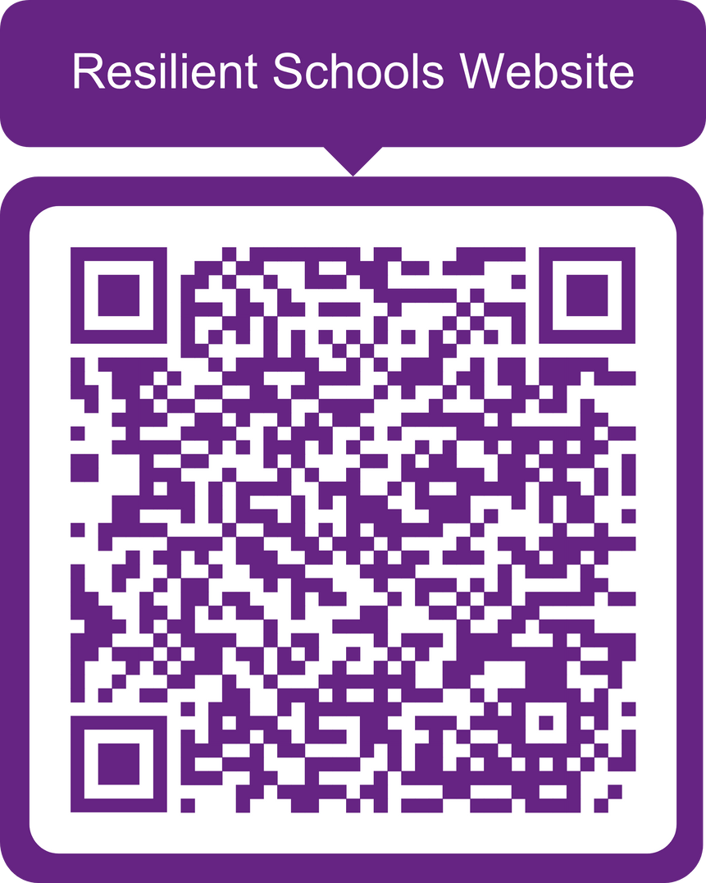


Get in touch
Primary Schools:
Michelle Leon
Health Improvement Officer
Michelle.leon@barnet.gov.uk
Secondary Schools:
Natasha Joseph
Health Improvement Officer
Natasha.joseph@barnet.gov.uk
For more information please contact:
Jayne Abbott
Resilient Schools Programme Manager
Jayne.abbott@barnet.gov.uk
Visit the Resilient Schools
Website
Thank you

Slide 34








Slide 35

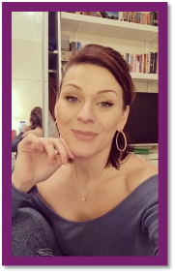

SCHEME STRUCTURE

Slide 36






Welcome to

Slide 37

Session One
Staying physically fit helps our brains, staying mentally fit helps our bodies.
Mental Health & Mental Fitness

Slide 38

WHAT CHANGES IN THE BRAIN DURING THE TEENAGE YEARS?

Slide 39
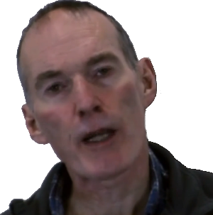
You Can Only Be As Old As Your Brain
“
”

Slide 40
Session Two
People with poor mental health are far more likely to neglect their physical health.
Poor Mental Health & Mental Ill Health

Slide 41




MENTAL HEALTH STATUS
Poor:
I’m not okay. I could be struggling a little, in crisis, or anywhere in between.
Adequate:
I’m “okay” but not good. I’m coping but could be doing a lot better.
Good:
On a spectrum from good to great. I’m doing well, maybe even thriving!

Slide 42





DEALING WITH A PANIC ATTACK

Slide 43
Session Three
Good mental health helps us to live longer. By almost 20%!
Being a Peer Champion

Slide 44
 |  |  |  |  |  |  |  | K |  | N
 |  |  |  |  |  |  |  | N
 |  |  |  |  |  |  |  | O | P | T |  |  |  |  |  |  | C
 |  |  |  |  |  |  |  |  |  |  |  |  |  |  | A
E |  | N |  | N | - | J |  | D | G |  |  |  |  |  | A | L
M |  |  |  |  |  |  |  | G
 |  |  |  | H
A |  |  |  | O |  | C | H | A | B |  |  |  |  |  | A
 |  |  |  |  |  |  |  | B |  |  |  |  |  |  | B
H |  |  |  |  |  |  |  | L
E |  | D |  | S |  |  | E | E |  |  |  |  |  |  | E
T
Of a good or benevolent nature or disposition, as a person (4)
Truthful; not lying or cheating (6)
Avoiding moral judgements (3-11)
Friendly and easy to talk to (12)
Hopeful about the future (10)
Well-informed (13)
Careful in speech or actions, especially to keep something confidential or avoid embarrassment (8)
At someone's disposal (9)
Showing an ability to understand and share the feelings of another (10)

Slide 45

THE 60-SECOND
LISTENING CHALLENGE

Slide 46












TALKING ABOUT MENTAL HEALTH

Slide 47
THE GRAFFITI WALL
Low Mood, Depression
High Mood, Mania
You have two minutes.
What mental health words and phrases have you heard in conversation?
What mental health words and phrases do you use in conversation?
If you think of any that might be offensive, write them down anyway!
Anxiety, Fear
Problems with Eating
Hearing & Seeing Things
Stress & Worry
Resilience, Mental Strength
Sanity, “Madness”

Slide 48
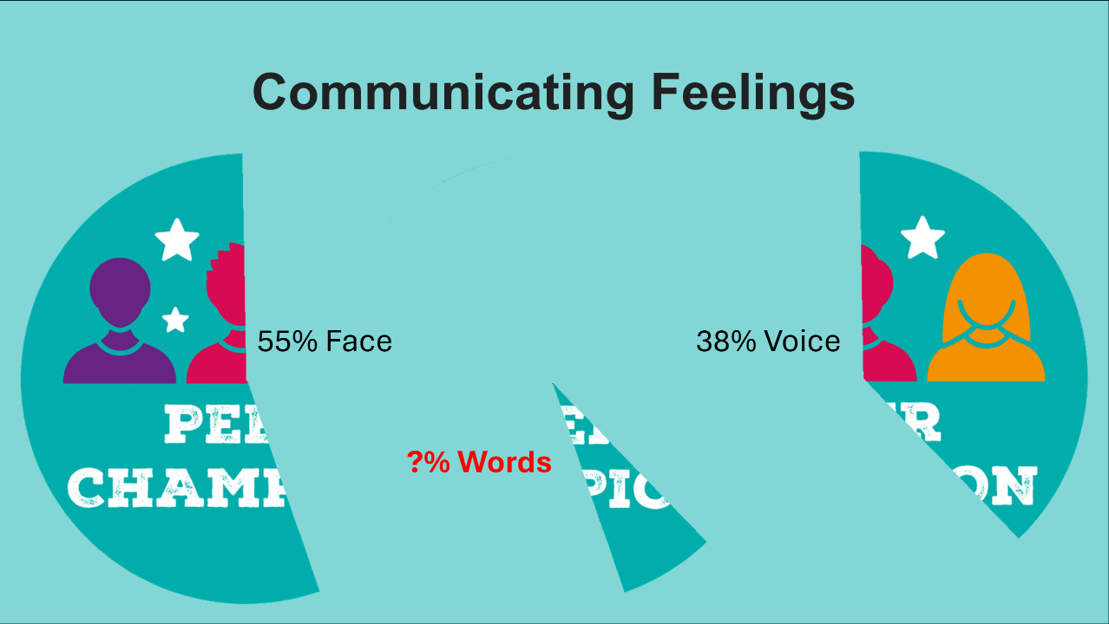

Slide 49






Interested
Bored
Distracted
Focussed
Silly
Struggling with
low mood

Slide 50

#AskTwice
When asked, 88% of 16-24-year-olds would tell friends and family they are “fine”, even if they’re struggling with a mental health problem.
I don’t want to burden people.
I’d only talk if I was confident my friend or family member really wanted to listen.
Just because people ask how you are, doesn’t mean they really want to know.
2018

Slide 51



SUPPORT VERSUS SHIFT RESPONSES
Would you like to talk to me about it?
I’m feeling really low at the moment.
So am I, let me tell you about MY problems!

Slide 52
Session Four
Physical exercise is as effective as antidepressants in improving mood.
Wider Impact & Self-Care

Slide 53
BOUNDARIES
Physical
Emotional
Verbal
My personal space & body
My thoughts & feelings
How we speak & what we discuss
Time
Format
When I’m available to you
How & where I’m available to you
Academic
Spiritual
Role
My education
My values & beliefs
What I’ll do for you & what I won’t

Slide 54

MANAGING YOUR WORRIES
Frontal Cortex
Brain Stem
Limbic System
Spinal Cord

Slide 55


Slide 56


COURSE STRUCTURE
Corporate Level Slides
4 Videos
(2 Bespoke)
11 Group Activities
1 Wellbeing Action Plan
ros@bdld.org.uk

Slide 57



Young People Thrive
Supporting Young Minds in London

Slide 58



Who are we?
Young People Thrive (YPT) supports the emotional health and mental wellbeing of:
children
young people
their parents/carers
families and communities.
How?
By delivering a range of innovative, accessible and evidence-based services to help them live Mentally Healthy lives and THRIVE
We are a team of professionals with a specialist interest in supporting the mental health and wellbeing of children and young people through…
training
lived experience
We provide support to those who don’t meet the requirements of statutory services (CAMHS/BICS), those who sit between child and adult mental health services, and we have a very short waiting list.

Slide 59
What do we do?
We work in Barnet, Brent, Enfield, Harrow and Hillingdon
Low intensity 1-2-1 & Group CBT Talking Therapies to young people aged 17-25 years in Barnet and Enfield
Brent Children and Young People (0-25years, Parents/Carers & Families: A Needs- based Thrive Framework – A Mental Health awareness and Anti-Stigma social movement
We have recently delivered 3 projects called Baby Plus You, Barnet Wellbeing Together, and Food and Me.
Winter Pressures: [Barnet & Enfield]
Be Brave Be Bold (B4) Peer Mentoring Mental Health Resilience programme for primary school pupils Transitioning to Secondary school
Thrive & Rise, offering free support to young people aged 17-25 from minority ethnic communities with tools to overcome challenges and thrive.
Notes:
[barnet wellbeing together – still being delivered but the contract has been taken over by Hestia]

Slide 60
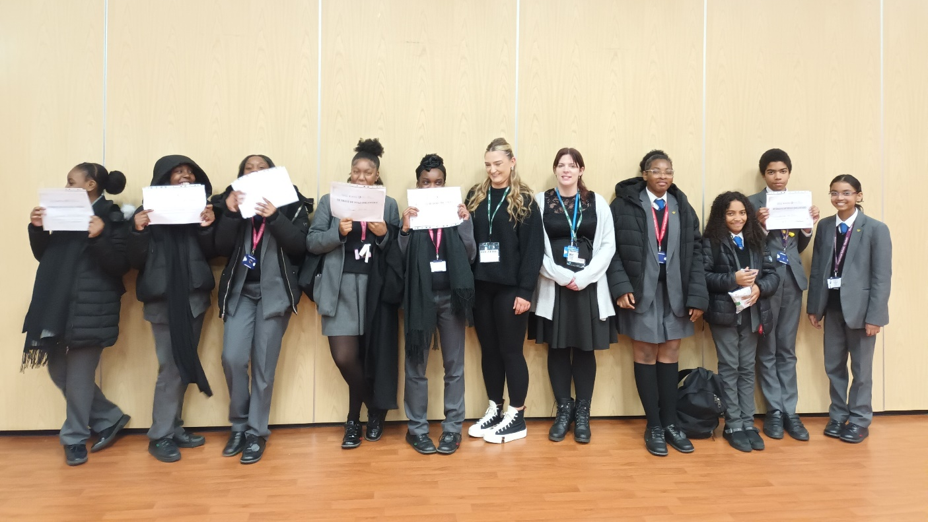
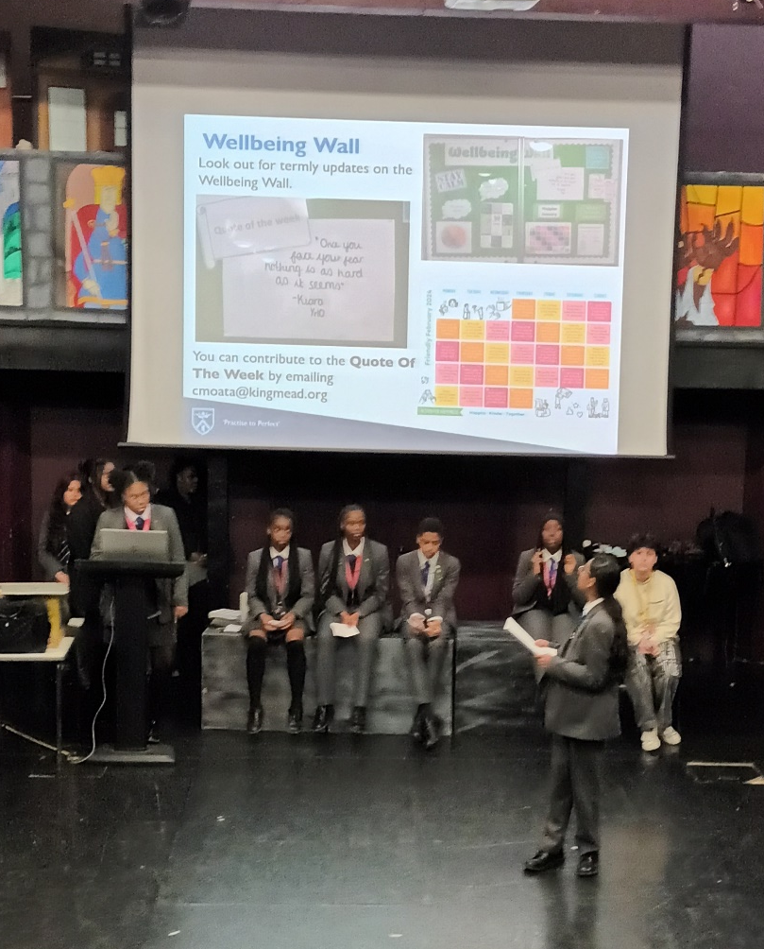

i) Be Brave Be Bold [B4]
Young people tell us that their experiences of moving up to secondary school can be daunting for them and their peers especially those from culturally diverse communities.
Be Brave Be Bold (B4) is a peer-led project designed to support Year 5/6 pupils transitioning to secondary school. Working with selected primary and secondary schools to ease this transition and promote emotional wellbeing.
This programme is for…
Year 5/6 pupils preparing for secondary school
Year 7/8 students who will mentor younger pupils
Parents, carers, and schools.
Pupils learn ways to look after their mental health and gain social and peer mentoring skills.
They gain …
self-confidence
self-esteem
a sense of empowerment by making a positive contribution to their school and others.

Slide 61
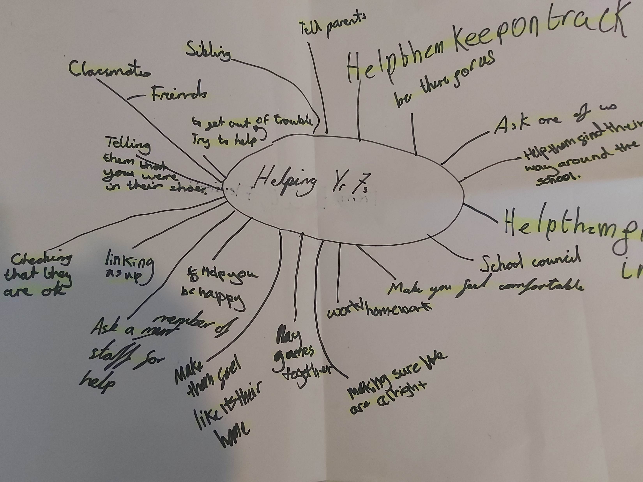
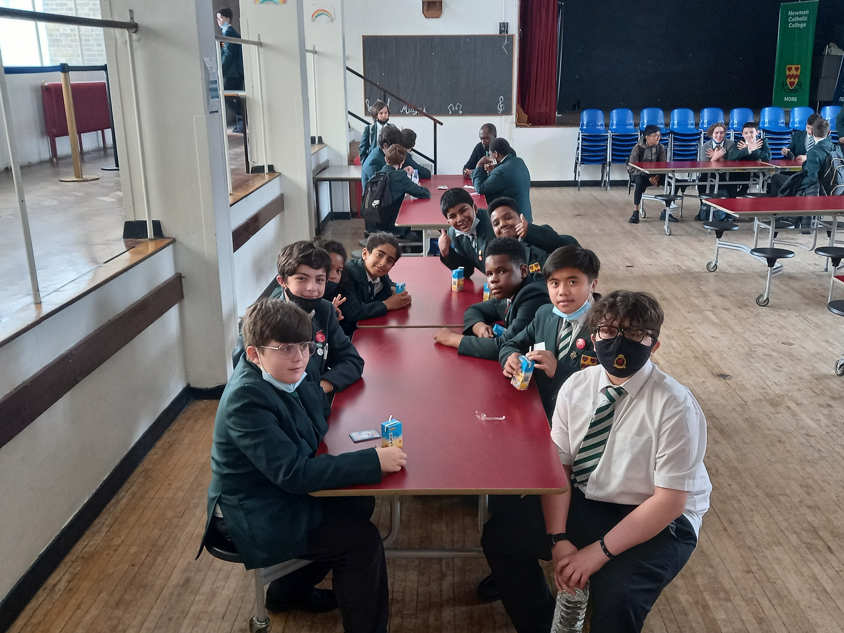
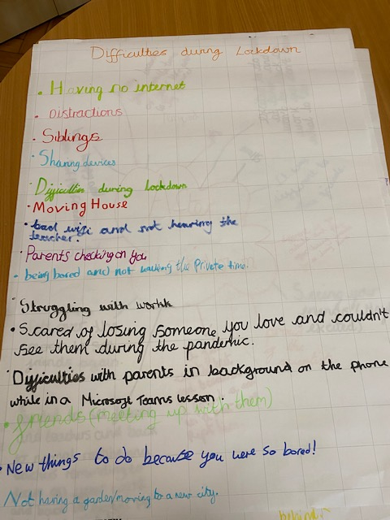
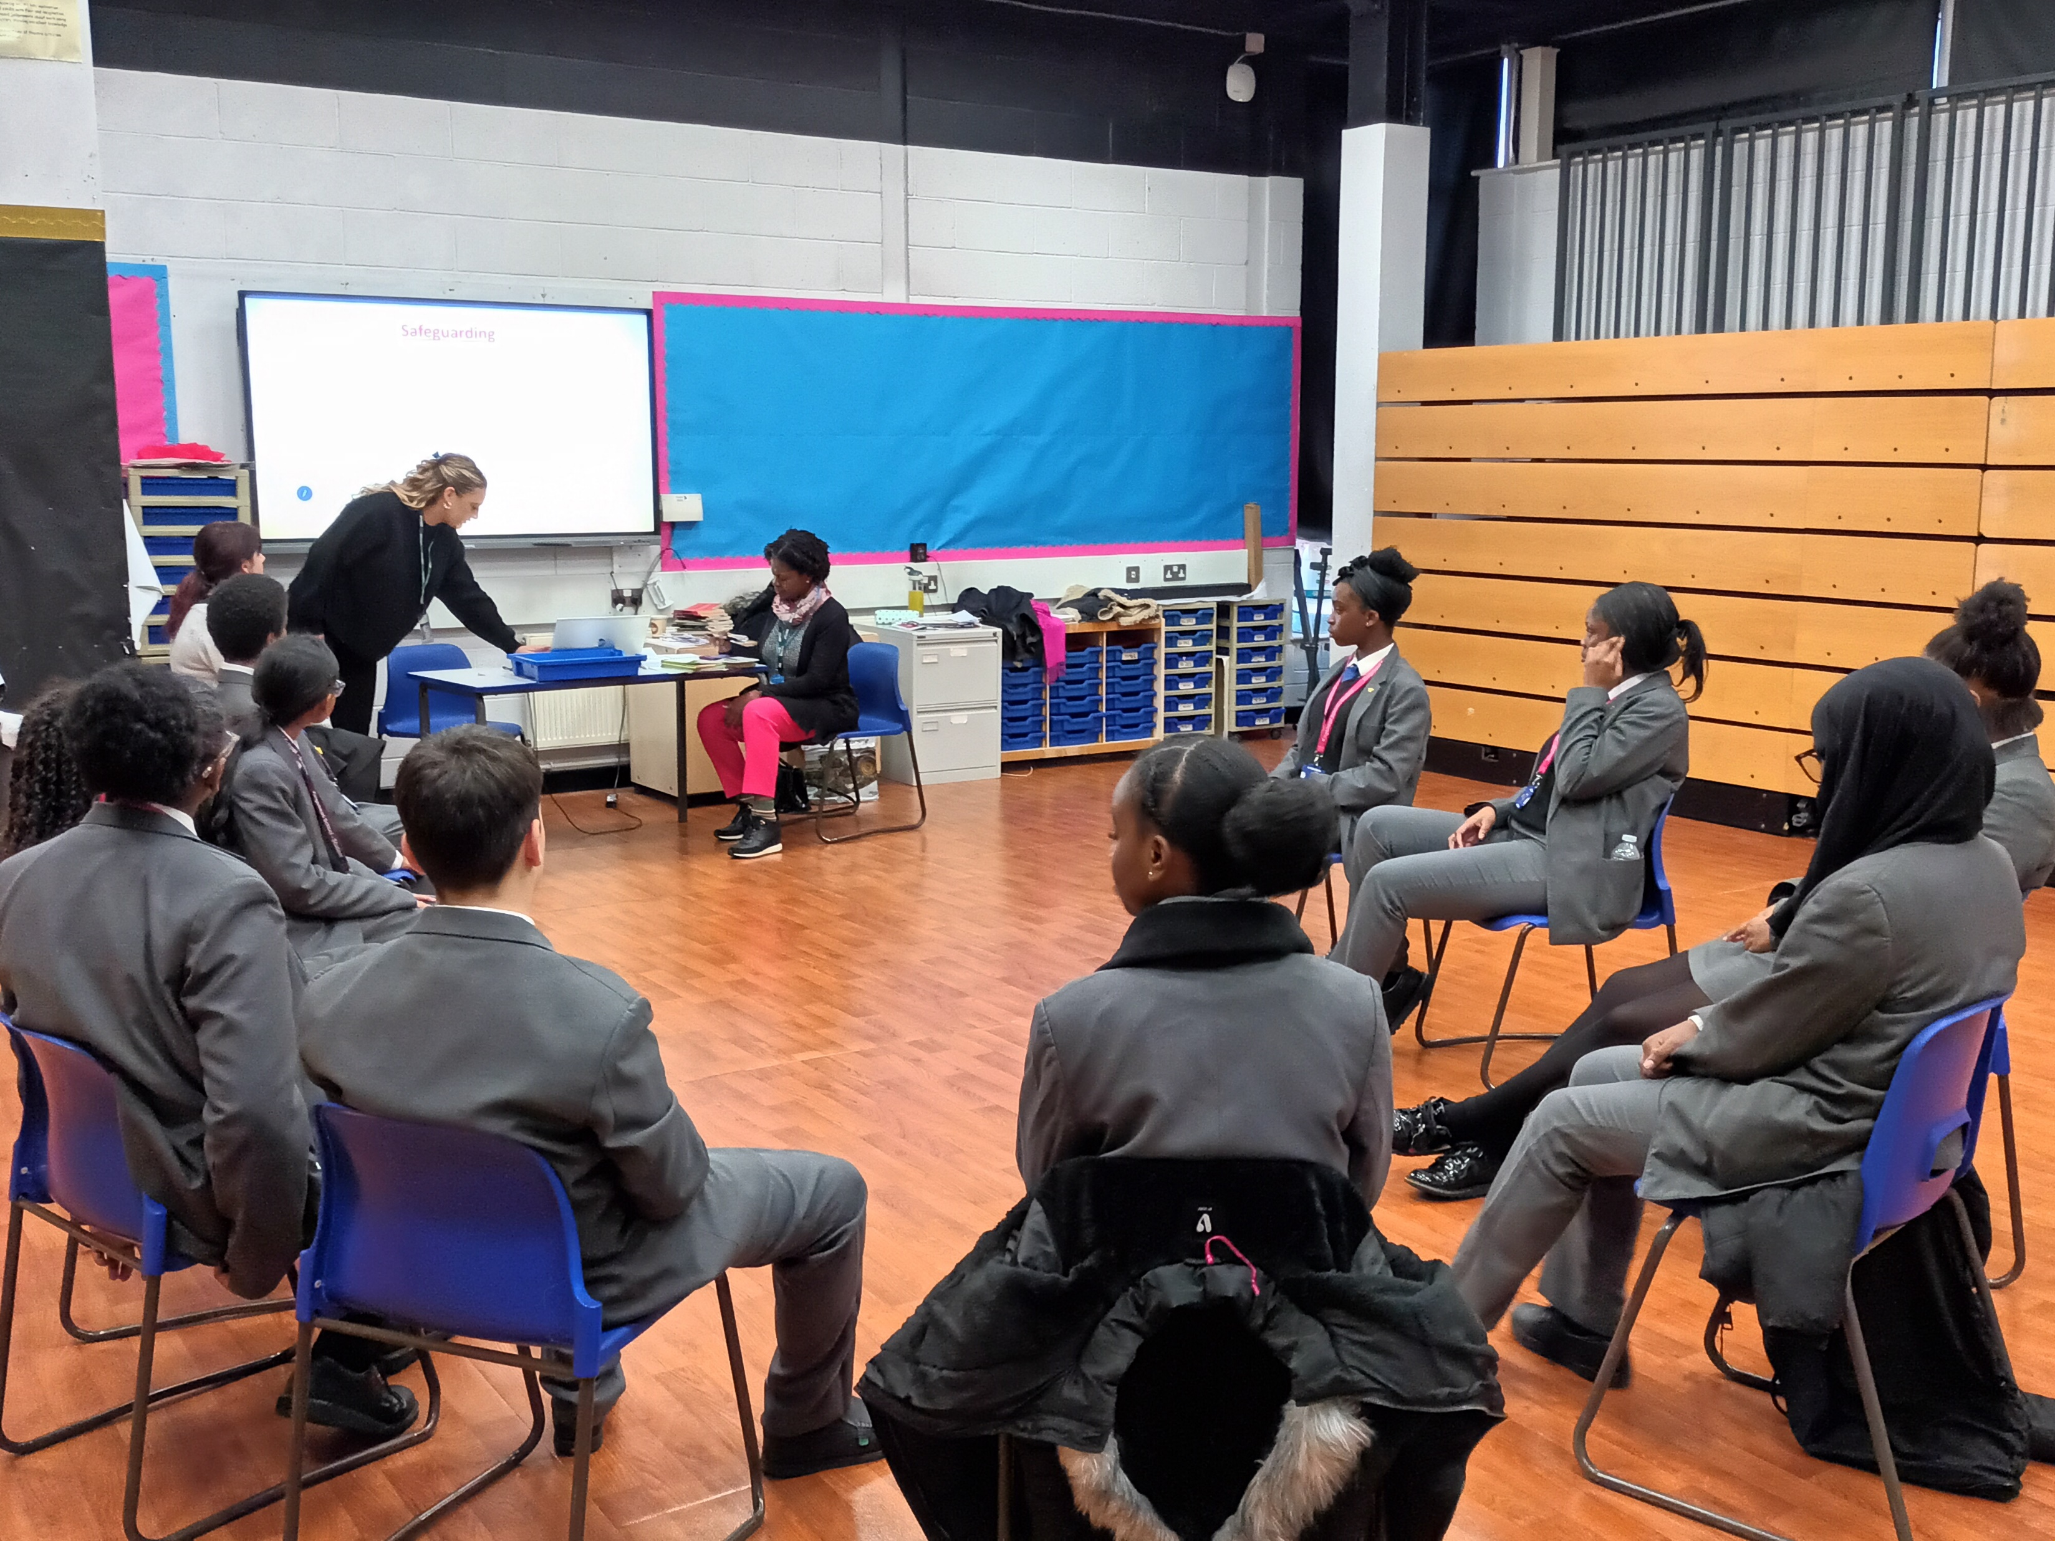
i) Be Brave Be Bold [B4]
Already been delivered at.. Kingsmead School Enfield, St Vincents, Kingsbury High School, Newman Catholic College, Kingsbury Green Primary School, John Keble Primary School, East Barnet, Danegrove, Hendon School, Finchley Catholic, Hendon Secondary School

Slide 62
]t-
ii) Thrive & Rise
Helping young people from diverse communities build bright futures
Our service is specifically designed for BAME young people aged 18 to 25 who are at risk of youth offending, entering the criminal justice system, or engaging in antisocial behaviour. We have a particular interest in supporting Black young men.
We focus on providing support to those who may be…
struggling with poor mental health
facing challenges in school
at risk of educational exclusion
at risk of being referred to the criminal justice system
expressing behavioural concerns as a result of familial or community-based challenges.

Slide 63
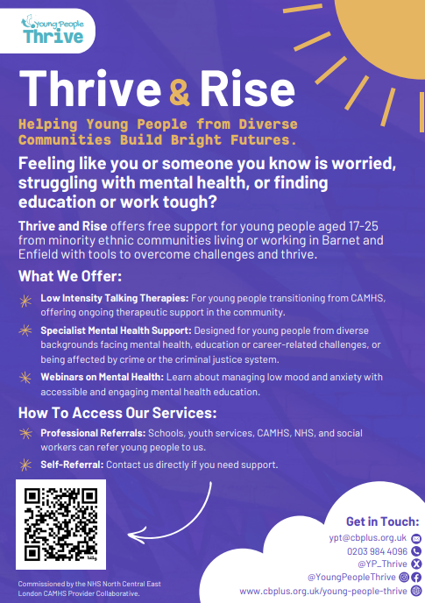
]t-
ii) Thrive & Rise
Helping young people from diverse communities build bright futures
We offer 6-8 weeks (Short Term) of CBT based Talking Therapy interventions for those who need help with
Anxiety, Emotional Dysregulation, exam stress, low mood, Phobias, panic attack, sleep difficulties, stress, unhealthy habits that impact on wellbeing.
PLEASE NOTE: we do not see clients with severe and enduring mental health difficulties such as OCD and complex trauma. All clients are assessed for suitability when their referrals are received.
We offer support to those who may have been discharged from CAMHS who need ongoing community-based therapeutic support
We offer webinars, offering accessible mental health education and support.

Slide 64
More about the service
We are a team of …
CYP and Psychological wellbeing practitioners
High intensity practitioner & Clinical supervisor
Individuals who represent our communities with lived experience
4 CYP Psychological wellbeing practitioners
1 clinical IAPT trained supervisor
Referrals come from services including ...
Social prescribers
Schools/Colleges/Universities – Barnet & Southgate College, Middlesex
Change Grow Live – Drug and substance misuse service
BICS – non CAMHS talking therapies
Other VCS providers – British Red Cross, Youth Realities
Young people who self-refer

Slide 65











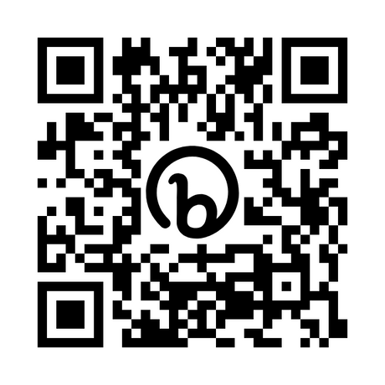

0203 984 4096
@YP_Thrive
@YoungPeopleThrive
cbplus.org/young-people-thrive
laura.spencer@cbplus.org.uk
Scan me!

