Slide 1







Slide 2
Team around the School Meeting
Reduce the amount of times schools attend meetings
Advice and support in one place
Building relationships with services
Building relationships with each other
Sharing best practise
Sharing new initiatives
Celebrating what we do together
Case Consultation

Slide 3
Agenda
09:00 | Refreshments and Networking |  | 30
09:30 | Resilient Schools and MHST’s | Jayne Abbott Sarah Konn | 20
09.50 | Role of the SMHL | Emma Scelsi | 20
10:10 | Early Help (young person’s voice) | Debra Davies | 15
10.25 | Tackling Youth Violence & Exploitation Team Summary | Christopher Kelly | 20
10.45 | Round up of Services in the Room | All | 15
11.00 | Networking with services and colleagues /Comfort Break |  | 30
11.30 | Launch of Mental Health Week | Sarah Konn | 15
11.45 | Sharing Good Practise | All | 20
12.05 | What do schools want from the meetings? - Menti | Schools | 15
12.20 | Case Consultation/Support from services | All | 40

Slide 4
What is the Barnet Resilient Schools Programme?
The Programme Aims To:
Raise awareness and de stigmatise mental health
Help school communities (pupils, staff, parent and carers to recognise their own and others mental health needs and be confident to seek support for themselves and others.
Through awareness be able to intervene early to prevent the escalation of poor mental health
Notes:
My focus today will be on moving into our Universal offer open to any school in Barnet and how we distinguish between those that are making some use of the Resilients Schools Offer and those that are really embedding the whole school approach – and how are schools being recognised for this – Resilient Schools logo?

Slide 5
Resilient Schools 2017 - 2023

Slide 6
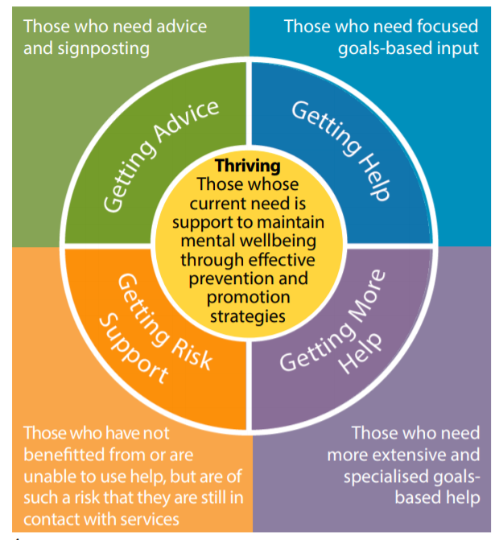

Barnet Integrated Clinical Service
Barnet Education Learning Support
CAMHS
Inclusion Advisory Teams
Voluntary Sector
Family Services
Barnet Safeguarding Partnership
CYO Mental Health Board
Suicide Prevention Partnership

Slide 7


RESILIENT SCHOOLS UNIVERSAL OFFER
Training
Youth Mental Health First Aid – 3 times a year
Support
Support through Programme Manager and Health Improvement Officer
Suicide Prevention – 3 times a year
WISE training for Secondary
Peer Champions
Links to evidence based, low cost or free training
Peer to Peer Support
Resilient Schools website
Links to new evidence-based support and resources
Resilience in Schools Support – Inclusion Advisory Team
Team Around the School Meeting (case consultation)
Audit Tool
MHFA
Suicide Prevention
Digital Resilience
Kooth and Qwell
Network Meetings
Core Components
Evidence of being a Resilient School

Slide 8


AUDIT TOOL
This can underpin, reinforce a Whole School approach – not replace it.
on, anger
An ethos and
environment that
Promotes respect
And values diversity
Curriculum,
teaching and
learning to promote
resilience and support
social and emotional
learning
Looking at your key strengths
Looking at your challenges
Using as a reflective piece
Enables and formalises the sharing of good practice between schools
Targeted
support and
Appropriate
referral
Enabling
student voice
to influence
decisions
Leadership and management
that supports and champions
efforts to promote emotional
health and wellbeing
Staff
development
to support their own
wellbeing and that
of students
Working with
parents/carers
Identify need and
monitoring impact of
interventions

Slide 9
Identifying Need and Monitoring Impact
Key Question: How does the school or college assess the needs of students and the impact of interventions to improve wellbeing?
Key Question Example from Audit Tool
Links with the Ofsted Inspection Framework: When inspecting the quality of leadership in and management of the school Ofsted inspectors should consider the effectiveness of monitoring and evaluation and the extent to which it is shared with governors. They should also consider how well the school meets the needs of all vulnerable groups of pupils. Assessing and responding to the emotional health and wellbeing needs of children and learners, and taking steps to mitigate the impact this has on their capacity to learn could provide supportive evidence in relation to all key judgement areas: the achievement of pupils at the school, the quality of teaching in the school, the behaviour and safety of pupils at the school and the quality of leadership in and management of the school.

Slide 10
C
O
R
E
C
O
M
P
O
N
E
N
T
S
Audit Tool
Strength base.
Mental Health Awareness
Kooth & Qwell
Promotion Kooth for young people
Self Harm and Suicide
Insert Self Harm and Suicide document in existing safeguarding/wellbeing policy
Evidencing 8 principles of whole school approach
Progress Tracker
Have at least one MHFA
Evidence of MH awareness to staff/parents
Deliver MH awareness to pupils
Yearly communications sent out for zero suicide training for all staff and parents
Digital Resilience
Raising awareness of the impact on mental health through delivery of co produced film, lesson plans, signposting to resources – Secondary Schools
Physical Activity
Working in collaboration with Public to promote the positive impact exercise has on Mental Health.
Promotion of Qwell for staff
Have at least one person who has suicide awareness half day training

Slide 11

RS Kitemark
22/23 - A total of 21 schools have successfully completed their RS Audit tool or Healthy Schools London silver/gold application & achieved the RS kitemark:​
Child's Hill Primary
Holly Park Primary
Brookland Junior
Claremont Primary
Colindale Primary
Chalgrove Primary
St Catherine’s Primary
Osidge Primary
Barnfield Primary
Deansbrook Junior
Dollis Primary
Beis Yaakov
The Annunciation RC Junior School
Friern Barnet Secondary
Finchley Catholic Secondary
East Barnet Secondary
Mill Hill County Secondary
Henrietta Barnet Secondary
Mill Hill County International School
Hendon Secondary
Ashmole Academy

Slide 12
Resilient Schools/BICS - Mental Health Support Teams
83 schools on the Resilient Schools Network​
40 schools have a Senior Mental Health Lead and a named Mental Health Support Practitioner from BICS​
Wrap Round Approach for Schools
~ Audit Tool ~
~ Raising Awareness ~
~ Joint Training ~
~ Shared Resources ~
~ One Meeting – Team Around the School ~
Audit Tool
Youth MHFA​
Kooth & Qwell​
Suicide Prevention Doc.​
Peer Champions​
Pastoral forum​
Resilience in Schools Forum​
Network Meetings
Audit Tool​
Pupil School Survey​
1-2-1’s​
Group Work​
Workshops​
Trainer the Trainer​
Pastoral Forum​
MHST Meetings
Notes:
The three-pronged approach to our campaign includes:
Provision of 24/7 accessible resource Stay Alive app developed by Grassroots suicide prevention charity. The app is a pocket suicide prevention resource, with useful information and resources to help people stay safe from suicide. The app includes Barnet services and signposting information.
We commissioned direct listening and engagement events delivered by local voluntary organisation “CommUNITY Barnet.
Provide opportunities for peer-to-peer support for men delivered by Andy’s Man Club

Slide 13

2022/23.........

Slide 14

Barnet Suicide Prevention Partnership:
Children and Young People Action Plan Refresh 23-25

Slide 15

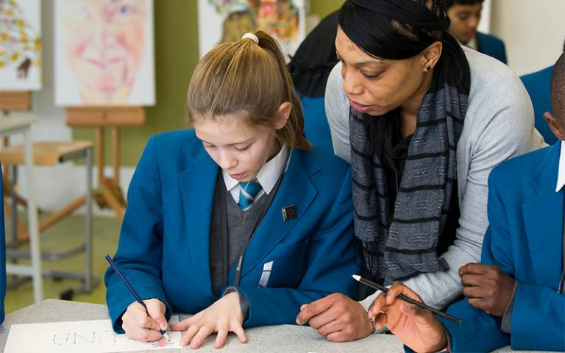

WISE BEFORE THE EVENT Preparedness Session
All rights reserved. Copyright 2018 Dr. Alish Rodgers
Aims:
To help the Critical Incident Team (CIT) to feel ‘prepared’ to respond in the event of a suspected suicide death within their school community.
Including
To affirm current practice
To build on existing knowledge and skills
To be able to create a suicide postvention plan for the setting
Notes:
Dr. Alish Rodgers is an Educational & Child Psychologist, Suicide Postvention Trainer, Clinical Supervisor, Associate Lecturer at University College London, UK.
Work in Australia following
The Barnet Suicide Prevention Partnership aims to make Barnet a borough where every year, the number of residents lost to suicide falls.
Participating agencies include the NHS, Integrated Care System, community, voluntary and faith sectors, schools and universities, police service, local employers, regional and national partners.
The current three-year average suicide rate in Barnet 4.8 per 100,000 remained the second lowest in London (interpret with caution as under reporting may be an issue.) Many elements to the work including the Resilient Schools Programme which includes training people in Youth Mental Health First Aid, which covers self and suicide. The Suicide Prevention training offer is offered universally to all schools in Barnet with the additional bespoke Wise training to Secondary schools which we are talking about today.
a cluster of suicides. Lucky enough to have accessed a day’s training for the service to build on our knowledge.

Slide 16
Self-harm & suicide prevention
51 school staff attended Papyrus suicide prevention training provided through RS.
Notes:
X schools reported using the Self-harm & suicide policy template

Slide 17
Mental health first aid
239 Trained Youth Mental Health First Aiders
108 Barnet schools in total have a trained YMHFA. That is approx. 83% of all schools in Barnet.
41 RS schools have more than 1 YMHFA
48 young people trained as peer champions

Slide 18

Peer Champion Scheme - Big Dog Little Dog
New Offer - Available to Barnet Secondary State Schools
The peer champion service will provide young people in Barnet secondary schools with an additional support network in school to help build good mental health and promote awareness and reduce stigma.
Will include accredited mental health first aid training and a half day co-production workshop.
The implementation of the Peer Champion Scheme will be unique for each school as trained young people will decide on the delivery of the service for their school. For example, some may decide that they would like a mentor service and others may wish to focus on raising mental health awareness.
www.bdld.org.uk/barnet
Notes:
This will add to the current evidence-based offer already provided to local schools to support young people’s mental health and well-being.

Slide 19
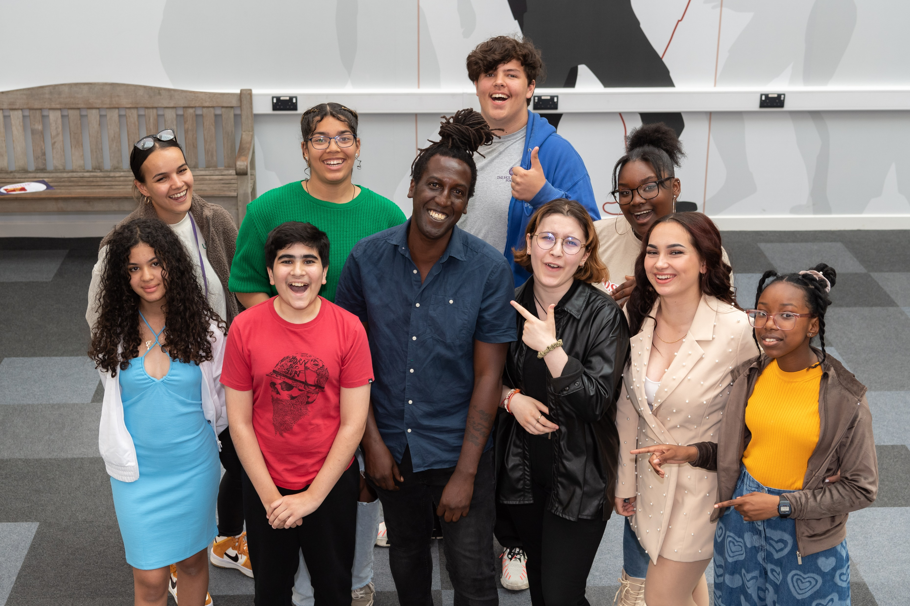
Generation Verified: Synopsis
The Resilient Schools Programme, Barnet Public Health is proud to showcase a Youth Realities and Pink Productions film ‘Generation Verified’. From identity to pressure for perfection, popularity, and the desire for likes, Generation Verified is a short film that explores young people’s experiences of the online world and how they cope with the unique generational challenges that they must navigate in their day-to-day lives.
This short film has co production at its heart ensuring that a group of young creatives experience all aspects of scriptwriting, acting and film making to explore the online world and the effects it has on young people’s wellbeing.
Jayne Abbott, Resilient Schools Manager says “I wanted to showcase what young people experience online in a way that was meaningful and had the lived experience at the heart of it. This film reinforces that co production and ensuring that young people's voices are heard is central to all we do in supporting our youth.”

Slide 20

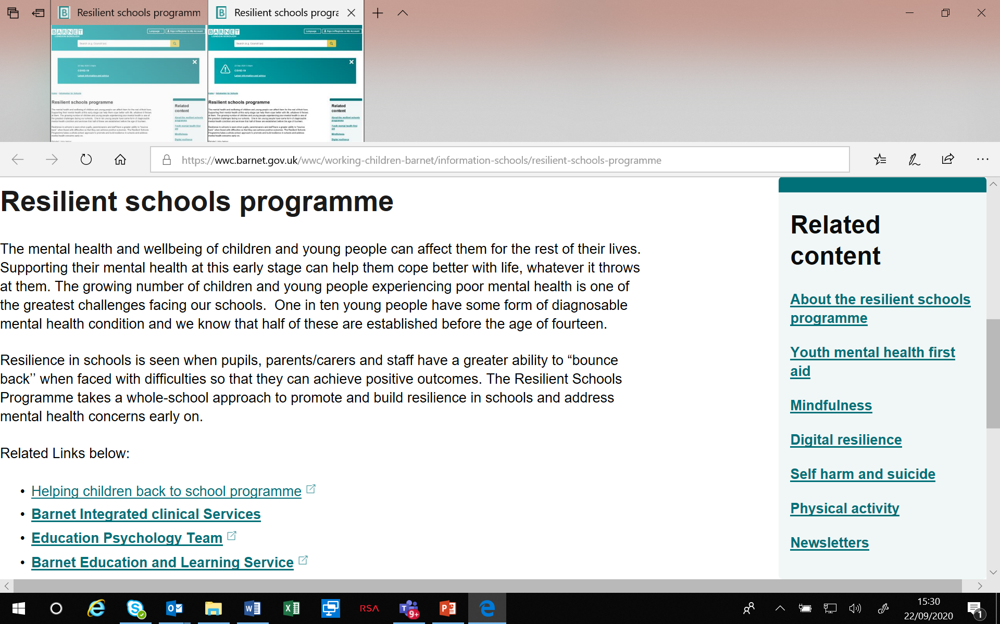
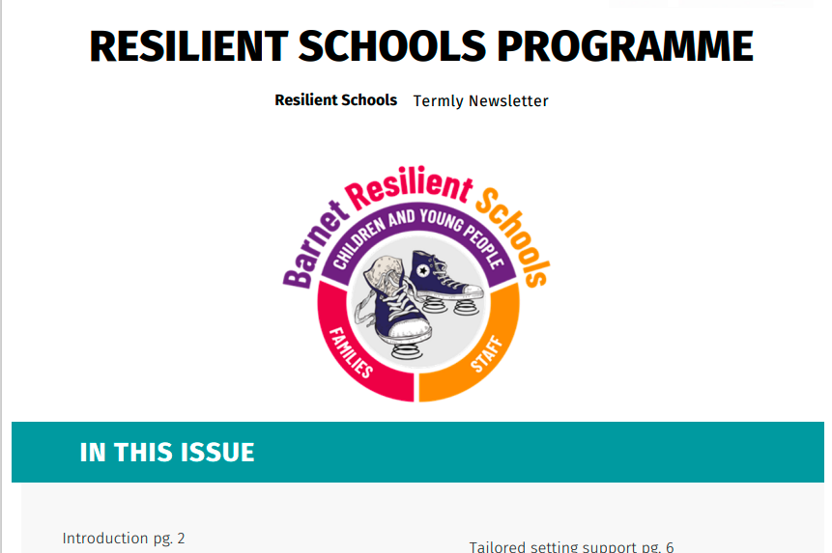
Where to find resources
Website
Newsletters & Focus Sheets
https://wwc.barnet.gov.uk/wwc/working-children-barnet/information-schools/resilient-schools-programme
Notes:
Schools are signposted to a wealth of resources through the RS website, newsletters and focus sheets.

Slide 21
MHST

Slide 22
MHST: What makes us different?
To deliver a preventative approach as reported in the Green Paper and NHS Long Term Plan ambitions (3 core functions): ​
Deliver evidence-based interventions for mild to moderate mental health and emotional wellbeing needs, supporting the reduction in health inequalities ​
Support senior mental health leads in education settings to develop and introduce their whole-school or whole-college approach to mental health and emotional wellbeing ​
Provide timely advice to staff and liaising with external specialist services so that children and young people can get the right support and remain in education.​
Monitoring of the delivery of functions:
How these functions will look in your school is dependent on the demands
Termly meetings will be held to discuss the delivery of these functions
Notes:
How these functions will look in your school is dependent on the demands…
We are aware that there is always room for improvement in these areas and we have spent time reflecting how we can provide these 3 functions more effectively.
Where you're school sits with regard to these 3 functions begins with ensuring you're school has a designated MHL and that they have completed the training and have completed the WSCA audit.
We will then monitor the delivery of these functions by holding termly meetings with your lead during which we will ensure we cover these functions

Slide 23
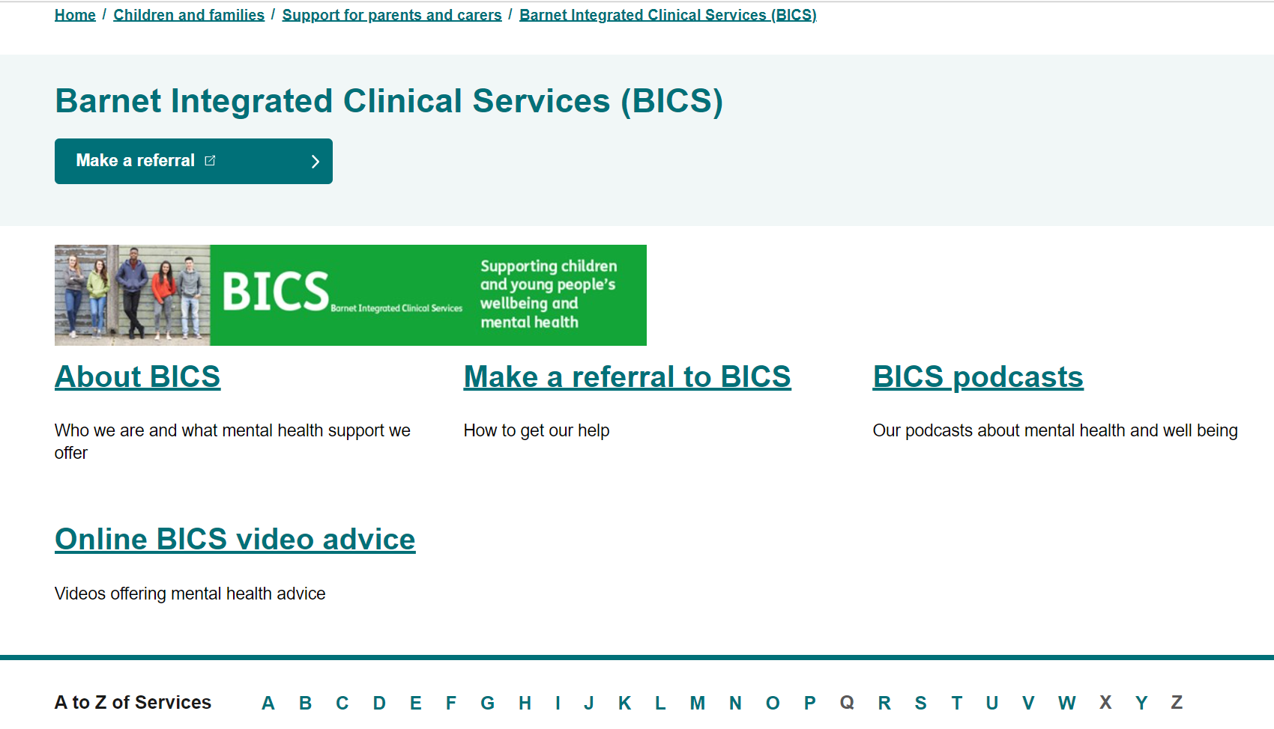
Function 1
Deliver evidence-based interventions for mild to moderate mental health and emotional wellbeing needs, supporting the reduction in health inequalities ​
As part of this function, we will deliver evidence-based interventions to children/ young people and families
Referrals can be made through the BICS website using the Universal Plus Form
Each school will be assigned an MHST link person who you can liaise with regarding referrals
Notes:
This is the same offer that anyone referred into BICS receives.

Slide 24
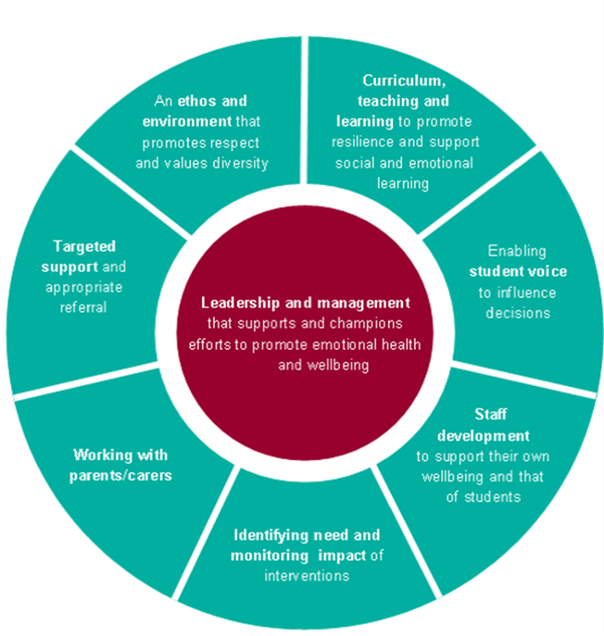
Function 2:
Support senior mental health leads in education settings to develop and introduce their whole-school/ college approach to mental health and emotional wellbeing ​
We want to support you to promote a culture of positive mental health in your school/ college by encouraging engagement of the whole community; students, parents and carers and staff
This support will look different depending on the needs of your school or college
Examples include wellbeing displays, assemblies, consultation on how mental health is covered in the curriculum and Train the Trainer sessions on exam stress, friendships and more...
Notes:
Function 2 is about us supporting your whole school community. What that looks like is dependent on what your school / college needs.
Looking at the 8 principles which are assessed through the school audit, your link worker will think about how we can support the school to achieve any goals identified.
As part of the MOU you may have noticed our train the trainer sessions. We recognize that we are unable to meet the demand for running groups and workshops when you need them. These are sessions which we would like our MHST schools to attend at least 3 a year During these sessions we will give you all the material needed to run workshops in your school on subjects friendship, DBT techniques that teachers / parents can use when a child or young person is dysregulated , exam stress and many more. Through discussions with your link person we will keep adding to this list.
We also want to add to our menu of preventative support. Your link person will help you to think ahead of what support you may feel you need at different times of the year. School council / Student voice bodies
In addition we will continue to offer Brain buddies, which is our universal offer for classes where emotional regulation support is needed. This is the only group that we will directly run at the moment.

Slide 25

Function 3:
Provide timely advice to staff and liaising with external specialist services so that children and young people can get the right support and remain in education.
For example;
Regular consultations and case discussions
Signposting to alternative groups, workshops and organisations…

Slide 26
2022/23.........

Slide 27
MHST
Successfully conducted a review of our service by reaching out to our schools and asking for feedback
Service review feedback used to assess if we are meeting the needs of the schools.
Relaunch of service, together with an MOU which clearly explained what the schools can expect from us and what we hope they will do in return. Each Barnet MHST school have been allocated a link person
Building of relationships with our schools, reviewing their Whole School Approach audit and helping them to create individual school goals
Looking at the schools’ individual goals to ascertain what MHST can support with or linking in with other services.
Working with the mental health lead to ensure that schools are aware of the wider team around them
MHST providing preventative support to schools by running of train the trainer workshops for MHST schools and all other schools in the borough.
Pulled together as a team, working hard and have taken their new responsibilities to heart and have risen to the challenge and for some this was an area of development
Annual student survey – “Your Voice” survey. The aim of the survey is to identify trends of difficulties that may be happening in schools e.g., worries around bullying, exam stress or world matters. Over three thousand responses thus far. Psychoeducation events planned for schools in line with your voice survey responses. Youth Engagement officer to begin to school councils and student voice body.
Integrated work with early help in schools in Barnet e.g., St. James on self-harm, anxiety, and low mood. Additionally joint work with Early help and PMHT at Millbrook Park- responding to voice of YP.
Swift critical incident response.
Joint resilient schools work. Launch of team around the school.
ROMS feedback (e.g. service user questionnaires).
Notes:
Information sent by Sarah K.
2. Schools which have not engaged with our service despite being reached out in numerous ways were written to and it was explained that we would be withdrawing the MHST service, but they are still entitled to BICS support. This allowed us to offer schools with high level of need our support e.g., Totteridge Academy
3. The MOU contained an agreement to participate in our train the trainer sessions and attend termly meetings to address their needs. Commended by Laura Kennedy, Regional Mental Health Lead – London Dfe for the 40 schools who are engaged and on board and have signed our MOU. Asked to share how we went about this
5. Or linking schools in with wider services such as Resilient Schools, Early Help or other external services. We are beginning to put together a plan for the academic year focussing on Function 1, 2 and 3. We are also providing consultations for schools, attend pastoral meetings and other requested meetings by the school which may be advice seeking.
7. Both sessions very well attended. Information, PowerPoint and resources shared. The aim of these sessions is that the leads would then be able to provide the training to other members of staff and to start to manage low level difficulties that may arise in their schools

Slide 28

Any Questions?

Slide 29

Children's Mental Health Week
5 to 11 February 2024
My Voice Matters

Slide 30


Now your turn......
Menti survey

